Slide 1
Volunteer Engagement & Activation Resources
Volunteer Pilot Project :
Models for Corporate, Workplace, Teen, and Episodic Volunteerism in 4-H

Slide 2
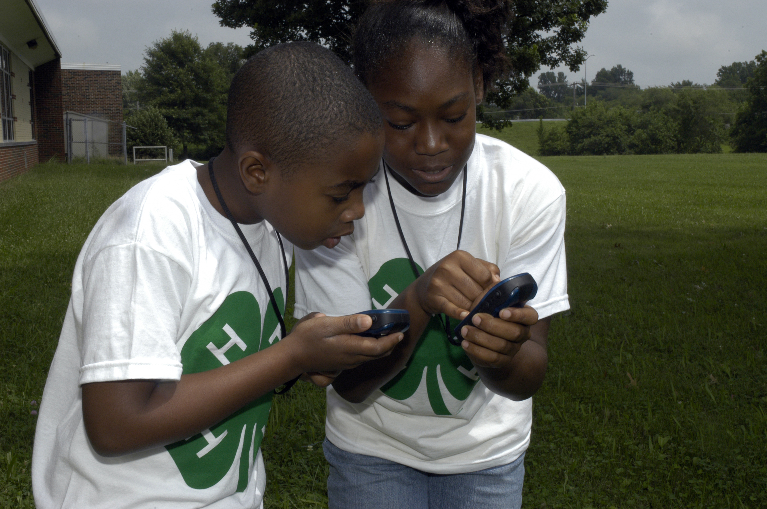
Session Three: Developing and Communicating Clearly Defined Roles for Volunteers

Slide 3
I need volunteers . . .
Imagine your phone rings and a familiar voice on the other end of the line says, “I need your help.”
Notes:
As a volunteer specialist, I often get calls from our field staff that begin with, “I need volunteers.” So, those of you who know me might know that my response would be, “to do what?” I’m learning that sometimes we are told that we need more volunteers because our reporting depends upon our ability to show large numbers, but in reality, if we can’t talk very specifically about what we need volunteers to do, we don’t really need volunteers, do we? So let’s take this from a different perspective . . . . .

Slide 4
Poll Question
Notes:
Imagine your phone rings – cell phone, desk phone, any phone! – and a voice very pleasantly says, “I need your help.” Let’s take a quick poll to see if we might respond in the same way to this call . . . .
Process polling responses –
Let’s think about how to prepare to make such a call asking for help from potential volunteers.

Slide 5
Session Objectives
Overview (very briefly) ISOTURE Volunteer Management Model
Examine value of role descriptions in volunteer engagement
Describe components of role descriptions
Notes:
In our brief time together today, we’ll be taking a quick look at an overall model for volunteer management, focusing on the most relevant aspects of the model, we’ll examine the reasons that we place such value on developing and maintaining role descriptions for our volunteers, and we’ll talk a bit about the various components needed for our volunteer role descriptions. Let’s get started!

Slide 6
Volunteer Management Model
ISOTURE
Identification
Selection
Orientation
Training
Utilization
Recognition
Evaluation
Notes:
Perhaps the best place to begin is to share with you that volunteer management is one of the most time-consuming, difficult, amazing, wonderful, inspirational things that you will do in your work!
In Cooperative Extension, we have long recognized that volunteer engagement is best handled in a systematic way, and for many, many years, the ISOTURE model has been the model of choice. While there are many others, this one seems to best take into account the holistic nature of Extension realities for volunteer involvement. It is simply an acronym for the seven steps in the model.
We will be focusing upon the Identification component of the model for this first 90-minute segment of training. This is the component of the model that includes developing plans for volunteer engagement and recruiting appropriate individuals to fill those roles. More information about ISOTURE is available via accessing resources provided for the session, and I encourage you to take a look at the other components of the model to get a view of the holistic process.

Slide 7
Focusing on Identification
ID needs of the “community”
ID needs of the agency
Determine if there are “gaps”
Determine alignment
Develop role descriptions
Recruit
Notes:
Let’s take a closer look at the Identification phase of the model. This is where we begin by assessing the needs of the community or target population of our mission. In 4-H Youth Development work, we have known for over a hundred years (literally!) that young people need out of school opportunities to support learning and leadership development, and we know that volunteer engagement helps make this happen more efficiently and more effectively. In each of our communities, how this positive youth development happens may look different, but there is a reality that opportunities are needed for kids.
Then, we consider the needs of the agency. Once we understand the needs and wants in our communities, we look at our organization to assess our capacity to deliver the needed programming. Sometimes our task is to defer to someone else more suited to the need. Sometimes our role is to partner with others to bring about the needed change. Taking this internal look helps us to decide what the needs are for our agency in providing needed assistance.
And sometimes, we decide it’s within our mission to tackle this challenge with our connection to land grant resources and our subject matter experts. The next step then is to determine alignment and decide whether the work could or should be assigned to a volunteer. Again, in Extension we have more than a hundred years’ experience at involving volunteers in program design and delivery. This step in the process means looking at the specific tasks, considering internal policies and legal limitations, and determining whether the work is appropriate for unpaid staff members.
The next step of the Identification phase of the model is really where we’ll focus our time during this session. Developing role descriptions is a critical aspect of volunteer engagement, and only when we have role descriptions should we ever consider recruiting volunteers. Remember our poll? For most of us, we are willing to help, so long as we understand what it is we are being asked to do, and why would we expect our potential volunteers to be so very different from us?
So let’s take a look at the realities of role description development.

Slide 8
Recruiting before designing jobs is rather like trying to dance before the music begins. The possibility of ending up out of step is very good indeed.
Marlene Wilson
Notes:
I think Marlene Wilson said it best. She was one of the groundbreakers in the profession of volunteer administration who understood the intricacies of managing volunteers daily. Her analogy to dancing before the music begins really paints a picture for us of what it looks like for us to put out a call for help prior to developing role descriptions. Certainly something to make us think, right?

Slide 9
Why Bother with Role Descriptions
Reducing Turnover
Boosts morale
Ensures right fit
Valuing Volunteers
Clarifies roles
Prevents misuse
Improving Organizational Management
Expectations clearly outlined
Manages risk

Slide 10
Components
Title
Purpose/Objectives
Major Responsibilities
Qualifications
Supervision
Time Commitment
Location of work site
Benefits
Signatures
Notes:
Let’s begin with the idea that there are several components included in most role descriptions, and that these components are basically the same whether for paid or unpaid positions. We begin with a title for any role we’re developing --- or if you’re like me, you may design the assignment and come back to assigning the title -- like those of us who write the paper then prepare the abstract rather than vice versa. Regardless, titles matter! So spend the time needed to create titles that are truly indicative of the work the volunteer will be doing. Let’s practice with creating a descriptive title for a volunteer role (POLL)
Creating a purpose or objective statement helps the potential volunteer understand the desired outcomes for the work he or she will be conducting.
Accurately defining the major responsibilities is critical. This helps the volunteer understand exactly what they’re signing on for, and becomes the basis for evaluations and recognition later in the process. This is also one of your best risk management tools! By defining the scope of responsibility, you are protecting your volunteer, your agency, and yourself!
Defining qualifications can help to convey desired entry skills and knowledge. This helps the volunteer ensure fit with the agency’s needs and her interests. It will be important to utilize many of the same human resource rules that apply to defining qualifications for paid positions. While in most states, volunteers are not included in due process standards, it is important that there is not even a perception of bias or discrimination, and properly defining qualifications helps to alleviate those types of concerns as we search for those people with the specific skills needed for these positions.
Supervision and location of work site simply confirm for both the volunteer and the agency that everyone understands from whom the volunteer will take direction and where their work will be performed.
Time commitment gives the volunteer some idea of exactly how much time will be committed to the work, and for project specific assignments, this serves as a notice of the length of the project.
Finally, including a benefits section creates an opportunity to share information about what the volunteer receive, and about what the agency receives because of the volunteer engagement.
One additional critical component of the role description is the inclusion of signatures of both the volunteer and the “hiring” or supervising staff member.

Slide 11
What would you call it??
Notes:
Can this be inserted into the previous slide to illustrate “Title”? If not, I can incorporate it into discussion and skip this.

Slide 12
Thinking About Benefits
Notes:
I’m finding as I work with our Extension staff members, that sometimes stating the benefits for volunteers is really difficult. We have to remember that everyone comes to us with their own needs and motivations, so we want to be sure that we help them see how they might meet their needs by coming to serve with us. And while we know that for 4-H volunteers, one of the most satisfying aspects of the work will be seeing a young person become excited about learning or seeing kids succeed as leaders, we also need to be aware that for some of our volunteers there are other motivators that might be more tangible. So let’s do some brainstorming quickly to think about some of the benefits we might include on a role description that might encourage volunteers to sign up to work with us. We’ll make this data available for you and your colleagues to use in designing role descriptions in the future, so let’s get busy for a few minutes to see how many benefits we can generate!!

Slide 13
Do’s
Be specific
Use accurate adjectives
Focus on the job, not the incumbent
Allow for flexibility
Keep role descriptions current
Be honest from the start – “easy” may not be as attractive as “challenging”
Notes:
When drafting role descriptions, it’s important to keep a few key concepts in mind. First, be as specific as possible. It’s better to be very clear in spelling out responsibilities, but it’s also important not to begin describing the process of doing the work. For example, perform routine maintenance on office machines is specific, whereas “pick up the tool, select the proper size fitting” becomes process description.
Use accurate adjectives to describe the work and the environment. Volunteers will need to know that it will be a noisy office, fast-paced workload, or cramped working quarters. But sharing long, flowery descriptions like quaint office space, or cozy environment wouldn’t be appropriate.
As you write the role description, it’s important to focus on the job not the incumbent. It’s important not to think about the person who has had the position or who is being recruited for the position, but think about the actual work that needs to be performed.
Creating flexibility in role descriptions. List specific responsibilities, but allow leeway for some “additional responsibilities as assigned” to give the supervisor room to adapt the workload for the volunteer as necessary.
Update role descriptions as needed to be sure that they remain current. Perhaps having the volunteer and supervisor review the role description as part of the annual evaluation process will help ensure that role descriptions remain current with organization or situational changes.
Finally, be honest about the work and the amount of time it will involve. Remember that sometimes easy isn’t as interesting or attractive as something that is challenging.

Slide 14
Don’t’s
Use subjective terms, opinions or recommendations
Use words that may imply discrimination
Use vague wording or jargon
Use derogatory language
Describe duties to be performed in the future
Notes:
Let’s also think for a few minutes about some things we don’t want to do in designing role descriptions. Rather than using subjective language, it’s important to use language that isn’t open to interpretation. Instead of saying something such as “this job is the hardest job on the planet,” simply stating the specific tasks or assignments for the position help the volunteer choose the assignment.
Don’t use words that imply discrimination, like youthful or able-bodied.
Don’t use vague or general wording or jargon. Be specific. If the role description says “helps take care of other volunteers,” does that mean training others, preparing welcome gifts, or calling to offer assistance. Perhaps what it really means is chairs the volunteer benevolence committee.
Finally, only include the duties that are to be performed as soon as the volunteer is on board. Don’t anticipate changes in the future and include new or different assignments based on possible future activities or programming changes.

Slide 15
I can’t please everyone. That’s not in my J.D., you know, not in my job description.
Maria Sharapova

Slide 16
Special Thanks to:

Slide 17
4-H is the youth development program of our nation’s Cooperative Extension System.

