Slide 1
Volunteer Engagement & Activation Resources
Volunteer Pilot Project :
Models for Corporate, Workplace, Teen, and Episodic Volunteerism in 4-H

Slide 2
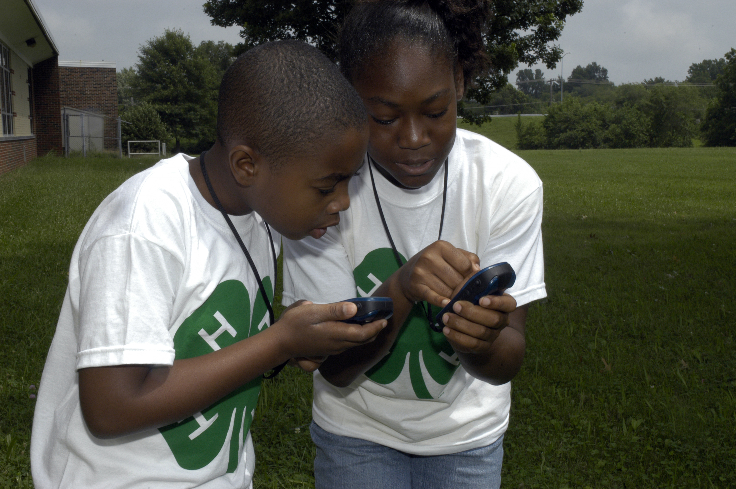
Session 6 – Episodic Volunteers Special Interest Clubs

Slide 4
4-H SPIN Club Volunteers
Episodic Volunteers
Engage youth in high-quality, positive youth development experiences
Help youth develop life skills or mastery of a subject
Organize and lead 4-H SPIN Clubs

Slide 5
Meet for a minimum of 6 sessions
Have a defined timeline
Engage youth in experiential exploration of a topic of interest
Allows youth to investigate topics typically not offered by 4-H projects
Engage episodic volunteers with expertise

Slide 6
Target new and/or underserved audiences, not typically part of 4-H clubs
Provides youth and volunteers an easy entry into the 4-H program
Appeals to special interests of youth & adults
Meet for a limited time
Participants are full 4-H club members and can participate in other 4-H events/activities/clubs

Slide 7
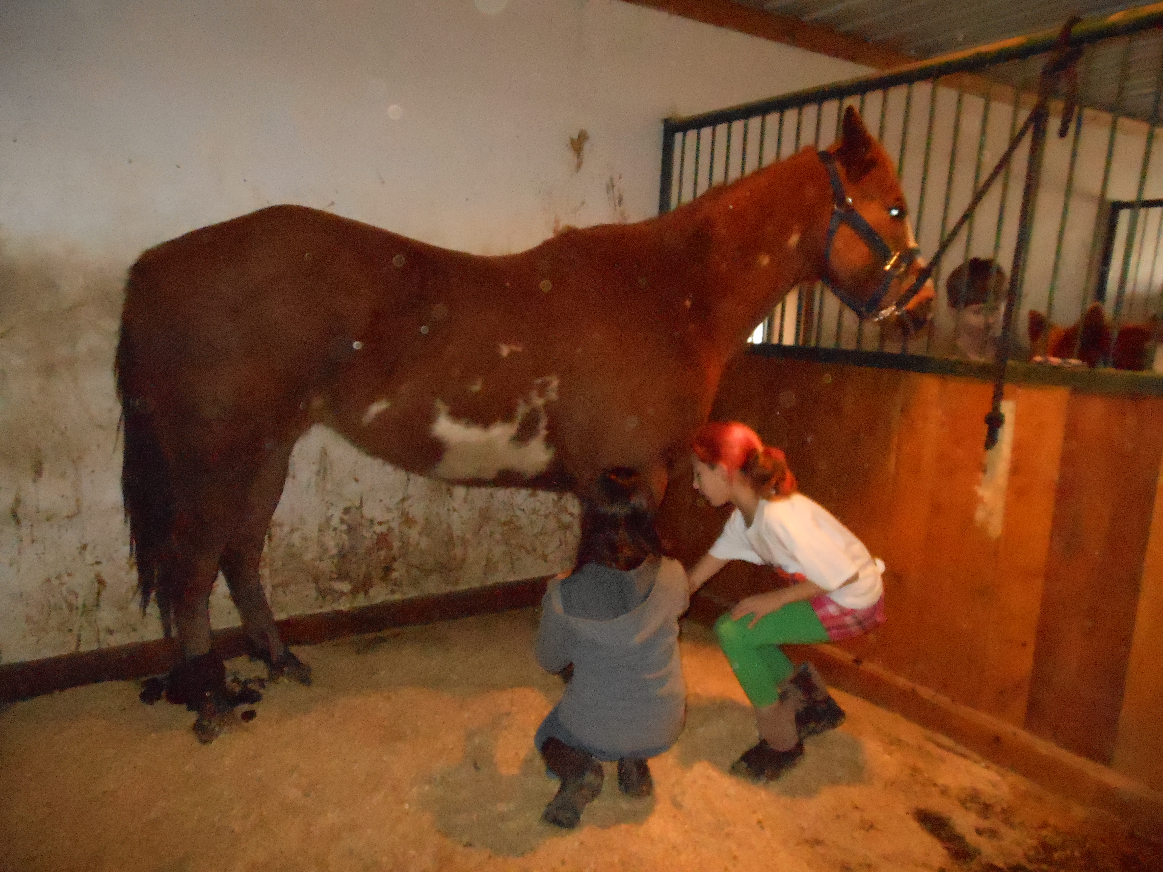

Slide 9
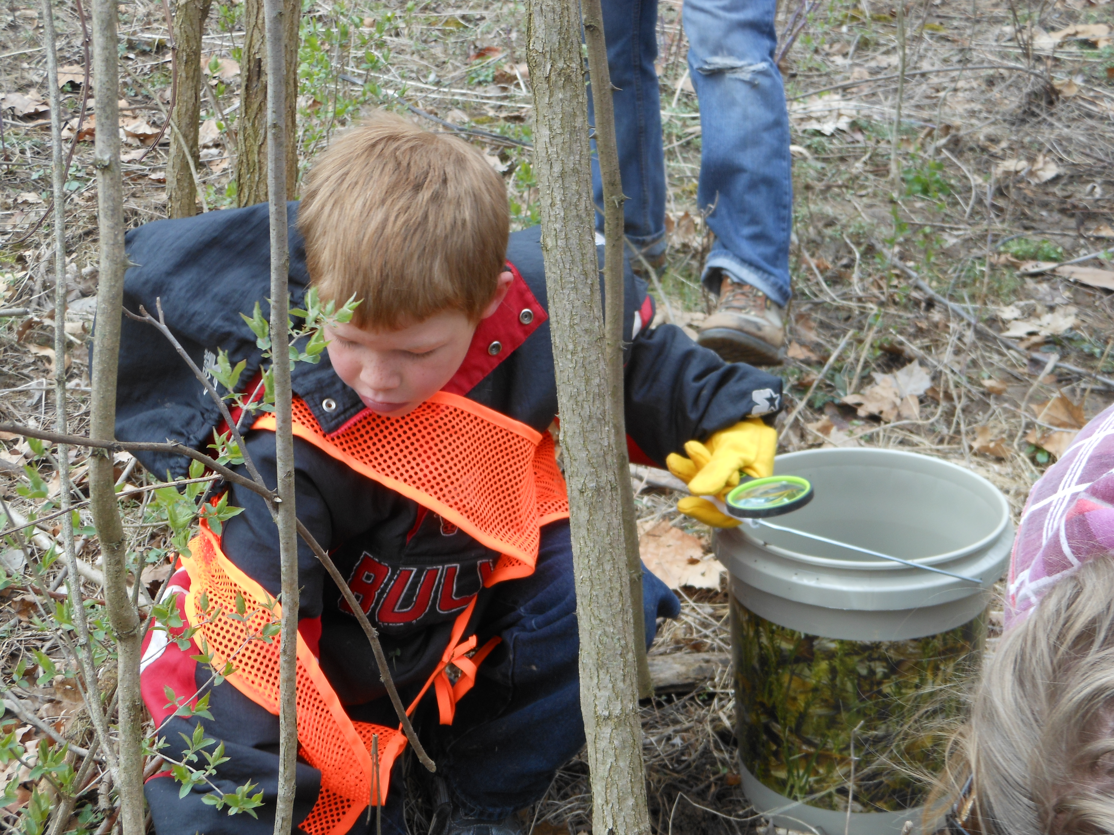

Slide 10
Recruiting Episodic Volunteers
Who is an episodic volunteer?
Volunteer with a commitment to a minimum of 6 sessions with youth
Key findings from the study
Life skill development is crucial for young people
Target key messages to the “right” volunteers
Focus on how and why we do what we do
Identify new volunteer populations

Slide 11
Key Marketing Messages
VEAR key messages incorporated into marketing and volunteer development resources
Pass on skills that you have learned
You can help young people in your community
Share your passion
Be a mentor

Slide 12
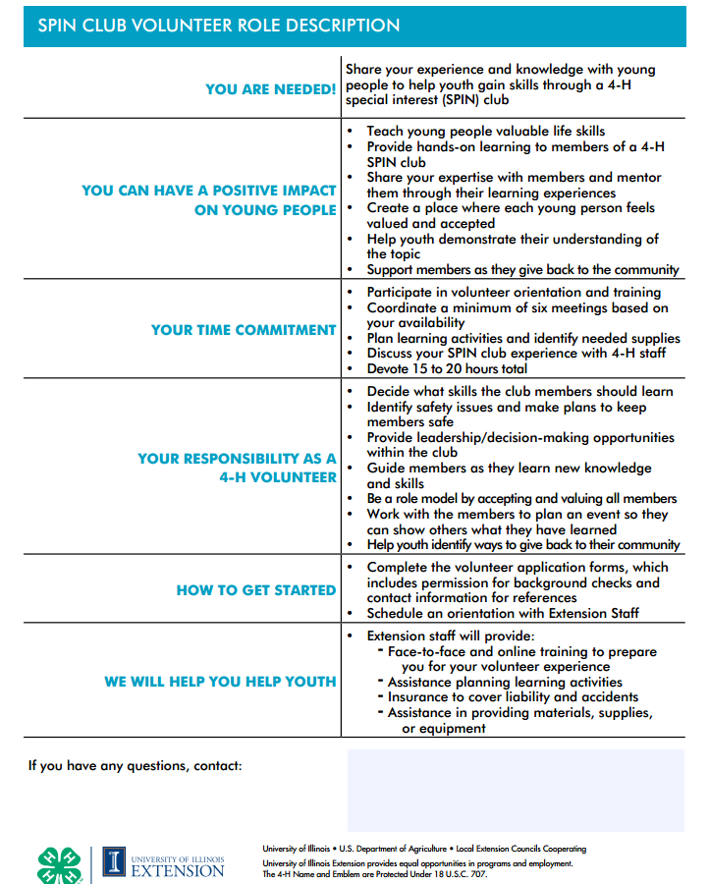

Slide 13
Poll Questions

Slide 14
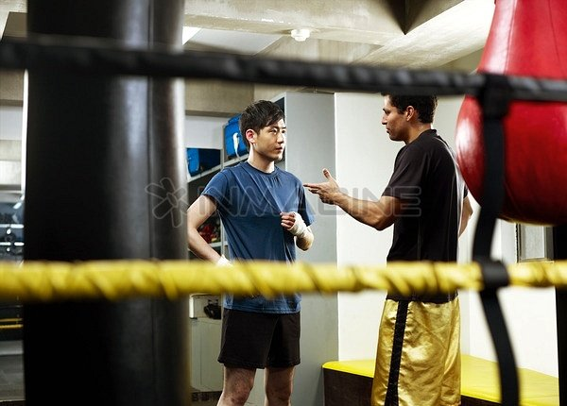
Volunteer Recruitment Best Practices
Word of Mouth is King! Promotion is NOT Recruitment

Slide 15
Volunteer Recruitment Best Practices
Recruitment = Relationship Building
One-on-One vs Corporate recruitment
Brainstorming Sessions: Expansion and Review Committee
Community Partners

Slide 16
Make the Ask
Focus on the appropriate key messages
Be the spark that inspires the next generation
You are needed
Make an impact on the next generation
Set convenient starting and ending dates and times
Agree on a specific topic
Outline their role and responsibilities
Offer training and support

Slide 17
Staff Can Be the Biggest Obstacle
Some are naturally resistant to change
Fear that 4-H is being “watered down”
Operating on old assumptions: “We can’t get people to volunteer in our county.”
Limiting contacts to people you already know

Slide 18
Episodic Volunteer Development
Make training available at their convenience
YouTube videos
Flexible times to meet
“Need to Know” format – they don’t have to learn everything about 4-H
Use technology, such as Facetime and YouTube
All volunteers must complete screening

Slide 19
Enrollment Increases
 | 2009-10 Year 1 | 2010-11 Year 2 | 2011-12 Year 3 | 2012-13 Year 4 | % Increase Yr 1 – Yr 4
Number of SPIN Clubs | 68 | 129 | 213 | 348 | 412%
SPIN Club Members | 851 | 1020 | 2352 | 4658 | 447%
SPIN Club Volunteers | 125 | 193 | 509 | 944 | 655%

Slide 20
4-H SPIN Volunteer Resources

Slide 23
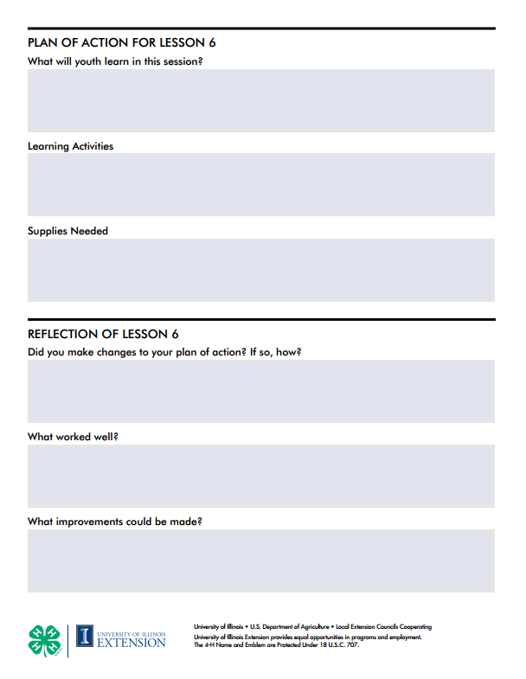

Slide 25
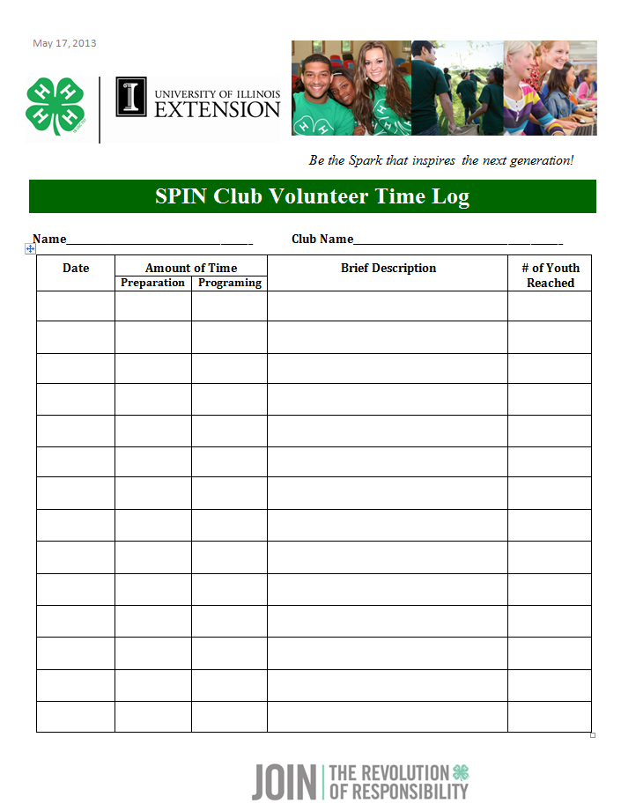

Slide 26
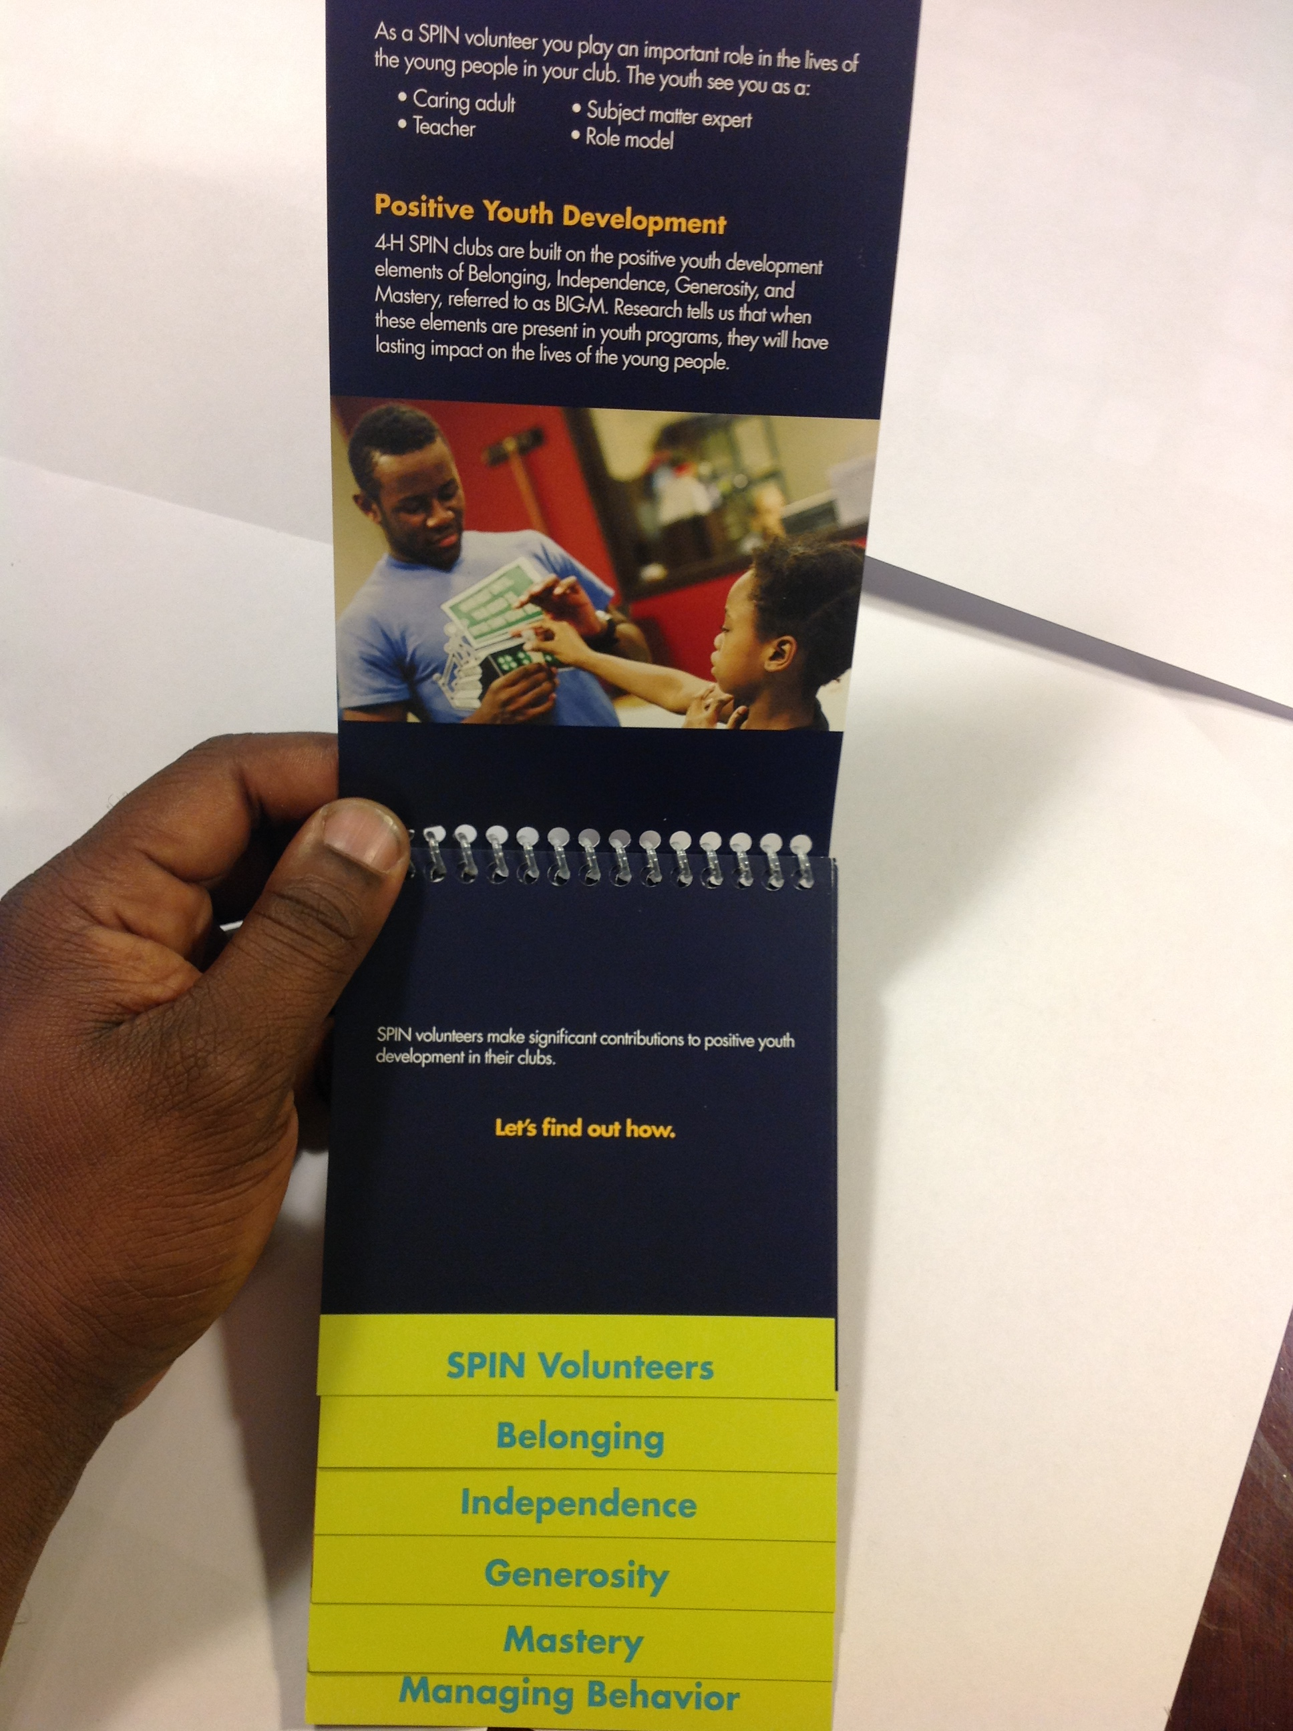
Resources
Positive Youth
Development
Flip-book

Slide 27
SPIN Volunteer Training Videos
Intro to PYD
Belonging
Independence
Generosity
Mastery
Risk Management and Risk Mg’ t Tools
Ages and Stages
Search or
click here for the Illinois YouTube Channel

Slide 28
Questions?

Slide 29
Special Thanks to:

Slide 30
4-H is the youth development program of our nation’s Cooperative Extension System.

