Slide 1
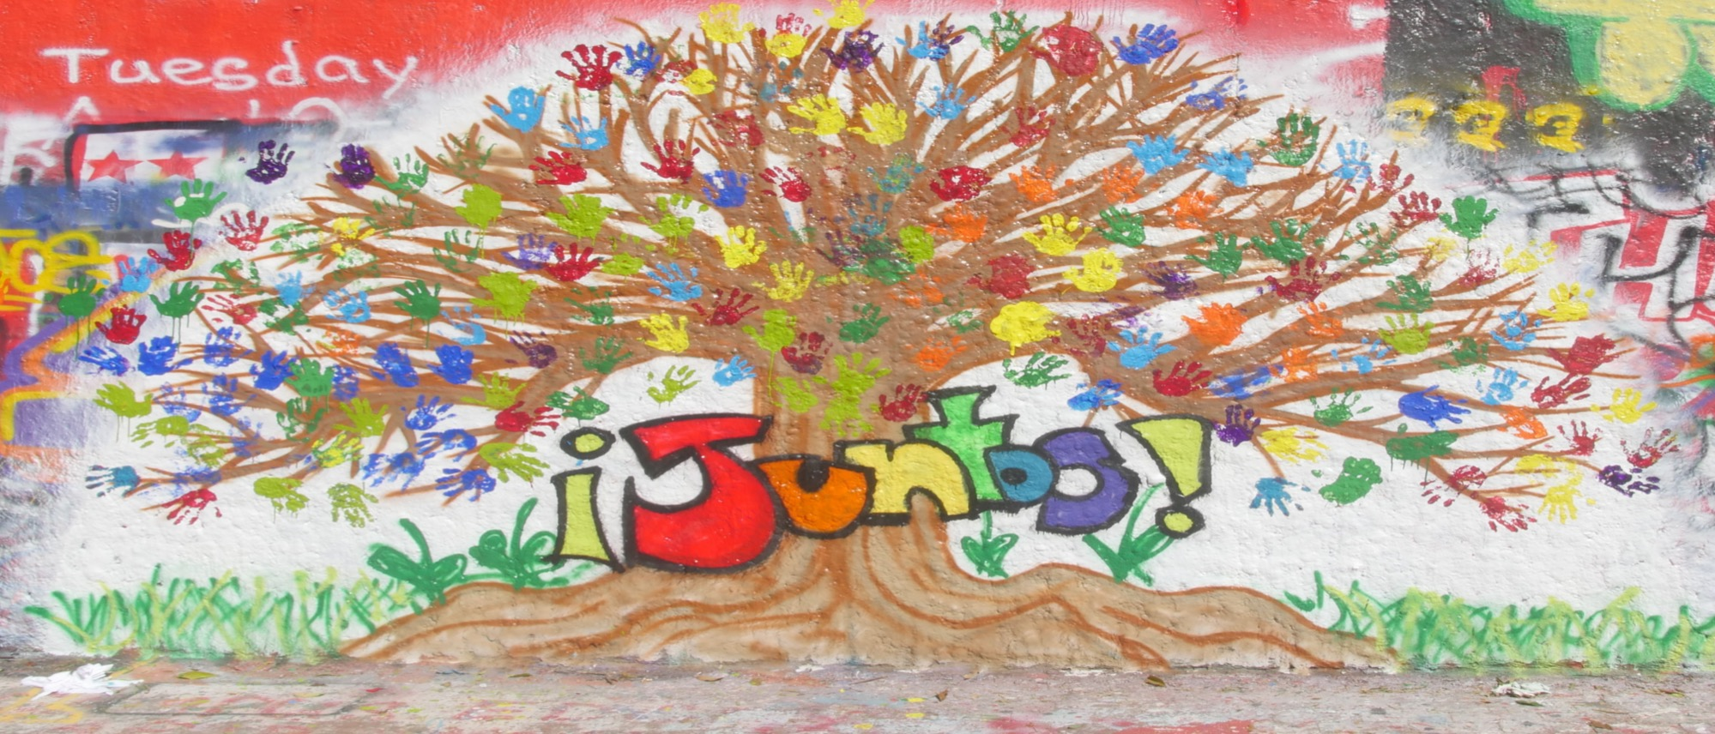
Juntos 4-H Summer Academy
Notes:
WHAT TO SAY:
We are pleased to introduce to you the final Juntos 4-H module. This module presents Summer Academy as the last component of the Juntos 4-H program. In this module, we will discuss Summer Academy in detail.

Slide 2
Recap From Past Modules
Notes:
WHAT TO SAY:
Before diving into Juntos 4-H Summer Pramming, let’s review what we have learned from past Juntos 4-H modules by answering some questions.
Ready!

Slide 3
What are the four components of Juntos 4-H?
Notes:
WHAT TO SAY: First question: What are the four Components of Juntos 4-H?

Slide 4
Four Components of Juntos 4-H
Family Engagement
4-H Clubs
One-on-One Success Coaching and Mentoring
Summer Programing
Notes:
WHAT TO SAY:
The four components are:
1. Family Engagement. You’ll remember this includes a 5-week Middle School Family Engagement Workshop Curriculum, a 6-week High School Curriculum, and Family Nights following the workshops.
2. 4-H Clubs. In clubs, youth meet after school twice a month and connect 4-H curricula and activities to their academic success.
3. Success Coaching and Mentoring. This one-on-one structure provides youth with yet another important resource to support their academic success.
4. Summer Programing. This gives youth a taste of the college experience. You will learn more about Summer Academy in the following slides.
All four components have been created using research-based best practices and are driven by the needs of families. Let’s go to the next review question.

Slide 5
Under the 4-H and NC State University partnership, what are the two components that must be implemented in order to be considered a Juntos 4-H program?
Notes:
WHAT TO SAY:
Next question. Under the 4-H and NC State University partnership, what are the two components that must be implemented in order to be considered a Juntos 4-H program?

Slide 6
Under the NC State University partnership and 4-H partnership, what are the two components that must be implemented in order to be considered a Juntos 4-H program?
Juntos Family Engagement
Juntos 4-H Clubs
Notes:
WHAT TO SAY:
Next question. Under the 4-H and NC State University partnership, the two components that must be implemented in order to be considered a Juntos 4-H program are Family Engagement and 4-H Clubs

Slide 7
What are three key factors for implementing Success Coaching?
Notes:
WHAT TO SAY:
Last question. What are three key factors for implementing Success Coaching?

Slide 8
Key factors on implementing Success Coaching?
Partnership with school
Individualized support for each student
Its main goal is to support students’ academic goals
Sessions take place at the school
Success Coaching focuses on task, performance, and giving feedback on observed performance
Notes:
WHAT TO SAY:
The key factors for implementing Success Coaching are:
A strong relationship with school staff
One-on-one structure meetings focused on individualized support for each student’s academic success.
An adult role model who offers support, advice, guidance, reinforcement, and constructive coaching aimed at achieving a youth’s goals, with emphasis on graduation and college access.
Meetings mostly happen during school hours
Focusing on specific tasks (for example goal-setting), academic performance, and giving feedback on observed performance.
Great job! Thank you for participating in our recap of the Juntos 4-H Modules.

Slide 9
Module 5: Juntos 4-H Summer Academy
Notes:
WHAT TO SAY:
This module will focus on the Juntos Summer Academy which provides Juntos 4-Her with a college experience and completes the program year. The module will also cover the importance of engaging these 4-Her in other 4-H summer programing.

Slide 10
Module 5: Agenda
Cultural Considerations
Planning and Costs for Juntos Summer Academy
Implementing Juntos Summer Academy
Research Considerations for Juntos Summer Academy
Notes:
Module 5 will cover four areas that give a picture of how to implement Summer Academy:
Cultural considerations that may affect families’ opinions of Academy.
The required planning and costs.
The implementation phase of Academy.
Research findings regarding the effects of summer programs on youth.

Slide 11
Juntos 4-H Summer Academy
Goal: To give Juntos 4-H youth a college experience
Length: Two to five days
Partnership: University (Higher Education) partners and planning committee
Summer Academy is how Juntos 4-H concludes the school year (August –July)
Notes:
WHAT TO SAY:
There are four important facts to know about the Juntos 4-H Summer Academy:
1. The goal of Academy is to provide an opportunity for youth in the program to experience college life. Academy equips students with the knowledge and tools that encourage them to be more committed to the pursuit of high school graduation and higher education.
2. Academy can be as short as a one overnight stay on campus and two-day programing experience; or as long as a week-long stay on a university campus. The length of time will depend on the funds available as well as the partnerships with the land-grant university or other local universities, although it is preferred that students are able to stay on campus for the full dorm experience. In communities where resources affect the planning for an overnight stay, sites have planned for day-long campus visits and workshops that last for two to five consecutive days in the summer.
3. The success of academy is achieved through strong partnerships with faculty and/or staff member(s) who are connected to the university hosting the event.
4. The Juntos 4-H Summer Academy completes the program each year. It’s the component that takes months to plan and a planning committee is vital for its success. The committee can consists of university staff, community partners, youth leaders in the program and college students.
We will discuss these important facts about Summer Academy in more detail throughout this module.

Slide 12
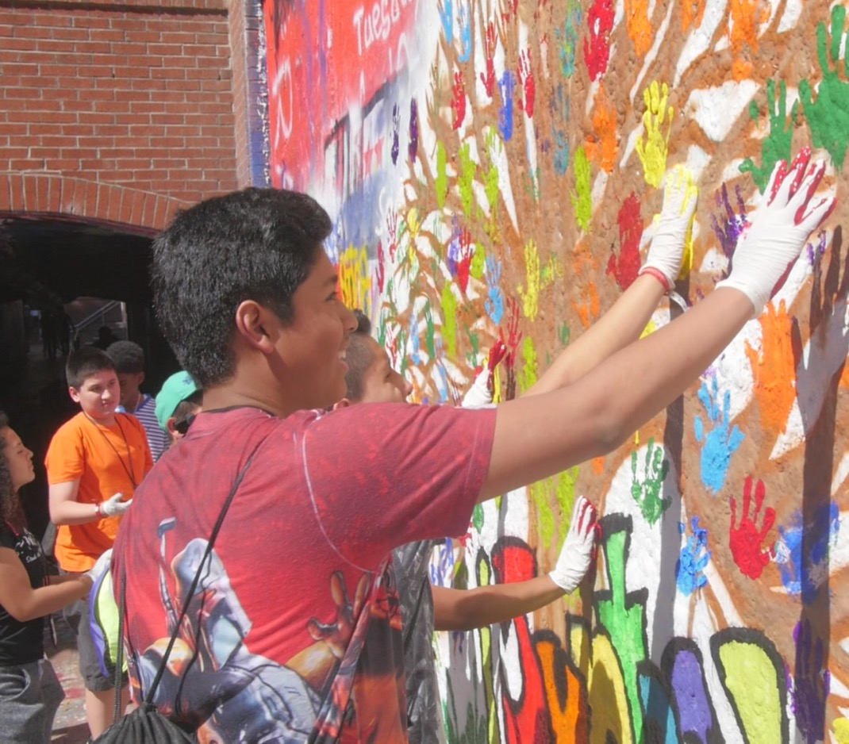
Activity
Why Academy?
Notes:
WHAT TO SAY:
Let’s try an activity to get us thinking about why Summer Academy is a vital component for the youth and families being served by the Juntos 4-H Program.
Ask the participants to pair up and grab a index card (which you will provide).
Tell the participants they have 2 minutes to come up with ideas about why they think Summer Academy is one of the four components of the program.
Rules: Each group will select the person who will present their ideas to the larger group and place their sticky notes on the flip chart sheet or designated location.
End by allowing each group to present their list and say: “This is a great list.” We will end this module by comparing this list to what researchers, program youth, and the developers have said about why Summer Academy is so effective.

Slide 13
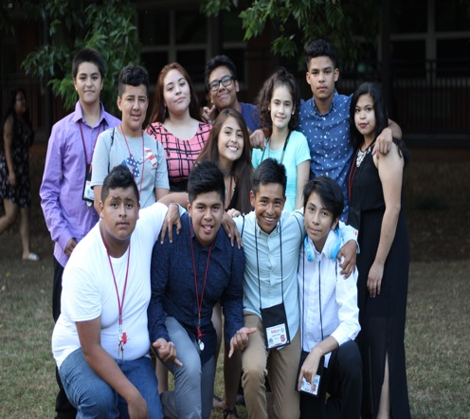
Juntos 4-H
Summer Academy
Cultural Considerations
Notes:
WHAT TO SAY:
The cultural considerations discussed in this module are based on what many families from Latin American countries (North, Central, and South America) may think when program leaders present the opportunity for youth to attend Summer Academy. Some of the examples you will hear come directly from what families in the program have expressed.

Slide 14
Cultural Consideration #1
Summer camps are not a norm in most Latin American countries.
Notes:
WHAT TO SAY:
Summer camps are not a norm in most Latin American countries. It’s important for program staff to be mindful of the fact that summer camps can be a new and unfamiliar resources for many Latino families. This cultural consideration will require program staff to take time to discuss Summer Academy’s benefits, which will allow families to judge for themselves if Academy is something they would want their children to experience.
Do not assume parents will immediately buy into the idea that giving their child a taste of the college experience is necessary and/or beneficial. Parents may decide that staying the night on campus is not an experience their youth need to have. After program staff share Summer Academy’s activities, resources, and positive outcomes with families, it’s very important that families are asked what they think of this opportunity.
Example: IT is important to discuss summer academy during enrollment and registration as you introduce the components of the program. During the Family Night April or May, program leaders/staff can share all the details about the upcoming Summer Academy, particularly its purpose. Staff should give families an opportunity to ask questions and provide their thoughts about this higher education summer programming. If this is not your first time implementing Summer Academy, you can invite a youth and/or parent who has participated in the past to share their experience(s). Staff must take the time to address any concerns and questions parents may have about Academy.
A Real Case Scenario: The program leader followed the example above and an in-depth conversation took place where parents discussed their fears of letting their children attend Summer Academy. They also talked about why it was important to allow their youth to have this experience. The majority of the families agreed that it was an opportunity their youth needed to experience, however some families believed that their children were too young to attend on their own and decided to consider it for a future year when their children were more mature. The parents who wanted their children to attend requested that the coordinator (whom they trusted and knew) attend Summer Academy with their youth. The program already had a policy in place for local program leaders to attend Academy so parents felt at ease with their decision to allow their child to attend academy.

Slide 15
Cultural Consideration #2
In many Latin American countries, leaving home for college (and living in a dorm) is not the norm.
Notes:
WHAT TO SAY:
In many Latin American countries, the idea of going away for college is not the norm. Many students who attend college will live at home or move in with family members who live close to the college. Even if Latino families are 2nd or 3rd generation (US born), they may not have someone in or close to their family who has had a college experience away from home. If program leaders take the time to know the families throughout the program year, they will be able to address any questions or fears that families have about their children visiting and/or staying at a university campus during Summer Academy.
Example: Parents in the program may fear that letting their child experience Summer Academy may lead them to want to leave home after high school graduation. Program leaders may want to address fears such as these by connecting families with college students from the community who live at home, and/or a parent who has a college student who lives on campus, to talk about the benefits of both options. These guests can be invited to a Family Night at the end of the school year when staff present details about Summer Academy.
The key is to allow families to realize that opportunities like Juntos 4-H Summer Academy will expose their youth to different higher education options.

Slide 16
Cultural Consideration #3
Many Latino parents are not accustomed to allowing their children to spend the night outside of their home.
Notes:
WHAT TO SAY:
Immigrant families come from different cultural backgrounds, and they carry with them certain cultural norms to their new homes in the United States. Many Latino parents are not accustomed to allowing their children to spend a night outside of their home. Spending the night for many Latino families means staying over at grandparents’ homes or with close relatives. Thus, if Summer Academy will include an overnight stay, it’s important for program leaders to develop a relationship with parents throughout the school year and learn how to best engage them in a conversation about Summer Academy. The relationships established with families will help staff have the right conversations as they introduce Academy.
When parents have experienced personal contact with program staff, they are more likely to disclose their concerns and fears about their youth attending Summer Academy.
Personal interactions and openness can empower individual families to make a decision about allowing their youth to attend Academy in a way that is not based on fear, but rather on how this unique opportunity can continue to reinforce their child’s academic success.
Example: For several parents in the program, letting their child attend Summer Academy is their first experience having their youth away from home. Mothers have reported tearful nights while their child attended Academy, but also expressing how grateful they were that their child had the Academy experience.

Slide 17
Cultural Consideration #4
Many Latino youth are expected to live at home until the day they get married.
Notes:
WHAT TO SAY:
Many Latino youth are expected to live at home until the day they get married. Although 2nd and 3rd generation families may have acculturated to social norms here in the U.S., they may still have relatives who don’t agree with these norms. It’s important to be sensitive to the beliefs and social experiences that Latino families value and maintain.
Example: There is a large immigrant Latino population in the state of North Carolina, and there are families in the program who have a very hard time with the concept of allowing their daughters or sons move away from home before marriage. This translates into ambivalence, fear, and/or reluctance when it comes to letting their children attend an overnight Summer Academy. Here is where trust in the program leaders plays a huge role; parents may allow their children to have the Summer Academy experience because of the confidence placed in the program and its staff. Remember, trust starts the moment you begin working with families, and it is trust that will lead to successfully gaining youth’s full participation in the program.
It’s important to point out that these cultural consideration does not define all Latino families; the level of acculturation is different from one family to the next. These considerations will also vary from community to community, some communities are made up of majority newer immigrants whereas others are second and third generation families.
Now, let’s discuss planning for Summer Academy.

Slide 18
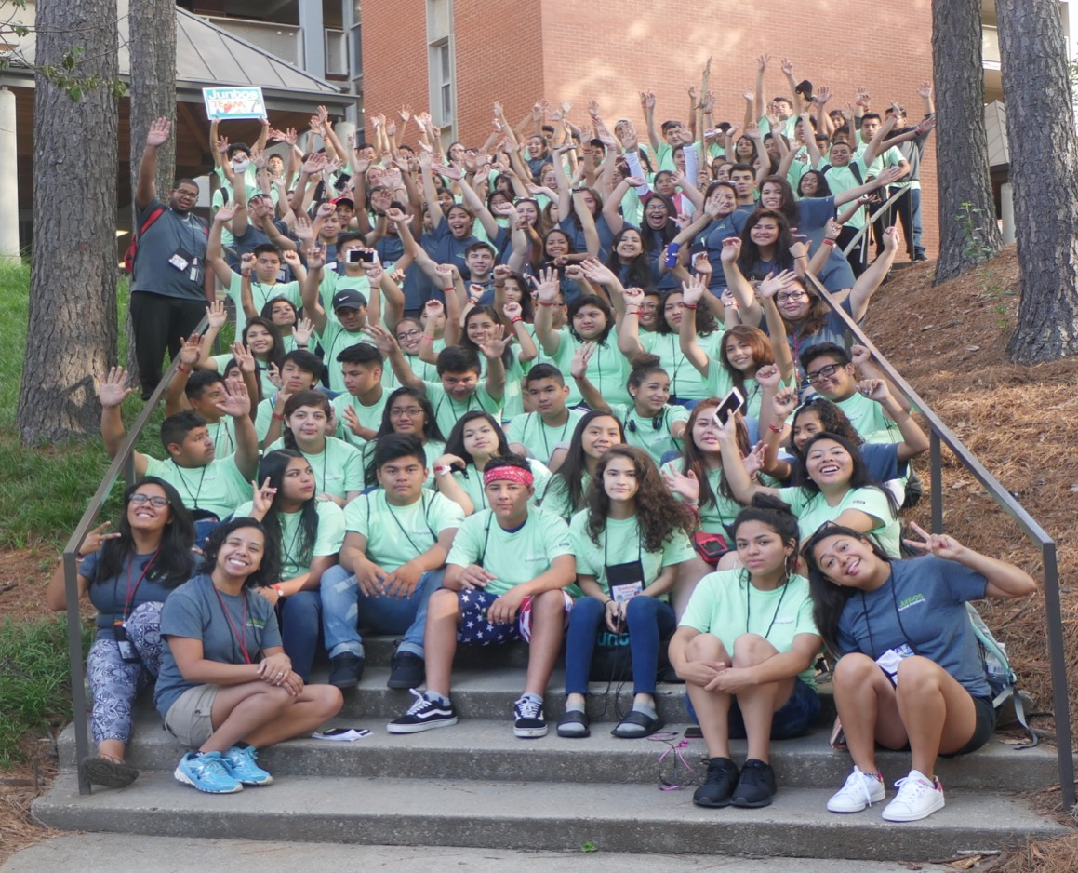
Planning for Juntos Academy
Notes:
WHAT TO SAY:
Let’s talk about a recommended timeline to support planning and executing a successful Summer Academy.

Slide 19
Ensuring Youth Participation in Academy
Fall (August-December)
Highlight Academy from the beginning
Clubs can create a selection process
Get to know the interest of the youth
Spring (Jan-July)
Meet and plan with local 4-H agent
Update and communicate with family
Be creative in introducing the event
Collect all registration documents
Notes:
WHAT TO SAY:
Here is an ideal to-do list to support youth participation in Summer Academy.
Fall: August – December
At the kick-off event, make sure to share with families the opportunity to attend Summer Academy if they participate in the program throughout the year.
Once clubs are up and running, share with the youth that all students may not be able to attend Academy. The club leader and/or club members can come up with a selection process for the youth.
Some examples of selection criteria that clubs have implemented include an application process with an essay and a record of good attendance at the club and Family Nights. It’s important to share this selection process with the youth and parents. Keep in mind that a selection process may not be needed until programs are established and the positive Academy experience is shared by youth and families who want to return the following year.
During a November or December club meeting, take the time to ask the youth what kind of careers they would like to learn more about, as well as what they would like to see when visiting or staying on a college campus. If time is an issue, these two points can be covered during a January or February club or Family Night meeting.
Spring: January – July
1. In early spring, meet with your local 4-H agent to discuss the local, district, and state summer opportunities for Juntos 4-H youth, as well as the best way to get this information to the families.
2. By April, share the Summer Academy dates during Family Nights, as well as any other summer opportunities that are available through local and state 4-H. Take time to talk about Academy and answer any questions the families may have. You may need to talk to some parents one-on-one if they are hesitant about summer opportunities for their youth.
3. During a Family Night and/or club event, share a preview of what is planned for your Summer Academy. Invite a college student from the host university to come and share a little about their experience at the university. The goal is to get families excited about the experience of an Academy.
4. Once all registration forms are collected, schedule a meeting with all participating youth and their families to:
discuss what to pack (for overnights), expectations, and rules and regulations; and
update any necessary registration, medical, or legal forms.

Slide 20
Planning for Summer Academy
Fall (August-December)
Identify host campus & potential presenters
Identify Planning committee members & community partners
Identify transportation needed
Spring Jan- May
Confirm location and date
Meet with planning committee
Meet with community partners
Plan Academy schedule
Select youth and team captains
Notes:
WHAT TO SAY:
Let’s spend some time looking at the logistical process of planning for Summer Academy.
In the fall, the focus will be on:
1. Identifying the host campus as early as possible in order to secure Academy dates and reserve the space needed, such as meeting rooms and dinning arrangements;
2. Identifying individuals who can help in the planning and implementing stages, and who can join the planning committee that will be formed and meet in the spring.
3. Identifying if transportation will be needed and if so, where it will come from. Will transportation be provided by the schools, the university, or the local Extension office, and what will the cost be? It’s important that once transportation is identified, reservations are made.
In the spring, the focus should shift to:
1. Confirming the local or land-grant university that will host Summer Academy, and finalizing the dates. Securing the host campus will guide the partnerships needed to ensure success;
2. Meeting and planning with the identified committee members. Identify your planning committee and plan for Academy. Examples of committee members include professors, college students, community partners, and program leaders;
3. Identifying and meeting with individual partners during the beginning of spring, who will support the implementation of Academy. This may include professors or professionals who want to lead classes, university housing, college student leaders, etc.;
4. Setting the Academy schedule, including classes, fun activities and projects, college student and professional panels, tour and university experiences, etc.;
5. Selecting the youth who will attend and team captains (college students, volunteers) who will support the youth during Academy.

Slide 21
Planning for Summer Academy
Summer time (June-August)
Academy happens in June or July
Communication before Academy
Debriefing meeting
Share the Academy experience with current and new parents
Notes:
WHAT TO SAY:
Summer Academy can take place in June or July; dates are subject to host campus availability. Dates can be set as early as August when programing starts.
Youth participation, as discussed earlier, will depend greatly on good communication with parents who trust the program and its leaders.
After Academy, it’s important to hold a debriefing meeting with everyone who supported the planning process to discuss what worked and what can be improved. It’s important that all who supported have closure. This debriefing can take place during a meal or meeting so that you can also take time to thank everyone for their support.
Plan how the returning youth can share their Academy experiences with their families and the next cohort. Some programs make time during their first Family Night of the following school year to have two or three youth share their experiences. Program leaders need to make sure to guide the youth as they prepare to present. Another example of what programs have done is to have a parent and youth present the Academy experience during a Family Night with a new cohort of families. This helps families hear the perspectives of both a parent and a youth.
Please Note: Program leaders may choose to partner with an existing summer experience only if the objectives of Juntos 4-H Academy are met. Some state extension programs may already have an existing 4-H college campus program that can easily include Juntos 4-H youth. Program leaders should discuss this decision with all individuals who have worked to bring the Juntos 4-H program to the state and local sites. Also, combining programs can take away from the experience Juntos 4-H youth have as a group, thus leadership will need to work at planning ways for the Juntos 4-H youth to still be able to have their identity as a group and culture.

Slide 22
Goals for first year Academy
Building relationships with host campus
Start with a small number of students
Identify the the best dates for Academy
Notes:
WHAT TO SAY:
The first year of Summer Academy implementation should focus on building relationships with the host campus. This includes learning what types of programming the host campus already has in place for first-generation, immigrant, and/or minority students.
1. Find the on-campus Latino student community, which can become an asset to your planning. Members of this community can provide support by volunteering their time as college counselors known as “team Captains” during Academy (or they may also be given a small stipend). If you are partnering with an existing program that meets the objectives of Academy, take the time to get to know the leadership staff and make sure they understand the Juntos 4-H program and the families it serves.
2. It is highly recommended that programs implementing Academy for the first-time plan for a small number of participants (~15-40 youth). This will allow program leaders to learn from the first year of implementation, while giving the host campus a vision of growth.
3. Make sure to communicate with state and local 4-H leaders regarding Academy dates to avoid overlapping with other 4-H summer activities that Juntos 4-H youth may want to participate in.

Slide 23
Goals after the first year
Establish a strong partners list to support following years
Identify the person(s) managing Academy
Grow partnership with Latino college student population
Gain campus support around the sustainability of Academy?
Grow your attendance numbers
Notes:
WHAT TO SAY:
The first year of implementing Summer Academy is really a learning year for all involved. It’s crucial that the debriefing meeting with all the partners and host campus leads to planning a better Academy in future years. This includes having a conversation on next steps to start planning for the following year.
1. After first year of implementing you will gain and know your strong partners and be able to assess who is missing from your list. It’s important that you take time to follow-up and thank all your partners. For example: sending them a thank you card with a group picture of all who attended academy.
2. It’s important that program leaders identify the person or people who will lead the Summer Academy’s planning. This individual(s) will work on building partnerships, creating the schedule, and ensuring that schools, parents, and youth are getting all the necessary information about participation in Academy. The planning for Summer Academy can be a collaborative effort (so not one person has to shoulder EVERY responsibility); if a lead person is identified, they should delegate specific tasks to others who can support them.
3. In North Carolina, Summer Academy has seen success in partnering with the Latino college student population of the host campus and other campuses in the state. It is evident that Latino college students want to give back to the younger generations by sharing their college experiences. Program leaders have found that having Latino college students as Academy counselors is an effective way for Juntos 4-H youth to see themselves reflected in the people who are mentoring and guiding them during their time at Academy.
4. Program leaders should finalize a list of resources and have conversations with the host campus about how the university can continue to provide support.
5. With grant funds and support from host campuses, Summer Academy has the potential to grow in size. The size of Academy is really up to program leaders, available funding, and existing or future partnerships.

Slide 24
Local 4-H Summer Programming
A Summer program schedule provides:
Opportunities for youth and their parents to learn more about 4-H,
Connections among Juntos 4-H youth, and
A chance to build a community and watch youth grow from experiences.
Notes:
WHAT TO SAY:
Before continuing with the cost of Academy, it’s important to point out that with strong commitments from local 4-H agents, Juntos 4-H youth can also be connected to local 4-H summer schedules in their counties and participate in day/overnight camp events. Not all Juntos 4-H youth will be able to experience Academy so ensure they know about all their summer in 4-H opportunities.
Making the effort to share local 4-H summer programming with Juntos 4-H families will allow them to be even more integrated into 4-H. State 4-H can also be intentional about how they can provide opportunities for youth to participate in state summer programming.
Juntos 4-H youth who have experienced local and state 4-H summer opportunities have shown to take on leadership positions with in 4-H and become spokespeople for 4-H in their community. Youth share their experiences at Family Nights or club meetings, which gives parents and other youth concrete examples of all 4-H has to offer.

Slide 25
Juntos Means Together
Notes:
WHAT TO SAY:
Remember that the word Juntos does not mean one person doing all the work. In order to be successful in planning and implementing Summer Academy, it will take a team of individuals.
Summer Academy is not possible without:
Partnerships with the land-grant universities, including professors, staff, university housing, interns, and various departments that are committed to the goals of Juntos 4-H Summer Academy;
Gaining the trust of the families;
Community partners who value the purpose of Juntos 4-H Summer Academy. These partners include non-profit educational advocacy groups like the local Latino community center, Corporate partners with a vision to support youth’s educational success life New York Life Foundation, and state-run educational systems like the Community College system;
A strong Summer Academy planning committee made up of professionals, college students, Juntos 4-H youth, and program leaders, who guide the planning process and provide necessary resources;
Funders who believe in access to college is for all; and
Partnerships with state and local 4-H to enhance the summer experience for youth.

Slide 26
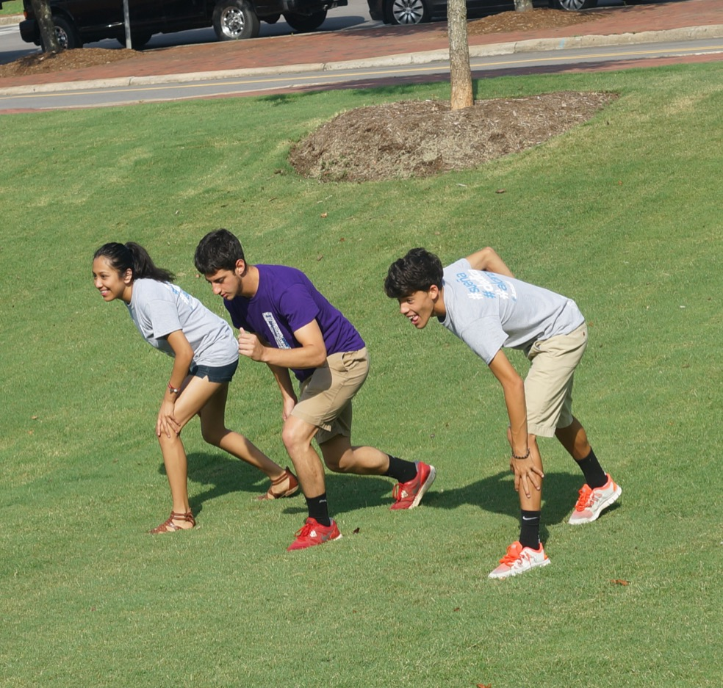
Cost for Juntos 4-H
Summer Academy
Notes:
WHAT TO SAY:
Implementing Summer Academy has costs to consider.

Slide 27
Without Additional Funds
Juntos team to lead planning committee
Volunteer college-age students to serve as camp counselors
University Housing and meal costs provided by university
Transportation support provided by schools, families, and/or cooperative extension
Supplies and snacks provided by local or state extension and/or community partners
Notes:
WHAT TO SAY:
Let’s first talk about how Academy can be run without additional funding:
First, the Juntos 4-H team would be made up of a group of individuals from the state and/or local level who have lead the efforts to implement the Juntos 4-H program. This group would bring together a Summer Academy Planning Committee to delegate additional duties.
Second, volunteer college students from local partnering college(s) would serve as camp counselors to the students throughout the Academy. We suggest a 1:6 ratio.
Third, university housing and meal costs could be provided by university funding, fundraisers, and/or supplemental funding from attending students.
Fourth, transportation to and from campus could be provided by schools, families, and/or Cooperative Extension staff using local vans and other forms of transportation.
Fifth, the costs for educational supplies and snacks for the Academy could be provided by local extension, the University and/or community partners.
Note to Trainer: Feel free to share an example of leadership in a University that has committed to support this type of programing for their community. Go to http://ure.uncg.edu/prod/cweekly/2017/02/28/uncg-selected-new-national-initiative-support-student-success/

Slide 28
With Additional Funds
Juntos Team assign someone to lead academy planning
Paid college students to serve as camp counselors
University housing and meal costs provided by grant funding and/or other additional sources
Transportation to/from campus provided by grant funding
Necessary supplies and snacks provided by grant funding
Notes:
WHAT TO SAY:
When funding is available, these items might be included:
First, the identified Juntos 4-H team would assign someone to lead the Academy Planning Committee. This individual will need to be added in the budget so that organizing Academy is not an added burden on the program coordinator. The assigned individual will manage the logistics of academy.
Second, a budget could be included to hire or provide a stipend to college students to serve as camp counselors for the youth during Academy.
Third, university housing and meal costs can be provided by grant funding, by the university hosting, and/or other additional sources.
Fourth, costs for transportation to and from campus can be provided by grant funding.
Fifth, grant funding can pay for necessary educational supplies and snacks.
Keep in mind that payment for hired individuals often depends on their credentials, skills, and responsibilities. If a new site decides to implement all components of this program, it is advisable to create a Juntos 4-H Coordinator position that can manage and support all the components. Summer Academy and/or summer programming is one component that the coordinator cannot do alone.

Slide 29
Sample budget of a 3-day on-campus stay implementation of Academy with grant funds
Note: Budget based per student served
Notes:
WHAT TO SAY:
Let’s look at the breakdown of costs from North Carolina, as an example, when funding is available. Keep in mind that this is a budget based on a per student cost.

Slide 30
Sample 3-day Budget
Salary or Supplemental Pay for Academy Leadership | Number of hours depends on size and length of Academy $3,000 average cost for all students
Hire or contract college student camp counselors | 1:6 college student: participant ratio $16/day per student
University Housing and Meal Costs | $34/night housing cost per student $10/meal cost per student
Transportation | $5/day per student
Supplies & Snacks | $13/day per student
TOTAL for 30 youth for 3 days | $9,179 or $306/youth
Notes:
WHAT TO SAY:
In North Carolina we have a full five-day Summer Academy Program for over 100 youth, which costs approximately $480 per student. As they start out, most programs will have a much smaller number of student participants and potentially a shorter program, such as this example with 30 youth and a three-day program agenda.
The salary for a bilingual Juntos 4-H Coordinator is written into the grant when implementing all four program components. The cost dedicated to the planning and execution of the Juntos 4-H Summer Academy is averaged at $3,000 for the amount of this person’s time that is dedicated to planning and organizing the Academy for the year prior to the event.
The cost includes paying for a pair of bilingual college students for every team of 12 students participating in the Academy. These students act as camp counselors for the youth, focusing on helping youth understand the possibilities for higher education. In the past, this has cost approximately $100/staff member per day, or around $16/student per day.
The largest cost of the Academy is the cost of housing and meals for the youth and staff. These costs will differ by college campus, but we average around $34/student per night for housing on campus and around $32/student per day for meals. For a three-day program, we would estimate a two-night stay per student and seven meals.
The transportation budget includes getting the youth to and from the campus, and the use of vans for field trips outside of campus. This can be made possible for approximately $5/student per day.
Supplies for educational activities and snacks needed between meals and in the evenings are approximately $13/student per day.
The total cost for a three-day, two-night Summer Academy for 30 youth would thus be approximately $9,179. This cost could be much less depending on the cost of the salary for the Academy Leadership.

Slide 31
Juntos 4-H
Summer Academy
Implementing Summer Academy
Notes:
WHAT TO SAY: Let’s now move on to how to implement the Summer Academy.

Slide 32
Academy Objectives
Increase youth’s aspirations and expectations to go to college
Increase youth’s preparation for career and higher education options
Notes:
WHAT TO SAY: Remember, the two objectives for Summer Academy are:
1. to give youth a college experience so that they can learn about the accessibility of going to college and choose to strive to achieve a college education; and
2. to provide youth access to the resources and experiences needed to guide their decision about their higher education options and future careers.

Slide 33
Identify a theme and goal(s) for each Academy
Notes:
WHAT TO SAY:
In order to achieve the objectives of Summer Academy, it’s important to identify a theme and goal(s) that will drive Academy. These will guide your partners as they focus on planning and implementing Academy.
An example of a past Summer Academy theme was DREAM-COMMIT-ACHIEVE.
The goals included:
1. The youth identifying and putting a value on their dreams for themselves, their families, and their communities.
2. The youth learning that commitment leads to achieving their dreams. This commitment includes determination, perseverance, and passion.
3. The youth committing to achieving their personal, academic and community goals to bring them closer to their dreams.

Slide 34
Academy Must Haves
Introduction to diverse majors and careers
College student panel
Tours with an academic and campus life focus
Admissions and paying for college
Exposure to and networking with college professors
College student volunteers
Notes:
WHAT TO SAY:
Below you can see the important topics that Summer Academy leaders should build into the experience:
It’s important to get youth excited about the college experience. Let them know they will be attending classes like any other college student; learning about different degrees, careers, college options and how to pay for them; meeting professors and Latino college students; and touring the campus.
Through conversations at Summer Academy, college students can give youth a glimpse of where they can be in a few years. Getting connected with both Latino and non-Latino college students allows youth to hear about the process of getting into college. Hearing it from Latino college students personalizes the possibility of making it to college. In North Carolina, college students are ‘Team Captains’. This means that a male and a female student together are assigned to interact with a group of 8 to 16 (depending on your Academy size) youth throughout the entire Summer Academy experience. Other college students are also invited to participate in panels, which may include students who are attending community colleges, private colleges and public colleges, and who are living at home or on campus. It’s important that different college journeys and experiences are shared with the youth.
Giving youth the opportunity to step foot on a university campus and see it first-hand gives them a real life experience of what college is like. The goal is for college to no longer be a foreign environment to them; it should become an environment and experience they can talk about. If students are not staying in the dorms, make sure they get to see the rooms. Touring all aspects of a college campus is key. Tours should also be interactive and fun. In North Carolina they have become a fun competitive activity, such as a scavenger hunt or modeling the Amazing Race.
It’s very effective when the program partners with professors who lead hands-on and interactive classes that get students excited about specific majors. An extra bonus is when the professor is Latino(a), as it provides students with a role model who represents their culture.

Slide 35
The College Experience
Extras
Project focus
Talent show
Dance
Keynote speakers
Night discussion topics
Latino professional panel
Teamwork & cultural identity
Exposure to health and wellness (physical and mental)
Notes:
WHAT TO SAY:
Some extra activities that have been effective in Summer Academies include:
Giving a project during evening hours for youth to share their Summer Academy experience with their community back home. For example, one group did a Science, Technology, Engineering, and Math (STEM) + Art (STEAM) focused project, where they developed a plan for how they would inform and provide resources to their community in the event of a natural disaster. The youth developed videos and toolkits to accomplish their tasks. Another project involved a sustainability mural made from soda plastic bottles;
Holding a talent show for youth to showcase their talents and have fun together. Provide freedom and safe spaces for students to integrate their cultures and language, for example the spoken word performed in Spanish, singing or dancing to popular Latino artists;
Holding a dance event at the end of Summer Academy for students and staff to have fun together. Again, allow students to select music that may represent their cultures and language, while still making sure it’s appropriate;
Building in time at the start and end of Academy to bring in a keynote speaker who identifies as a Latino(a) professional and has made great achievements in their community as an individual and/or professional. Alternatively, select a high-achieving Latino(a) college student who has not only been an example of a model student, but who has also used their time in college to give back to their community, or who has been recognized for his/her achievements in and out of the classroom;
Incorporate night discussion topics into the students’ schedule to give them an opportunity to debrief about the day and their experiences. This keeps them busy until they go to bed;
Organizing a Latino professional panel from various careers. This will allow students to learn about many career options
Introducing students to a variety of topics such as public speaking, teamwork and cultural identity, where youth are able to connect with the benefits of identifying with two cultures and are exposed to leadership development to broaden their knowledge and gain new skills; and
Exposing students to health and wellness opportunities on a campus to emphasize establishing healthy habits in college.

Slide 36
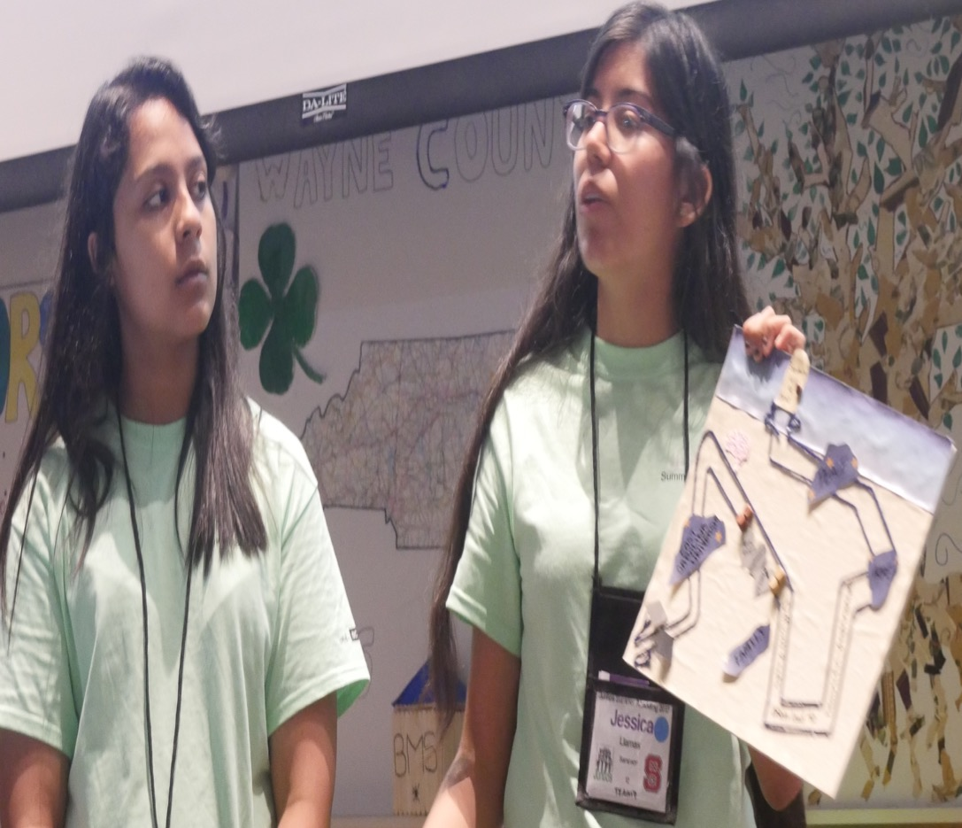
Sample of
Academy
Schedule
Notes:
WHAT TO SAY:
Let’s look at sample schedule for Summer Academy.

Slide 37
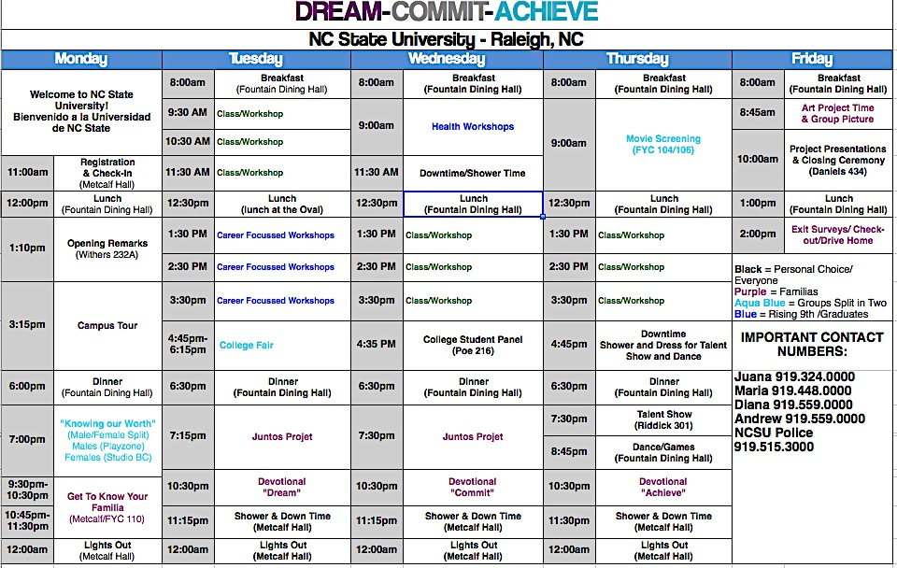
Notes:
WHAT TO SAY:
This is a sample schedule of a five-day Academy in North Carolina which hosted around 130 student participants. The schedule that was handed out to you is one with the titles of the classes which followed this layout.
Monday starts off Academy with registration, lunch, remarks by leadership and a keynote speaker. Invite someone from the university campus to welcome the students. We finish the day with a tour of the campus and a female/male discussion on a given topic. Team captains have time with their team to get to know each other better.
Tuesday starts the interactive classes. In this schedule you will see classes on STEM, design and textiles, forensics, and an introduction to the week-long project. The day ends with a college fair, where college representatives from different institutions are invited to share their information with students. Students then have project time and end with night discussions.
Wednesday begins with fitness and wellness classes, followed by classes focused on what is needed to get into college. The day ends with a college student panel, project time, and night discussions.
Thursday starts with an inspirational movie (e.g. McFarland USA), after which students are given time to discuss the movie. The day continues with classes that focus on identity, leadership, and 4-H. The night ends with a talent show, dance/games and discussion time.
Friday is a short but important day to reflect on the week’s experiences, including connections made between college students, staff, and youth. Youth also present their team projects. Program staff lead the closing ceremony and Academy ends with lunch and check-out.
Note to Trainer: Provide a copy of the complete sample schedule included with this module. Make sure you have a copy as you discuss this slide as it provides a more detailed schedule from the one on the screen.

Slide 38
Juntos Summer Academy
Notes:
WHAT TO SAY: The experience of Summer Academy gives Juntos 4-H youth an opportunity to experience the life of a college student in a real and memorable way. It’s a safe space for them to share their cultural similarities and see the opportunities available to them for achieving higher education.

Slide 39
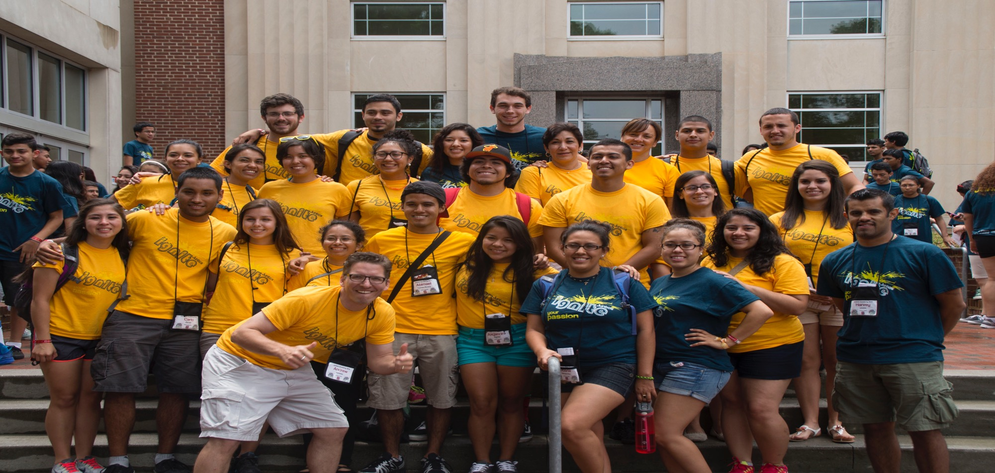
College students mentor and guide the youth
Notes:
WHAT TO SAY: College students have a lasting impact because they are positive role models and mentors for youth for the duration of Summer Academy. Through their relationships with youth, college students show Juntos 4-H youth that they, too, can make it to college.
In North Carolina, strong mentoring relationships have been established during Summer Academies as college students continue to volunteer in the program as mentors to the students they connected with during Academy.

Slide 40
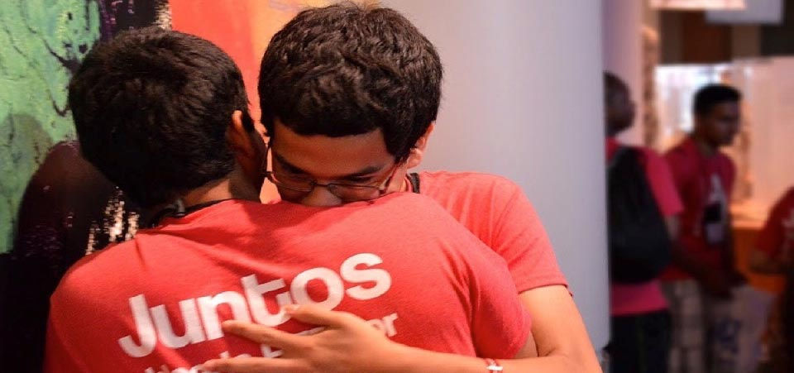
Lasting memories and relationships are made
Notes:
WHAT TO SAY: Lasting memories and relationships are made during Academy; there is power in experiencing something with a group of people. Academy provides Juntos 4-H youth an opportunity to celebrate their identity as Latinos and to see the diversity they bring to their communities as an asset worth embracing. At the end of Academy youth have expressed the positive impact and encouragement in being around others with similar backgrounds.
In North Carolina, Summer Academy has grown to include up to nine counties, and students from the different counties stay in touch with each other. Strong bonds are established such that when one community suffers due to a natural disaster, Juntos youth from other counties raise funds or collect supplies to support the families who have been affected.

Slide 41
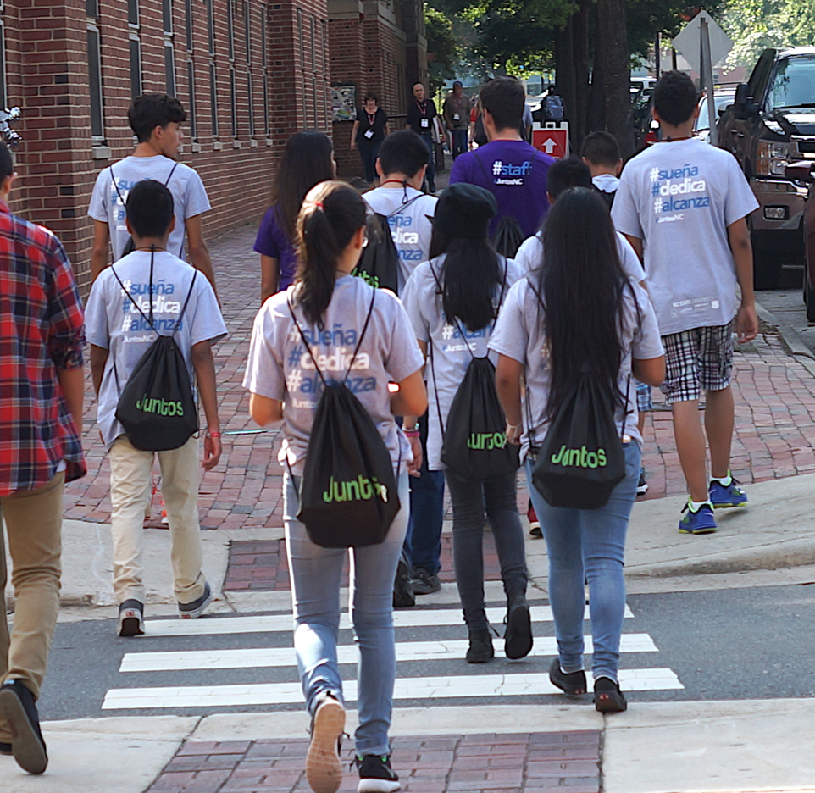
Juntos 4-H
Summer Academy
Why Academy Works
Notes:
WHAT TO SAY:
Let’s now move onto the last topic in this module: Why Summer Academy works.

Slide 42
Why Summer Academy Works
Financial aid workshops
Exposure to college living
Academic advising
Validation of Latino youth’s belonging in college
Notes:
WHAT TO SAY:
Remember the list we created at the beginning of the module on why we believed Summer Academy was an important component?
A 2008 report by the Pell Institute on college success for low-income and first-generation students highlighted individual elements that shape college success. The report showed that access to the following resources supports college success:
Financial aid workshops.
Exposure to college living.
Academic advising.
Validation of their belonging on a college campus.
From this report, it is obvious that the Juntos 4-H Summer Academy experience contributes to the positive attainment of a higher education, as it includes all of the above listed elements.
Note to Trainer: Have participants recall the list the created at the beginning of the module and make correlation with the report discussed in this slide. If participants are interested in reading this particular Pell Institute report, you can provide the link (http://files.eric.ed.gov/fulltext/ED504448.pdf).

Slide 43
Why Summer Academy?
It is a promising intervention which can guide first generation and low-income potential college students as they explore higher education.
It promotes and can lead to a strong college-going culture.
It provides a space for Latino students to gather with their common backgrounds and cultures and experience college together.
Notes:
WHAT TO SAY:
Let’s go back to why this type of experience is important for Juntos 4-H youth.
In January 2014, the Executive Office of the President revealed promising models and a call to action report entitled, Increasing College Opportunity for Low-Income Student.
This report identified summer enrichment programs like Summer Academy as being promising interventions that can guide first generation and low-income potential college students, as they help them to explore the idea of higher education and promote a strong college-going culture.
(Source: https://obamawhitehouse.archives.gov/sites/default/files/docs/increasing_college_opportunity_for_low-income_students_report.pdf
In the years that Juntos 4-H has been in existence, the majority of its youth have come from low-income homes and identify as future first generation college students. The Juntos 4-H Summer Academy provides students who have a common background and culture with an opportunity to step into a college student’s world.

Slide 44
Quotes from the youth on their Academy Experience
Notes:
WHAT TO SAY:
Let’s hear first from youth who have experienced Summer Academy.

Slide 45
Leslie Hernandez:
Juntos Academy has impacted me as a Latina. I met other Latino individuals who have been successful in their life. Academy motivated me to continue my education after high-school, to earn a four year Bachelor's degree, and continue to strive as a leader in my community.
“
“
Notes:
WHAT TO SAY:
Leslie Hernandez, a 15-year-old in 10th grade, had this to say about her Summer Academy experience:
“Juntos Academy has impacted me as a Latina. I met other Latino individuals who have been successful in their life. Academy motivated me to continue my education after high-school, to earn a four-year Bachelor's degree, and continue to strive as a leader in my community.”

Slide 46
“
Mayron Cordon:
“I liked Academy because it surrounded me with new experiences, new places, and new people to interact with. The best part was making a newscast (STEM Project), where we as a group came up with a problem and shared the best solution in the world.”
“
Notes:
WHAT TO SAY: Mayron Cordon has this to say about his Summer Academy experience:
“I liked Academy because it surrounded me with new experiences, new places, and new people to interact with. The best part was making a newscast (STEM Project), where we as a group came up with a problem and shared the best solution in the world.”

Slide 47
“
Jasmine Noyola:
Attending Academy has helped me see that I have a purpose to go to college. It has shown me how to write essays and what I need to improve to go to college. The Juntos summer academy is fun and an amazing one-week stay at NC State where we get to do what college people do. The Juntos summer academy has driven me to achieve my goals in high school, go to the community college, and get a degree in the career I want.
“
Notes:
WHAT TO SAY:
Jasmine Noyola
“Attending Academy has helped me see that I have a purpose to go to college. It has shown me how to write essays and what I need to improve to go to college. The Juntos Summer Academy is fun and an amazing one-week stay at NC State where we get to do what college people do. The Juntos Summer Academy has driven me to achieve my goals in high school, go to the community college, and get a degree in the career I want.”

Slide 48
“
Diana Urieta, Co-developer of the Juntos Program:
Academy gives Latino youth a real vision of college life. Meeting and building relationships with Latino college students especially empowers the youth to believe that they, too, can go to college. In the end, Academy is an experience that youth can take back to their communities; they can be the voices in their communities that share what the college experience looks like.
“
Notes:
WHAT TO SAY:
Diana Urieta states: “Academy gives Latino youth a real vision of college life. Meeting and building relationships with Latino college students especially empowers the youth to believe that they, too, can go to college. In the end, Academy is an experience that youth can take back to their communities; they can be the voices in their communities that share what the college experience looks like.”
If resources are available it is highly encourage that a slideshow of pictures or a video be made for each academy you implement. It is a tool you can use to share with partners, funders, families, and your 4-H community.
Let’s finish this module with an Academy video from North Carolina.

Slide 49
Academy Video
https://vimeo.com/142824104
Notes:
WHAT TO SAY:
Let’s now watch a video that captures Summer Academy in North Carolina.
https://vimeo.com/142824104

Slide 50
A special thank you to:
National 4-H for leading the way and believing in Juntos 4-H, supporting the work and engaging with partners to ensure that more states benefit from the program
New York Life Foundation for their commitment to youth and Latino families
The families and youth that make up Juntos 4-H
Notes:
WHAT TO SAY: This is the end of the Juntos 4-H modules.
A special thank you to National 4-H Council for leading the way in believing in Juntos 4-H, supporting the work, and engaging with partners to ensure that more states benefit from the program.
We also especially appreciate the New York Life Foundation for their commitment to youth and Latino families.
We would also be remiss if we didn’t thank the families and youth that make up Juntos 4-H, without whose participation this program would not be possible.

Slide 51
Thank you for taking the time to learn about Juntos 4-H!
Notes:
WHAT TO SAY: Last, but certainly not least, we thank you for taking the time to learn about the Juntos 4-H Program.

