Slide 1
Module 4: Juntos 4-H Success Coaching and Mentoring
Notes:
WHAT TO SAY: Welcome to Module 4, Juntos 4-H Success Coaching and Mentoring!
This module will inform 4-H agents, educators, Family Consumer Science (FCS) professionals, volunteers, and community partners about four key areas that will lead to the successful implementation of Juntos 4-H Success Coaching and Mentoring.
This module is the fourth in a series of five Juntos 4-H modules, all of which have been made possible through National 4-H Council’s partnership with NC State University and the New York Life Foundation.

Slide 2
Recap from Juntos 4-H Clubs Module 3
Core of the Juntos 4-H Partnership
Cultural considerations lead to club’s success
It takes a team to achieve success
Notes:
WHAT TO SAY:
Let’s recap what we learned in the previous module.
In Module 3, we learned what 4-H Clubs look like within the framework of the Juntos 4-H Program, and that in the Juntos 4-H partnership, 4-H Clubs and the Family Engagement components are required when implementing the program.
Three important cultural considerations are:
4-H is new to many Latino communities in the US, so it’s important to discuss the past, present, and future of 4-H.
Clubs have different meanings in Latin America, so find out those meanings and take time to talk about the 4-H Club culture.
As with Family Engagement, familismo must be the core of the Juntos 4-H Clubs.
Extension agents (FCS, 4-H agents, etc.), community partners and volunteers must work together to lead 4-H Clubs to success.

Slide 3
Juntos 4-H Success Coaching and Mentoring
This component cannot be implemented without conducting both Family Engagement and 4-H Club components.
Notes:
WHAT TO SAY:
It is important to remember that the success coaching and mentoring component may NOT be implemented without conducting both the Family Engagement and the 4-H Club components.

Slide 4
Module 4: Juntos 4-H Success Coaching & Mentoring
Cultural considerations
Planning for Success Coaching & Mentoring
Implementing Success Coaching & Mentoring
Retaining families
Notes:
WHAT TO SAY:
Module 4 will cover four focus areas:
Understanding the cultural considerations when implementing Success Coaching and Mentoring.
Planning for Juntos 4-H Success Coaching and Mentoring.
Implementing Juntos 4-H Success Coaching and Mentoring.
Retaining families through Juntos 4-H Success Coaching and Mentoring.
Let’s take some time to define Success Coaching and Mentoring, and see what we know about the impact Success Coaching and Mentoring can have on youth.

Slide 5
What is Success Coaching?
Success Coaching
Happens during school hours
Offers support, advice, guidance, reinforcement, and constructive coaching
It focuses on specific tasks and academic performance, while giving student feedback on observed performance
Notes:
WHAT TO SAY:
Success coaching is the individualized support of an adult role model during school hours who offers support, advice, guidance, reinforcement, and constructive coaching aimed at achieving youth’s goals with an emphasis on graduation and college access. It focuses on specific tasks and student performance, as well as giving feedback on student’s observed performance.

Slide 6
What is Mentoring?
A structured and trusting relationship that brings young people together with caring individuals.
Mentor offers guidance, support, and encouragement aimed at developing the competence and character of the mentee.
Notes:
WHAT TO SAY:
Mentoring is a structured and trusting relationship that brings young people together with caring individuals who offers guidance, support, and encouragement aimed at developing the competence and character of the mentee.

Slide 7
Definition by a Juntos 4-H Coordinator
Success coaching helps and empowers students to recognize their weaknesses and strengths, and works with them to introduce new academic strategies.
A mentor is more of a cheerleader; they provide emotional support and additional guidance.
Notes:
WHAT TO SAY:
Here is a simple and clear definition from a Site Coordinator from North Carolina, who has been both a Success Coach and a mentor during her time with Juntos 4-H.
“Success coaching helps and empowers students to recognize their weaknesses and strengths, and works with them to introduce new academic strategies.”
“A mentor is more of a cheerleader; they provide emotional support and additional guidance.”
Let’s see what we know about these two roles.
Note to Trainer:
Below are some links that can help you learn more about the difference between success coaching and mentoring. These websites provide a picture of each role to help you explain it during your presentation. Feel free to provide these resources to learners who continue to have questions about these two roles.
Leadership Thoughts:
http://www.leadershipthoughts.com/difference-between-coaching-and-mentoring/
Association for Project Management:
https://www.apm.org.uk/blog/coaching-vs-mentoring-why-the-difference-matters/
Association for Talent Development:
https://www.td.org/Publications/Blogs/Human-Capital-Blog/2014/08/Mentoring-Versus-Coaching-Whats-the-Difference

Slide 8
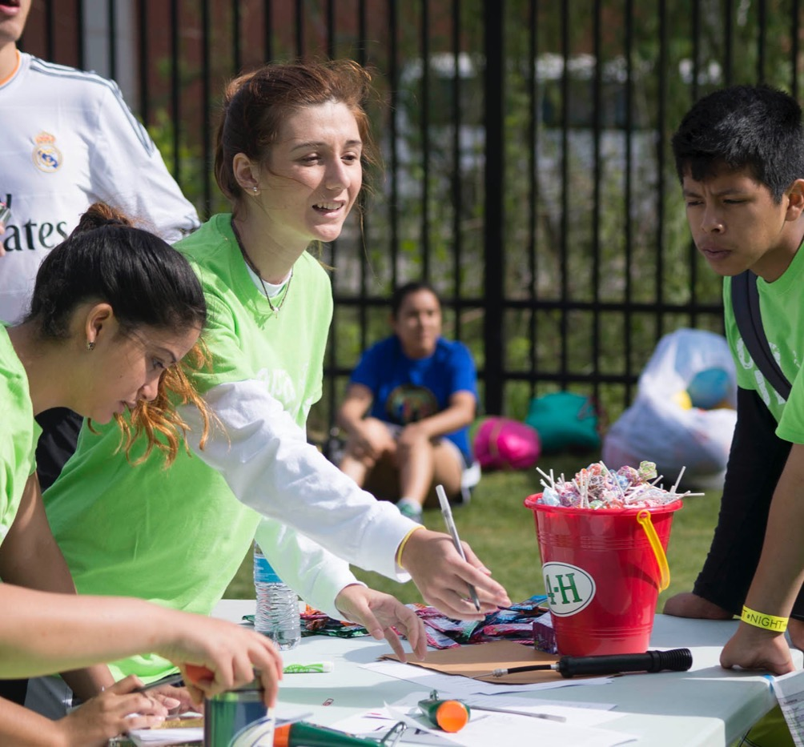
Success Coaching & Mentoring Impact
What the experts say
Notes:
WHAT TO SAY:
The next three slides provide multiple-choice answers to statements regarding academic success coaching and mentoring.
First, I’ll read the statement on the screen, followed by the multiple-choice answers. Write your answer down on the index card provided. I’ll ask you to raise your hand according to what you think is the right answer.
Let’s see if we are on the same page as the experts.
Note to Trainer:
The next two slides ask the participants to consider which answers are correct when it comes to success coaching, while the third one focuses on the impact mentoring has shown to have on youth.
Make sure to show the questions and answers as you read them and give participants time to think through the answers (10-20 seconds). You can ask if everyone is ready to vote on the correct answer.
Ask participants to raise their hands depending on which answer they think is correct as you call them out for the second time.
Get a feel for the participants; if you think that giving anonymous responses to the questions is best, you can provide the answer once you sense everyone has identified their answer on the index card you will provide for them.

Slide 9
Experts claim that success coaching
Deepens student learning
Enables students to take responsibility for their actions
Increases students’ GPA by 30%
Both A and B
All the above
Notes:
WHAT TO SAY:
Success coaching experts claim that the process of coaching:
Deepens student learning
Enables students to take responsibility for their actions
Increases students’ GPA by 30%
Both A and B
All of the above
Please write down your answer.

Slide 10
ANSWER
D. Both A and B
Deepens student learning
Enables students to take responsibility for their actions
Notes:
WHAT TO SAY:
The answer is:
D. Both A and B
Deepens student learning
Enables students to take responsibility for their actions

Slide 11
Experts claim that through the process of success coaching, students
Improve their effectiveness
Improve their relationship with parents
Consciously create their outcomes in life
Create a love for learning
All the above
Both A and C
Notes:
WHAT TO SAY:
Success coaching experts claims that through the process of success coaching, students:
Improve their effectiveness
Improve their relationships with their parents
Consciously create their outcomes in life
Develop a love for learning
All of the above
Both A and C
Please write down your answer.

Slide 12
ANSWER
F. Both A and C
Improve their effectiveness
C. Consciously create their outcomes
in life
Notes:
WHAT TO SAY:
The answer is:
F. Both A and C
A. Improve their effectiveness
C. Consciously create their outcomes in life
Last question.

Slide 13
Young adults who were at-risk for falling off track, but had a mentor are:
55% more likely to enroll in college
78% more likely to volunteer regularly
90% are interested in becoming a mentor
130% more likely to hold leadership positions
All the above
A, B, and D
Notes:
WHAT TO SAY:
Young adults who were at-risk for falling off track, but had a mentor are:
55% more likely to enroll in college
78% more likely to volunteer regularly
90% are interested in becoming a mentor
130% more likely to hold leadership positions
All of the above
A, B, and D
Write down your answer.

Slide 14
ANSWER
E. All the above
55% more likely to enroll in college
78% more likely to volunteer regularly
90% are interested in becoming a mentor
130% more likely to hold leadership positions
Notes:
WHAT TO SAY
This answer is:
E. All of the above
55% more likely to enroll in college
78% more likely to volunteer regularly
90% are interested in becoming a mentor
130% more likely to hold leadership positions

Slide 15
Any surprises?
Notes:
WHAT TO SAY:
Were any of these answers surprising to you? Did you learn anything new about the impact that success coaching and mentoring can have on youth?
These facts on success coaching and mentoring come from author, speaker, and international student success expert, Carol J. Carter. Carter is an expert in k-16 academic coaching. The mentoring answers came from research completed by The National Mentoring Partnership:
http://www.mentoring.org/why-mentoring/mentoring-impact/.
Note to Trainer:
Allow time for the participants to share any thoughts they may have and take time to talk about what they do know about success coaching and mentoring from their own experience.

Slide 16
Success Coaching and Mentoring
Cultural Considerations
Notes:
WHAT TO SAY:
Let's talk about cultural considerations within success coaching and mentoring.

Slide 17
Cultural Considerations
Personalismo
Meaning that Latinos place great emphasis on personal relationships
Notes:
WHAT TO SAY:
As more families were introduced to Juntos 4-H Family Engagement and 4-H Clubs, they began to voice a need for youth to have a person who was connected with the school and had a relationship with the families to guide them towards academic success, walk them through the process of applying to college, and help them find the resources to pay for college.
In talking to and interviewing youth and parents, it became clear to the program developers that youth and parents wanted a one-on-one relationship with someone who could walk the academic journey with them.
It was also apparent that many Juntos youth from both rural and urban schools did not feel confident or comfortable talking with their school counselors. In fact, many 11th graders in larger schools reported that they didn’t know who their counselor was or had never scheduled a meeting with them.
It became evident to the program developers that families were seeking a person who was willing to form a relationship with the youth focused around academic success, so they looked to the research on success coaching and mentoring for a solution.
The positive impact of success coaching within Communities in Schools and the great research behind The National Mentoring Partnership and 4-H National Mentoring Program supported the decision to add success coaching and mentoring to the full Juntos 4-H Program package.

Slide 18
Personalismo in Success Coaching and Mentoring
Provides a relationship
Bridges relationship between families and schools
Provides one-on-one resource to families
Provides a role modeling relationship
Notes:
WHAT TO SAY:
This third component adds to the hours of contact and impact that the program has on the youth and their parents. It provides a one-on-one relationship that fills the gaps that many Latino immigrant families face when living in the US.
Youth and their parents gain the relationship of a bicultural and many times bilingual person like them, whose purpose is to see these students thrive in school and life.
A Success Coach in particular is an active partner with parents and schools. They are able to build the bridges and relationships that are often missing due to language barriers, a lack of knowing the educational system here in the US, and other fears families may have in approaching the school system.
Immigrant families gain a one-on-one resource to help them navigate an educational system that is different from what they know.
Youth gain a role model that they may not have in their own communities; someone with resources, who may have walked in their shoes, and who is an example of what they too can achieve.

Slide 19
Success Coaching & Mentoring is NOT
An excuse for parents or schools to be uninvolved in youth’s education
A social worker, counselor, therapist, or legal advisor
An adopted parent or a “legal guardian”
A professional interpreter
Notes:
WHAT TO SAY:
When communicating with partners and families about implementing this component, it is important to point out what success coaching and mentoring does not provide.
It is not an excuse for parents to be inactive participants in their child’s education, or for school administrators or staff to stop providing regular services to students.
The person leading the success coaching or mentoring is not a social worker, counselor, therapist, or legal advisor, but should be aware of where to find those resources when needed within the school or in the community.
The person leading the success coaching or mentoring does not play the role of an adopted parent or ‘adopt’ the student into their family. Nor should they take on the role of a student’s legal guardian.
Success coaches and mentors should not play the role of interpreters in the school system.

Slide 20
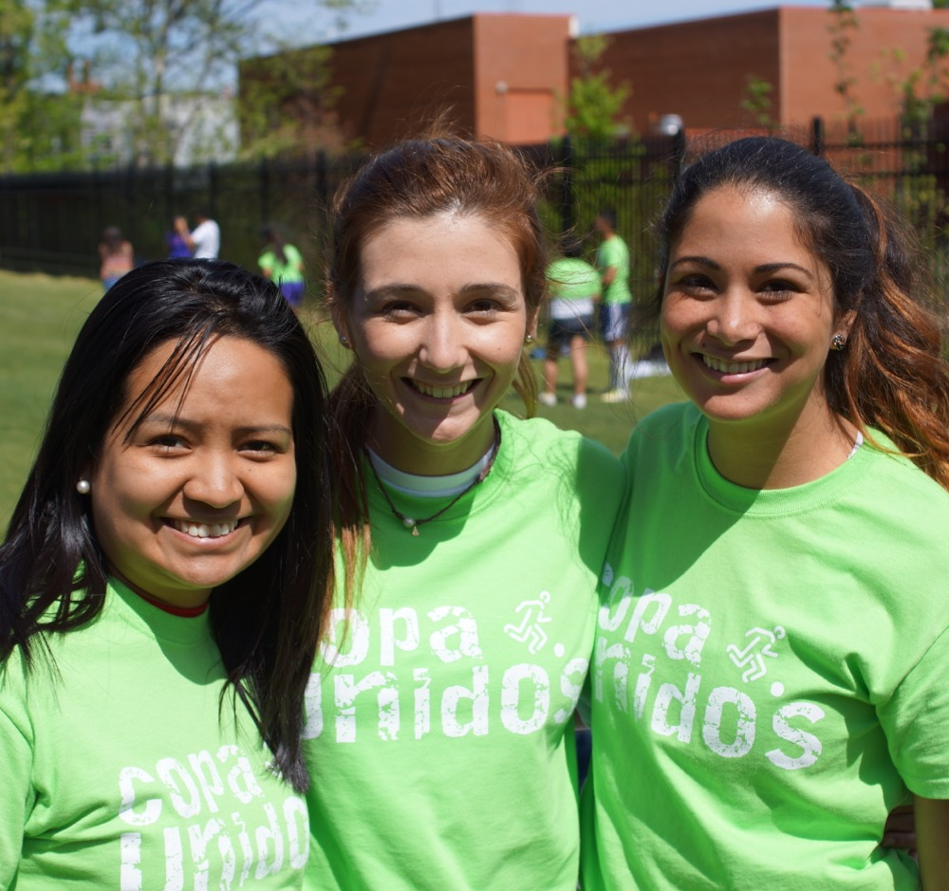
Success Coaching and Mentoring
Planning Phase
Notes:
WHAT TO SAY:
Let's talk about planning for success coaching and mentoring.

Slide 21
Remember
Family Workshops
4-H Clubs
Success Coaching
Notes:
WHAT TO SAY:
For the start-up year of program implementation, Family Engagement Workshops and 4-H Clubs should have taken place prior to beginning success coaching and mentoring. Exceptions to this program timeline have happened when the funding process or community partnerships have delayed start dates.
The Family workshop the program
The 4-H Club follow after the last workshop
Success Coaching starts the same month the 4-H club starts to meet but may take a following month for Juntos 4-H coordinator to meet with all students individually.

Slide 22
The GOAL: Youth Graduating from High School and Pursuing a Higher Education
1-on-1 Success Coaching
Mentoring
Who
8th- 9th grade youth
10th graders with GPA below 2.5
10th - 12th Graders are paired up with college students & adult community mentors
What
Tracks the academic progress and goals for each student and becomes an advocate
Main focus is to be a resources that supports youth’s academic success
Meets 1-on-1 at least once a month or more as needed with each youth for at least 30 minutes
Two or more interactions a month during 4-H Club, field trips, phone, virtual,
When
How
Success coaching sessions take place before, during, or after school
Adult community mentors & college mentors
Support from state and local Extension, state and local school admin, and community partners
Notes:
WHAT TO SAY:
Here is one model for success coaching and mentoring within Juntos 4-H. This model requires a part-time or full-time Juntos 4-H Coordinator who can provide the success coaching, and with the support of Extension, oversee the mentoring as youth continue to be served throughout their high school years. The goal, if resources allow, is for success coaching and mentoring to follow youth through high school graduation.
The chart provided here shows the recommended structure of this component.
The first column looks at the program’s success coaching layout when starting services with a cohort of 8th grade youth.
Here you can see that during 8th and 9th grades, students receive success coaching sessions on a monthly basis for at least 30 minutes, or more if needed. 10th graders in the program whose GPAs drop below a 2.5 receive success coaching sessions until they bring their grades up.
The second column shows that mentoring takes effect when the Juntos Coordinator and/or state or local extension staff can manage strong partnerships and establish a list of volunteer mentors. It is advised that students who remain in the program during their 10th, 11th, and 12th grade years be matched with a mentor.
Mentors become a cheerleader and resource for the youth. A mentor’s relationship with youth is focused on academic success.
Interactions can take place during club time, at school, on program field trips, by phone or virtually. It is recommended that at least two interactions with youth be made a month.
Examples of mentors who have joined the program are school coaches, ESL teachers, members of church groups, and college students.
Just like Family Engagement and 4-H Clubs, this component will need the support of Extension (at all levels if possible), school administrators and community partners who are passionate about the impact that Juntos 4-H can have on their community and state.

Slide 23
Juntos Timeline: Year One
This Timeline reflects first year of program implementation with 8th grade cohort
May-July
August-December
January-April
May-July
Build Partnerships & Volunteers
Relationship building with school, partners, and interested volunteers
Explain/introduce Program
Hire program staff
MOUs
Success Coaching
Monthly or more often if needed
One-on-one meetings lasting 30 min or more
Success coaching starts after workshop series
Success Coaching
Monthly success coaching to follow student’s academic progress
One-on-one meetings lasting 30 min or more
Building relationships with students, school personnel, and parent.
Meetings with School Admin
Revisit MOU
Discuss & plan Yr 2
ID and connect with new families
Summer Planning
Recruit volunteers & new community partners
Plan for following program year
Recruitment of families
Gather list of youth & families from school
Phone calls to build relationship of trust
Juntos information session for students and parents (optional)
Notes:
WHAT TO SAY:
Here is an ideal timeline for the first 2017 implementation of success coaching. This timeline coincides with the Family Engagement and 4-H Club timelines discussed in Modules 2 and 3.
Summer start-up: May - July: During the summer, prior to the beginning of the program, take time to focus on building relationships with schools and partners. Identify volunteers with the skills and passion to work with this population, who have talents in areas that would interest the youth. Hire staff who will support the program implementation. If you are implementing all four components of Juntos 4-H, it is advised that you hire a full-time person. If part-time staff is the only option, make sure you create a plan for families and their school to meet and interact with all the staff hired or who are supporting the program.
Plan for success coaching - Work with the school to develop a schedule for meeting with students and a communication plan for the school personnel.
Fall implementation: August - December: Success coaching should start after the last Family Workshop session. This means that the first success coaching session is likely to take place in October, depending on when the Juntos 4-H Family Workshop Series ends. It is recommended to schedule four to five sessions a day, with at least two days a week being spent on success coaching. This reflects a cohort of about 30 youth. Plan for the sessions to take 30 minutes or more. Each youth in the program should meet with their Success Coach at least once a month, or more if needed.
Spring implementation: January - April: Continue with the monthly sessions and slowly create opportunities for the youth to advocate for themselves as they reach out to teachers for help or with questions or requests. The person who is success coaching will need to build strong relationships with teachers, counselors, data specialist and other in the school to better support the students. This person will also need to be able to engage with the students parents. It may take a year or two for the youth to feel empowered enough to advocate for themselves and seek out resources when needed.
The following summer: May - July: Take time to discuss the successes and challenges of year one with partners, 4-H agents, and staff. Focus on what’s next with your partners. Include a conversation on how to improve the success coaching schedule and communication. For example, what were the highlights of the success coaching? What can be improved by the program staff and school administration? Share impact stories of success coaching.
Note to Trainer:
Provide a copy of this timeline to each participant.

Slide 24
Checklist for Success in Success Coaching
Trained staff
Parents “family” buy-in
School administrators and staff aware of Success Coach’s role.
Strong school partnership & relationship
Office space or meeting space in the school
Strong relationships with youth and parent
Consistency, follow through, & follow up
Listen & don’t assume
Notes:
WHAT TO SAY:
Here is a list of must haves to ensure that success coaching is implemented successfully
In success coaching:
Have staff who know what their role involves as a success coach, and who have access to resources within the school and community that can further support youth.
Getting buy-in from parents is key, so make sure to introduce success coaching early on in the introduction of the program.
Be certain that the school is clear about your role and supports the efforts of success coaching throughout the school year.
Build strong relationships with school personal by updating them on program progress. When possible make it a point to attend staff meetings to be informed and strength relationship all staff.
Ensure that the school provides a space where success coaching can take place and staff can manage the work.
The Success Coach must work to build a positive bond with both the youth and their parents, with a developed plan on how all three parties will work together to support academic success.
Be consistent with meetings and scheduling office hours at school. Following through with what you say is also essential, as it will create trust with students and parents. Make sure to always keep parents in the loop, and communicate with them on a consistent basis.
Take the time to listen to youth before making any assumptions.

Slide 25
Checklist for Success in Mentoring
Trained volunteers
Mentee orientation
Initial face-to-face interaction
Parents “family” buy-in
A student who wants a mentor
Commitment from both mentor and mentee
Intentional matches
Support from staff/adult leader
Notes:
WHAT TO SAY:
Here is a list of must haves for mentoring.
In mentoring:
Trained volunteers: It’s recommended that training occurs at least twice a year, and valuable resources should be provided to mentors throughout the year.
Initial face-to-face interactions: It’s important that mentees and mentors have a face-to-face meeting early in the relationship, as this will strengthen the bond between the mentee and mentor, which in turn will lead to successful mentoring.
Mentee orientation: Mentees also need to go through an orientation so they understand mentoring and their responsibilities as mentees. This will help strengthen their commitment to the process.
Making sure that parents are informed of the mentor match, meet their student’s mentor and support their relationship as mentor and mentee
Intentional matches: Matches need to be intentional. A pre-matching system should be put in place to ensure that the youth and their mentor are matched based on commonalities and interests.
Support from staff/adult leader: It’s important that every mentor is trained and guided throughout the year by the Coordinator or an adult leader. Providing mentors with resources and support will help strengthen the relationship. In addition, mentoring needs to be managed and overseen by an adult leader or program staff.
Let’s see what that timeline would look like.

Slide 26
Mentoring Only Timeline
This Timeline reflects first year of program implementation with 8th – 12 grade youth
May-July
August-December
January-April
May-July
Build Partnerships & Volunteers
Meet with high school(s) to discuss program
Engage with interested volunteers and potential mentors
Create MOUs with new school(s)
Identify volunteer or staff managing mentoring
Training for Volunteer Mentors
Start with a mentor/mentee matching special event
Mentoring
Mentors work on developing a relationship with mentee focused on supporting youth’s academic goals
Be a resource for youth and parents
Meetings with School Admin
Revisit MOU
Plan for year three
Mentoring starts in October or after Family Workshop Series
Mentoring interactions at least twice a month (clubs, school or program events/ field trips, or other times discussed with parents)
Summer Planning
Recruit volunteers & new community partners
Plan for following program year
Plan for sustainability
Plan & Build on Juntos mentorship
Mentor Volunteer Training
May: Have a mentor/ mentee matching activity (optional)
Notes:
WHAT TO SAY:
Here is an optional timeline for first year implementation when only mentoring, based on resources, can be implemented. This timeline coincides with the Family Engagement and 4-H Club timeline discussed in Modules 2 and 3.
Summer start-up: May - July: During the summer prior to the beginning of the program, take time to focus on building relationships with schools and partners. Identify volunteers with the skills and passion to work with this population, and who have talents in areas that would interest the youth. Hire staff or give mentor management responsibilities to someone who believes in the vision for the program. Remember, if you are implementing all four components of Juntos 4-H, it is advised that you hire a full-time person. If part-time staff is the only option, make sure you create a plan for the families and school to meet and interact with all staff hired.
Make it a goal to train volunteer mentors before school starts so they can interact with youth and families before matching begins. Be sure to work with the school to develop a process for volunteer mentors to be screened by the school if required.
Fall implementation: August - December: Mentoring can start following the last Family Workshop session. A mentor and mentee matching event can take place in early fall, depending on when the Juntos 4-H Family Workshop Series ends. It is recommended that mentors make an effort to have face-to-face interactions at least twice a month. Club time is the most convenient time, but not the only time.
Spring implementation: January - April: Continue with bi-monthly interactions and slowly create opportunities to encourage, empower, and support youth.
The following summer: May - July: Take time to discuss the successes and challenges of year one with partners, 4-H agents, and staff. Focus on what’s next with your partners. Include a conversation on how to improve mentoring (i.e., what were the highlights from mentoring? What can be improved by both the program staff and school administration?). Share impact stories of mentoring.
It may take a year two for all of the youth to be matched, but every effort should be made to match everyone. Mentors can choose to mentor more than one mentee and can meet with them as a group.
Note to Trainer:
Provide a copy of this timeline to each participant.

Slide 27
Preferred Success Coaching and Mentoring Model
Success Coaching in 8th and 9th grade
Success Coaching 10th graders with GPA 2.5 or below
10^{th,} 11th and 12th graders matched with mentors
Notes:
WHAT TO SAY:
So why should we follow this preferred model? National high school drop-out rates show that starting at age 16, students start to drop out. For most students this puts them in 10th grade. The purpose of introducing Juntos 4-H’ers to success coaching in the 8th and 9th grades is to provide them and their families with an advocate who will walk with them through the transition from middle school to high school, and watch them settle into the new high school environment, while focusing on maintaining positive academic outcomes and behaviors that will lead to high school graduation and applying for higher education.
When this model cannot be implemented due to a lack of resources, partnerships, and/or funds, the next option under this component would be to match youth with a volunteer mentor starting in 8th grade.

Slide 28
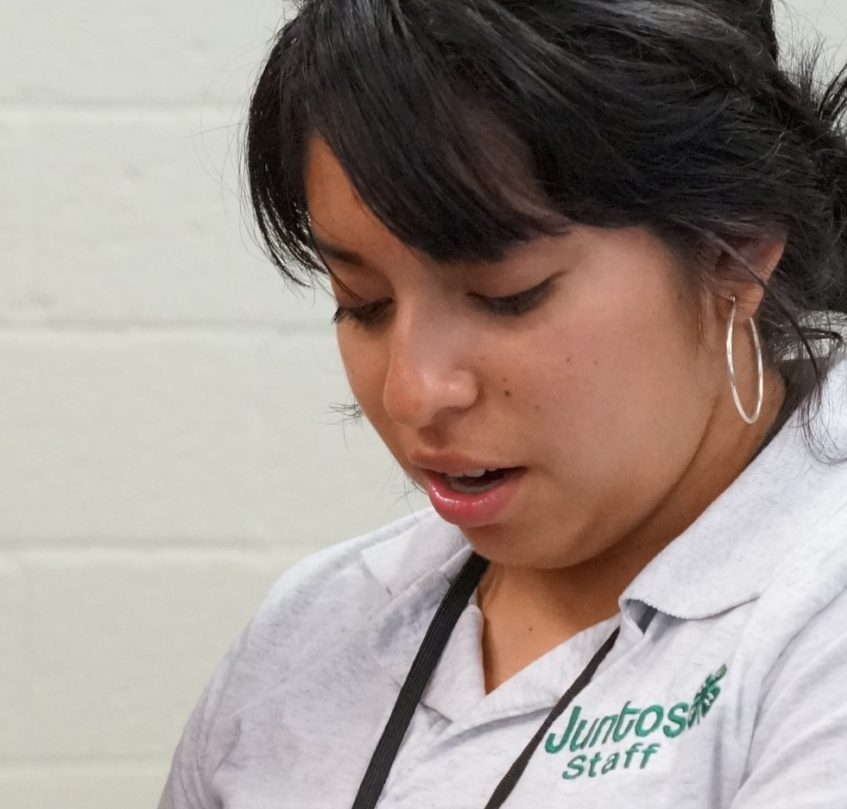
Cost for Success Coaching and Mentoring
Notes:
WHAT TO SAY:
Implementing Juntos 4-H Success Coaching and Mentoring has potential costs to consider as you plan.

Slide 29
When Additional Funds are Available
Success Coaching 8th & 9th Graders | Mentoring 10th - 12th Graders
Bilingual Site Coordinator who Success Coaches each youth | Bilingual Site Coordinator who oversees and trains mentors to work with participating youth as they enter the 10th grade
Professional training, ongoing support, & TA | Professional training, ongoing support, & TA
Budget for snacks and minimal office supplies | Budget for snacks for mentor trainings and minimal office supplies
Laptop computer or tablet | Laptop computer or tablet for planning
Notes:
WHAT TO SAY:
This chart shows the list of costs of success coaching and mentoring when additional funds are available.
Let’s start by looking at the left hand column to see what the costs are when you do have funds for success coaching.
Ideally, when implementing success coaching, communities are able to invest in hiring a Coordinator, who during the first year of the program will spend a large portion of their time coaching 8th graders. In future years, this person would then go on to coaching both 8th and 9th graders.
All individuals who plan to coach youth should receive the Juntos 4-H Success Coaching training from the NCSU Juntos team. It is highly advised that individuals managing mentoring have ongoing support from their own supervisors or Juntos 4-H Coordinators and 4-H agents.
Though not required, snacks can either be purchased or donated to encourage youth to come to their success coaching visits.
Additionally, a laptop or tablet computer is needed to complete the success coaching forms to track a youth’s progress and help them acheive their academic goals.
Now let’s look at the right hand column to see what the costs are for mentoring 10th through 12th grade students.
After the program has been established for two years, the first cohort of youth will have reached the 10th grade. Rather than being coached, they will now receive a mentor who will offer guidance and support to help them be successful in their transition to high school graduation and beyond.
Managing a mentoring program is complicated and the costs will depend on the local resources available to help it be successful. The cost of mentoring also depends on how often the site decides mentoring will occur each month, the number of mentors who are recruited and trained, and how difficult it is to retain mentors in the program. Research shows that mentors who visit more frequently and for more than six months have a greater impact on the youth they mentor.
Program leaders who plan to lead mentoring at their site can receive additional training on Juntos 4-H Mentoring from the NCSU Juntos team.
Though not required, snacks can either be purchased or donated to encourage mentors to paticipate in training events.

Slide 30
When Additional Funds are Not Available
Mentoring 8th -12th Graders
Agent, committed partner, and or adult volunteer who oversees and trains mentors to work with as many participating youth as possible
Professional training, ongoing support, & TA
Donated snacks and minimal office supplies
Notes:
WHAT TO SAY:
This chart shows what we suggest is done when there are no funds available for success coaching and/or mentoring.
When no additional funds are available, we suggest success coaching NOT be implemented. Instead we suggest that some mentoring be conducted by a 4-H professional or one of your partners with a handful of students who may be struggling academically or experiencing some other hardship. Managing a mentoring program is complicated and will depend on the local resources available to help it be successful.
As said previously, the time a volunteer would need to spend managing a mentoring program depends on how often the site decides mentoring will occur each month, the number of mentors who are recruited and trained, and how difficult it is to retain mentors’ involvement in the program. Mentoring may need to be less frequent (e.g., once a month) and/or conducted as group mentoring (e.g., one mentor with two to five youth) if one-on-one mentoring is not feasible. Running a mentoring program works best if a volunteer already has a consistent time set aside to be able to manage the mentoring program and has some experience running a mentoring program.
All individuals who plan to lead mentoring at their site can receive training on Juntos 4-H Mentoring from the NCSU Juntos team. It is highly advisable that individuals managing mentoring have ongoing support from their own supervisor or a Juntos 4-H Coordinator and 4-H agent.
Although not required, snacks can either be purchased or donated to encourage mentors to paticipate in training events.

Slide 31
Sample budget from North Carolina when implementing Success Coaching & Mentoring with grant funds
Notes:
WHAT TO SAY:
Let’s look at the sample breakdown of costs to run the program in North Carolina when funding is available to serve 30 youth.

Slide 32
Success Coaching and Mentoring Costs for 30 students
Item | Cost
Monthly Success Coaching for 30 youth | $20/hr @ 30 hours month x 12 months= $7,200
Training and TA Support | $675
Snacks and Supplies | $600
Laptop Computer | $600
Notes:
WHAT TO SAY:
The salary for a bilingual Juntos 4-H Coordinator is written into the grant when implementing all four components. The size of the youth group will determine whether a full- or part-time person should be hired. A large portion of their time will be expended in success coaching the participating youth.
The total cost on this chart covers Success Coaching hours. Training to be certified as a Juntos 4-H Success Coach costs $675 per person and includes ongoing TA/support to implement Juntos 4-H for one year.
Supplies and snacks needed for a complete year of service is approximately $20 per student.
If funds are available, we suggest purchasing a laptop for the Coordinator to use during success coaching visits.
You might also consider adding a small transportation budget for staff travel for training.
Additionally, if funding is available, you might decide to provide a small incentive (e.g., gift cards, awards, small gifts) to mentors in the program.

Slide 33
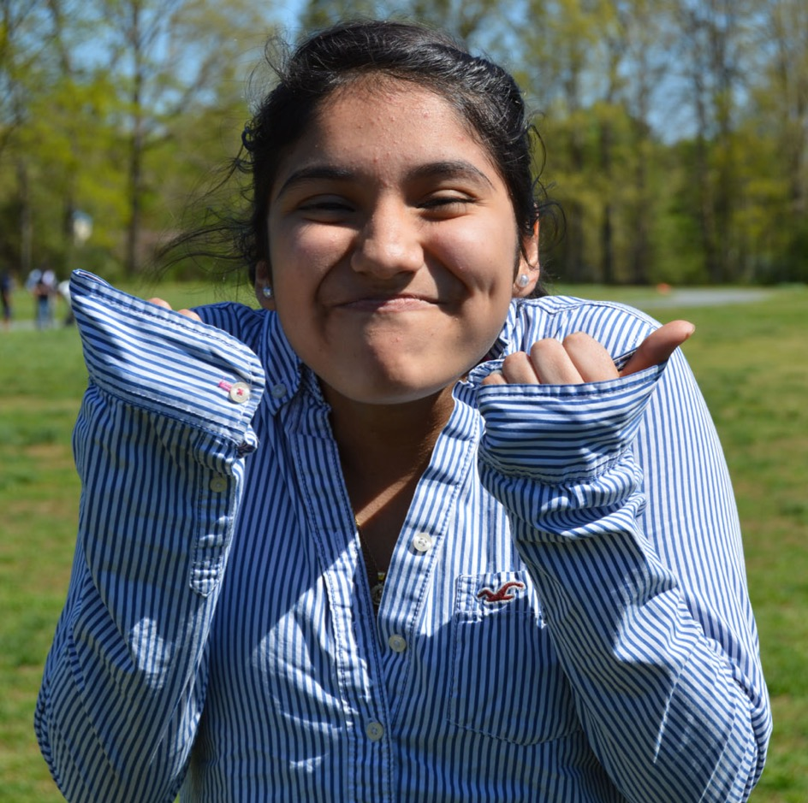
Success Coaching and Mentoring
Implementation Phase
Notes:
WHAT TO SAY:
Let's learn how success coaching and mentoring are implemented.
Remember that by the time this component starts, you’ve already led a group of families through the Family Workshops and are starting or have started Juntos 4-H Clubs. You have also established a base relationship with both schools and families. If you are following the preferred model, you are now starting success coaching and have at least two years to build on a mentoring program.
Let’s look at success coaching first.

Slide 34
Implementing Success Coaching
Role of Program Coordinator
Practice of Success Coaching
Capturing the Work
Success Coaching Requirements
Notes:
WHAT TO SAY:
Let’s first talk about success coaching by covering the following points.
What is the main role of the Juntos 4-H Coordinator who will be success coaching?
What does it take to implement success coaching?
How does the person who is success coaching document each meeting with the youth?
What is the list of must haves when implementing success coaching?

Slide 35
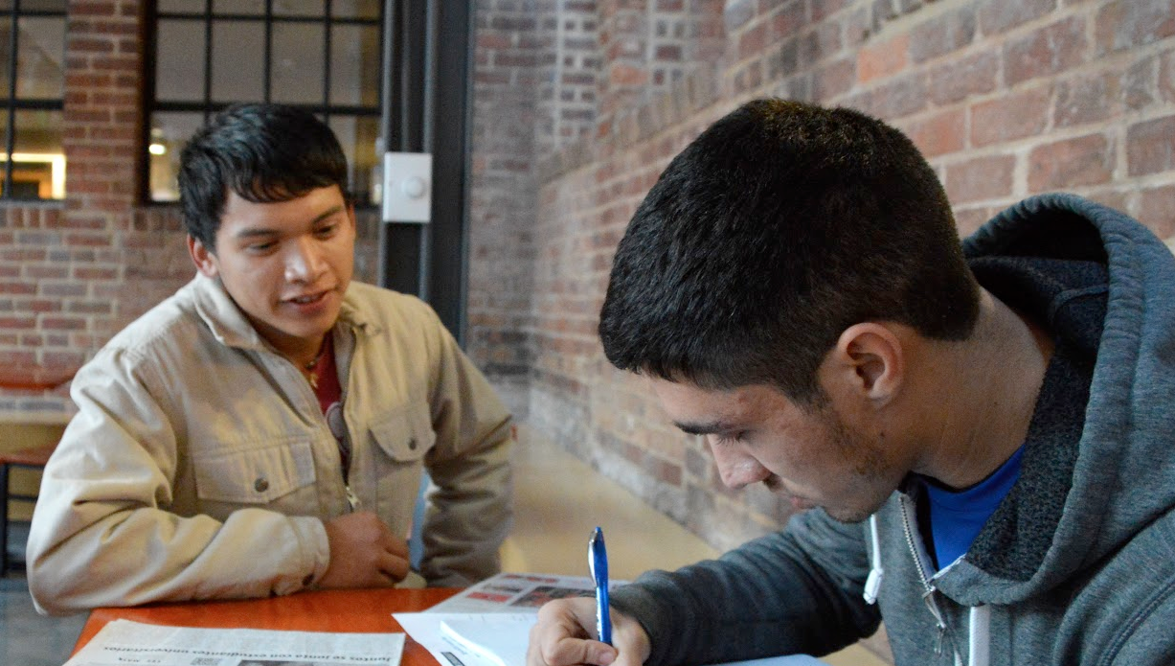
Show Your Interest
Goal: Academic Achievement
Remember what families tell you about them
Know the family unit
Be consistent and keep your word
Allow them to get to know you
Know that your time and commitment with the youth will gain parents’ trust over time
Notes:
WHAT TO SAY
It is very important that all partners, especially schools, parents and youth, understand the sole purpose of implementing success coaching in Juntos 4-H.
They should all be clear that success coaching provides youth with a trusted support person who is focused on their academic progress. Success coaching is not a counseling session, time to hang out, or a chance to get out of class; it is time used to discuss with youth their academic progress, and together with the Program Coordinator, come up with action steps to support any area of the youth’s academics that need improvement.

Slide 36
The Practice of Success Coaching
Starts at recruitment
Present self and role to school personnel
Remind families about success coaching
Notes:
WHAT TO SAY:
Having a consistent Juntos 4-H Coordinator to oversee the program and be responsible for success coaching leads this component to greater success, and also provides a face of trust for each component. The best scenario is when the Coordinator is part of the recruitment process and gets to know the school and families before the success coaching even starts. This allows him/her to not only develop relationships with the families and school, but also to set the stage for what success coaching will be like when the sessions begin. If this process is not possible due to hiring delays or other circumstances, it is important that the person who did start the partnership with the school, the recruitment process, etc. is able to introduce the person who will be success coaching and ensure that both the school and families are accepting of the person‘s role and contact with the youth.
Once school starts, it’s good practice to ask the principal to allow the person implementing the success coaching to present themselves and their role during a staff meeting. If this is not possible, ask the principal to introduce the person by email and ask permission for the person to email staff. The email should include a formal introduction to the person, the program, and their role in the success coaching.
At the last family session, make sure to remind students that along with the start of the 4-H Club you will also start success coaching meetings with the youth. Remind them of the purpose and process you will follow to meet with the youth. If someone who the families do not know will be doing the success coaching, this is the time to present them to the group. Have them introduce themselves and describe their excitement and goals for success coaching the youth.

Slide 37
The Practice of Success Coaching
Set up your meeting schedule
Set the stage at first sessions
Follow up sessions
Notes:
WHAT TO SAY:
It is the role of the person who will be success coaching to figure out with school administration and teachers the best time (i.e., before, during, or after school) for them to meet with students.
Example schedule:
Meeting students during their lunch time or elective periods.
The Juntos 4-H Coordinator needs to work with school staff, administrators, and students to set schedules that are the best fit for the students and school system. It is important to note that each site may look different, and that some schools may be more flexible than others.
Some examples may be:
Meet students depending on their lunch schedules.
Meet students depending on their A/B schedule and electives.
Meet students after school.
Meet student athletes on game days as they have free time before preparing for their game.
Strategies to help set the stage for the first meeting:
Secure a time and location.
Explain the roles and expectations of the student and the success coach.
Gather prior academic records to help the student develop appropriate goals for the year.
Once the youth and Success Coach are familiar with each other, the session will be more focused and goal-driven. Our experience has shown that tailoring these sessions to the youth’s needs, provides a personal touch that encourages the academic growth of the student.

Slide 38
Capturing the Work of Success Coaching
Notes:
WHAT TO SAY:
The following slides discusses what the program’s Success Coaching Monitoring Form captures that is used before, during, and after success coaching sessions. If you will be implementing this component, it is important that you be trained by the NCSU Juntos before using this form.

Slide 39
Success Coaching Monitoring Form Provides
Demographic information
Academic schedule
Summary of each Success Coaching session
Academic records & attendance
Notes:
WHAT TO SAY:
The monitoring forms cover the following key areas:
The first section of the form focuses on the student’s basic demographic information, information on how to access the student’s academic reports, any particular educational notes needed, who or what their academic resources are, and the educational goal the student wants to reach.
The second section is the student’s academic schedule of the student which includes: list of classes they are taking, teachers, and room numbers.
The third section is where the person completing the success coaching session can keep a record of what was discussed during the session and the action plans needed, the plans made, as well as the final results. This section is crucial as it follows the student’s progress and covers the work of the Success Coach in case anyone questions what has happened in each session.
The fourth section is where the academic and attendance records are periodically entered. This section includes an area where the Success Coach can document grades for each class, for each quarter, and document class absences.
Note to Trainer: Provide a copy of the sample form provided in this module before going over this slide for learner to follow along.

Slide 40
Success coaching requires…
Full or part time staff working in the school and with the school
Quality training to set the person up for success
A tracking system and documentation tools to:
capture the progress of students; and
provide quantitative and qualitative data to support students and share with stakeholders (e.g. schools system and funders).
Training and professional development
Notes:
WHAT TO SAY:
In order to provide success coaching, you will need a plan to pay for staff directly, or partner with another organization like Teach for America, AmeriCorps, or some other organization who can help support the staffing of this position. This will ensure that the Success Coach is a professional who is committed for the long-term. You might also decide to reach out to schools leaders who could choose to allocate a percentage of a staff member’s time to success coaching.
Alternatively, you can seek partnerships with other organizations that provide success coaching to youth. For instance, you might partner with Communities in Schools who could carry out the success coaching portion of the program, while you and your team are responsible for the other components of the Juntos 4-H Program. You could also apply for grants that would enable you to hire part- or full- time staff, depending on student needs and staff responsibilities.
Success coaching requires professional training to ensure purpose and quality; training provides staff with the best tools to capture the academic progress of youth. In addition, training for success coaching provides a documentation process that captures the progress of students and provides quantitative and qualitative data that can be used to better serve families and share with stakeholders (e.g., school personnel and funders).
Now let’s talk about mentoring…

Slide 41
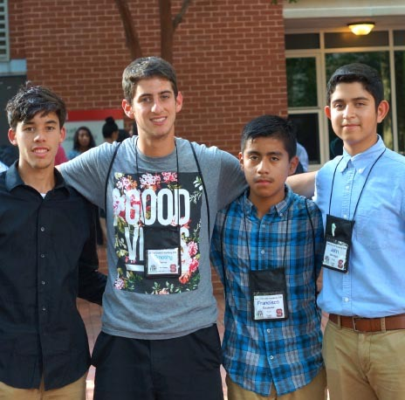
Juntos 4-H Mentoring
Notes:
WHAT TO SAY:
Mentoring in Juntos 4-H is developed over time. If you recall from the timeline, we suggest mentoring start in the 10th grade.
If mentoring is the substitute for success coaching, you have a different scenario. If you have strong partnerships, volunteers, and a person dedicated to managing all aspects of mentoring, matching your Juntos 4-H’ers to mentors can start the first year you begin with Family Engagement and 4-H Clubs.
Without strong partnerships and a designated person to manage the mentoring program sites can slowly progress to this point as the volunteer list and capacity to train and support develops. This process includes ongoing mentoring recruitment, screening, training, and consistent follow-up and check-ins with mentors.

Slide 42
Juntos 4-H Mentoring
Improve youth’s attitudes about adults in their lives
Encourage academic success
Promote self-worth
Provide new experiences and develop new life skills
Notes:
WHAT TO SAY:
Juntos 4-H sees mentoring as a way to:
Improve young people’s attitudes towards their parents, peers, and teachers;
encourage students to stay motivated and focused on their education;
promote student’s to establish better feelings of self-worth; and
provide new life experiences, and offer opportunities to develop new life skills.

Slide 43
Implementing Mentoring
The mentors and their qualifications
The time commitment
Leading mentors and mentees to success
Notes:
WHAT TO SAY:
The following points will be discussed in this section.
Who are the Juntos 4-H mentors and what are their qualifications?
What is a Juntos 4-H mentor’s time commitment?
What factors ensure a successful mentor and mentee relationship?

Slide 44
Mentors and their Qualifications:
Clean background check
Desire to work with Latino & immigrant youth
3-year age gap
Willingness to devote the time and commitment
Active listening skills and empathy
Notes:
WHAT TO SAY:
All mentors go through the 4-H volunteer background check. Additionally, some school partners may also require that each mentor undergo their district’s volunteer screening so that mentors can work with students at the school.
Mentors have to believe in the mission of Juntos 4-H and have an understanding of the youth they will be mentoring. If the desire is there to work with Latino youth but the potential mentor knows little about Latino families and immigrant youth, it is the job of program leaders and staff to provide such knowledge.
We suggest at least a three-year age difference between a mentor and their mentee. However, you should follow your state and local 4-H rules on this. In North Carolina, mentors have often been either high school or college students, so it is important that Coordinators ensure that there is at least a three-year age gap.
Mentors need to commit to at least a full year of mentoring and understand that the relationship will be most impactful when they commit to remain with youth through their high school journey. They must commit to being on time and being physically and mentally present when meeting with the youth.
Mentors should be good listeners and understand that their role isn’t to instruct and verbally direct youth, but to listen and learn from them and with them. Mentors should also have empathy for the youth and their families. This requires mentors to have a level of understanding and awareness of where the youth is in their life. It’s important that mentors be sensitive to factors that affect young people.

Slide 45
Time Commitment
Mentors attend 2 to 4 training sessions each year, each less than 2hrs long
Attend pre-matching event
2 monthly mentor-mentee interactions
face-to-face interactions
Bi-Weekly contact
Coordinators must communicate with each mentor at least once each month
Mentors submit a monthly report
Notes:
WHAT TO SAY:
The time commitment requirements of Juntos 4-H mentoring were influenced by some of the requirements established by the National 4-H Mentoring Program. These time commitments also reflect the time commitment that the staff or volunteer managing the mentoring will need to consider.
Mentors must attend training sessions which should be held two to four times each year and which should not exceed two hours at a time.
Mentors should attend a pre-matching event, in a natural setting, where mentors and mentees get to meet and agree to be matched.
Mentors should ideally maintain two face-to-face mentor interactions each month, though more is highly recommended. These interactions could involve the mentor attending Juntos 4-H Club meetings, family nights, school and program field trips or events, and other opportunities where parents have full knowledge and agreement.
Mentors should contact their mentee at least at bi-weekly but weekly interaction are encouraged – this could be a brief or a lengthy phone, text, and/or social media communication that focuses on how the youth is doing with school and how the mentor can help. A great way for mentors to interact with mentees is to attend the Juntos 4-H club scheduled twice a month.
Coordinators, or those responsible for mentoring, must communicate with each mentor at least once each month via text, email, and/or phone calls.
Mentors will be responsible for submitting a monthly report that informs the Coordinator on how many contacts were made, the results of the contacts, and any questions or resources the mentor may need in order to better support the youth.

Slide 46
Successful Relationship
Informative, resourceful, and fun trainings
Initial face-to-face interaction
Strong communication system
Three-way interest
Strong leadership
Follow-up and consistence
Notes:
WHAT TO SAY:
Some factors that have been shown to make mentoring implementation effective include:
Coordinators hosting informative, resourceful, and fun training sessions for mentors. A great resource is the Ready to go: Mentor Training Toolkit on building the mentoring relationship by Michigan State University Extension;
Mentors having initial face-to-face communication with the mentees and their parents will help develop strong and lasting relationships;
Mentors should develop a strong and consistent way to communicate with the youth and their parents;
Coordinators should assure that the the mentor and mentee are developing strong relationships. This becomes a three way interaction where mentor, mentee, and Coordinator are each concerned about each other. For example, if the parents and/or youth are not committed, mentors will quickly disengage and have no purpose to continue to volunteer;
Have an organized and consistent mentoring coordinator. This person must make the time and/or support to manage this detailed mentoring process; and
Coordinators must be consistent in tracking face-to-face interactions, training, and follow-ups or check-ins with mentors. This will lead to a mentoring system that works, which mentees, parents, and community partners will see as successful and trustworthy.

Slide 47
Mentoring Supports your 4-H Program
Juntos 4-H mentors can become advocates and spokespeople for your 4-H program.
Bilingual mentors can help non-bilingual staff communicate with parents and the Latino community.
Outreach to college students (e.g., community college and 4-year college students.)
Notes:
WHAT TO SAY:
Remember from Module 1 that having Juntos 4-H mentoring supports the local 4-H program in various ways. For one, it grows your volunteer base as you recruit mentors for youth. These volunteers will ultimately become a 4-H “face” in the schools and the Latino communities that Juntos 4-H serves.
In addition, mentors who are bilingual bring not only their second language skills but also their bicultural knowledge, which can help you further connect with the Latino community.
Finally, reaching out to college students expands your community outreach and opens doors to building relationships with college staff and faculty. In fact, North Carolina has experienced a growth in passionate Latino college students who have taken on the leadership of mentor recruitment and training with some staff guidance.

Slide 48
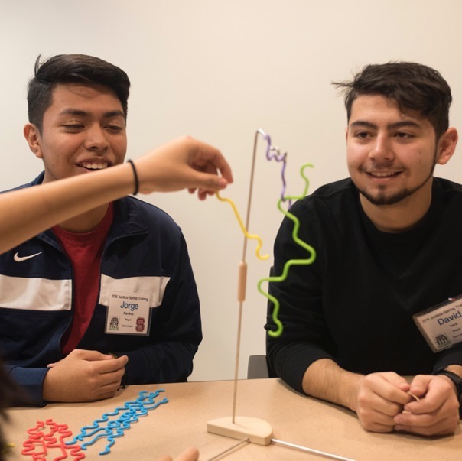
Retaining youth through Success Coaching and Mentoring
Notes:
WHAT TO SAY:
Now that implementation has been covered, let’s talk about retention.

Slide 49
SC and Mentoring help to keep the entire family engaged
One-on-one relationship
Consistency
Respect & reinforce
Achieving academic success
Empower
Have fun and create unity
Results of success
Accountability
Relationship development
Parent – child – school interconnection
Students become their own advocates
Notes:
WHAT TO SAY:
Here is a long list of how Success Coaching and Mentoring keep youth and their parents engaged in the program:
Success coaching and mentoring strengthens the one-on-one connection between the youth and their mentor and or Success Coach.
They help sustain the consistency of the relationship, which leads to greater academic success for the youth.
They also help reinforce what the youth learn in other parts of the program and help the youth gain greater respect for their educational opportunities.
They help the youth focus on achieving academic success.
They also help the youth gain respect for themselves in a way that empowers them as students.
They have fun with their mentor and/or success coach and learn to trust each other more. This trust builds unity in the program. They learn that they are not alone; there is a team of individuals who want to see them succeed. Parents in the program continue to point to Juntos 4-H as a program where they no longer feel alone; the process is no longer simply left in the hands of the youth because their parents did not understand it. Schools see success coaching in particular as a way to decrease the misperceptions that Latino students and their parents may have had about school.
Students see results when they are setting goals during Success Coaching sessions, which leads to further academic success.
Students have another person to hold them accountable. They learn what it means to be accountable to their own goals.
Youth learn about how relationships are developed, discover that it’s a two-way process, and start engaging in their own relationship building. For example, the program in North Carolina has seen a pattern of Juntos 4-H’ers in 11th and 12th grade want to peer mentor the 8th graders joining the program.
Success coaching has become for many Juntos 4-H families and schools the bridge that brings them all together; the students develop stronger relationships with their teachers, which leads to better communication all round.
Students learn to advocate for themselves. Over time, after watching the Success Coach model how to communicate with teachers, students gain the courage and skills to go to the teacher for themselves. The process empowers students to advocate for their own educational success.

Slide 50
A Special Thank You To:
National 4-H and New York Life Foundation for supporting the growth of Juntos 4-H
NC State 4-H for their feedback during the development of this module
The families and youth that make up Juntos 4-H
Notes:
WHAT TO SAY:
The developers of the program would like to give a special thank you to:
National 4-H Council for leading the way in believing in Juntos 4-H, supporting our work, and engaging with partners to ensure that more states benefit from the program;
The New York Life Foundation for their commitment to youth and Latino families;
North Carolina State 4-H for their support in creating this module; and
Most importantly, the families and youth that make up Juntos 4-H.

Slide 51
Notes:
WHAT TO SAY:
Thank you for taking the time to participate in Module 4, Juntos 4-H Success Coaching and Mentoring! Module 5 covers the last of the four components the Juntos 4-H Summer Academy.

