Slide 1
Module 1: The Juntos 4-H Program Overview
Notes:
WHAT TO SAY: We are pleased to introduce to you the Juntos 4-H para una Mejor Educación Program (Together for a Better Education Program) and its partnership with 4-H. This first module will provide a comprehensive overview about the Juntos 4-H program, which you can share with 4-H/FCS professionals, other extension staff, volunteers, and community partners who are not here today. This is the first of five modules. Modules two to five will give detailed information about each component of Juntos 4-H, which will be briefly discussed in this module.

Slide 2
National 4-H Council has partnered with the Juntos Program in North Carolina and the New York Life Foundation to reach more Latino youth
Notes:
WHAT TO SAY: All five modules were made possible through National 4-H Council’s partnership with the Juntos program at NC State University and New York Life Foundation.

Slide 3
Participants’ Introduction Activity
Share:
Your professional title.
Why you want to learn more about the Juntos 4-H Program.
Your experience and years working with the Latino community.
Why you think Juntos 4-H is needed in your community.
Notes:
WHAT TO SAY: To get started, let’s spend some time getting acquainted with one another. Please share your:
name;
why you are interested in the Juntos 4-H Program;
what your experience working with the Latino community is; and
why you think this program is needed in your community.
The trainer should share first to model for the participants. Give participants at least two minutes to write down their responses.
Note to Trainer: Close this introductory activity by using what you learnt from your audience. Emphasize how each person can play a part in the success of a program like Juntos 4-H. Highlight some of the similarities in the responses or interesting facts learned, for instance, you can add up all the years of experience and say, “We have a total of ___ years of experience working with the Latino community!” or “We came up with a total of ___ reasons why Juntos 4-H is needed in our community!”
Now let’s learn more about Juntos 4-H.

Slide 4
Understanding Juntos 4-H
Notes:
WHAT TO SAY: In order to understand Juntos 4-H, three key questions need to be asked:
What does ‘Juntos’ mean?
What is Juntos 4-H?
Why Juntos 4-H?
Let’s look at the first question.

Slide 5
What does Juntos mean?
Notes:
WHAT TO SAY: Who knows what the word ‘Juntos’ means?
Note to Trainer: Ask participants if they know what ‘Juntos’ means. Allow time for responses before moving to the next slide.

Slide 6
The name Juntos (pronounced “Who-n-toes”), which means “together” in English, is not just a name.
It is the core concept of the program, which brings partners and families “together” to prevent youth from dropping out, to increase parental involvement, and to promote access to higher education.
Notes:
WHAT TO SAY: Let’s first talk about what ‘Juntos’ means. The name ‘Juntos’ (pronounced “Who-n-toes”) means “together” in English. The developers of Juntos strongly believe that the educational success of Latino youth requires groups of people working together, which is why Juntos calls for the collaboration of families, schools, and communities. The program aims to unify groups at the local level. ‘Together’ we can prevent school dropouts, increase parental involvement in youth education, and promote students’ access to higher education.

Slide 7
What is Juntos 4-H?
Notes:
WHAT TO SAY: Now let’s look at the second question. What is Juntos 4-H?

Slide 8
Juntos 4-H is a program that helps Latino youth (8th-12th grade) and their parents gain the knowledge and skills needed to bridge the gap between high school and higher education.
Mission: To help Latino youth achieve high school graduation and attend higher education
Notes:
Slide: “A program that…”
WHAT TO SAY: Juntos 4-H is a program that helps Latino youth from 8th to 12th grade, as well as their families, gain the knowledge and skills they need to bridge the gap between high school and higher education.
The mission of the program is simple: to help students achieve high school graduation and attend higher education.

Slide 9
Juntos 4-H is a partnership between National 4-H Council and Juntos North Carolina, which aims to:
engage Latino youth in 4-H, and
support youth and families on their path to academic success.
Notes:
WHAT TO SAY: The Juntos 4-H partnership aims to engage Latino youth across the country in 4-H, and support youth and families in their journey to academic success.

Slide 10
Why Juntos 4-H?
Notes:
WHAT TO SAY: Let’s look at the reason behind the name Juntos 4-H.

Slide 11
To grow Latino 4-H’ers.
To engage the Latino community in 4-H.
To empower Latino families to thrive in their communities.
Notes:
WHAT TO SAY: There are three goals behind the name Juntos 4-H. These are:
to see more Latino youth benefit from 4-H programing;
to build relationships with Latino communities so they benefit and become involved in 4-H and other Extension programing; and
to empower Latino families with the resources needed to achieve their educational goals for their youth.

Slide 12
Juntos & 4-H = Real Impact
Notes:
WHAT TO SAY: 4-H’s long history of positive youth developmentand the increasing impact of Juntos 4-H on Latino families
makes Juntos 4-H a promising program to implement.
Let’s take a look at the real impacts brought about by both Juntos 4-H and 4-H itself.

Slide 13
Impact of 4-H on Youth
Improves skills in communication and self-expression.
Increases leadership abilities.
Develops socially acceptable behaviors and personal standards.
Develops effective and positive interpersonal relationships.
Helps youth “give back” to their communities.
Develops abilities to perform as productive, contributing citizens.
Notes:
WHAT TO SAY: Can I please get a volunteer to read aloud each bullet on this slide about the impact 4-H has on youth?

Slide 14
Delivery of 4-H youth development
A New York study of 4-H members showed 4-H’ers:
perform better in school
are motivated to help others, and
develop skills in leadership, public speaking, self-esteem, communications and planning
Notes:
WHAT TO SAY: Tufts University completed a longitudinal study on 4-Hers and found that youth in 4-H do better in school than other students, and are more motivated to help others. They further found that these youths are developing skills in leadership, public speaking, self-esteem, communication, and career-planning.
To access more research reports on the impact of 4-H, visit www.4-h.org, go to ‘About 4-H’, and click on ‘Research’.
Now let’s look at some of the recent positive effects of Juntos.

Slide 15
Impact of Juntos 4-H
Notes:
WHAT TO SAY: Let’s look at the impact the Juntos 4-H Program has on youth.

Slide 16
87% of students feel confident that they will continue their education after high school.
93% of students report that the Juntos Program helped them feel like they belong at school.
91% of participating youth improved their grades in school.
69% of students missed 10 days of school or less.
92% of students feel confident they will graduate from high school.
Notes:
WHAT TO SAY: Here are some outcomes from North Carolina State University’s pre and post youth surveys, school records, and program attendance records:
87% of participants feel like they now belong in school.
93% of students feel that Juntos helped them belong at school.
91% of youth improved their grades in school. 69% of students missed 10 days of school or less.
92% of students feel confident they will graduate from high school.
In order to value the impact Juntos 4-H is making, it is important to look at:
its history;
its growth; and
why it’s needed.
Let’s take a look at its history first.

Slide 17
History of Juntos 4-H
Notes:
WHAT TO SAY: Juntos was created as a direct response to the need to unify schools, families, and community efforts to prevent school dropouts, as well as to promote student access to higher education and parental involvement.
Juntos was launched in 2007 at North Carolina State University (NCSU) with a 6-week High School Family Engagement Workshops Curriculum.

Slide 18
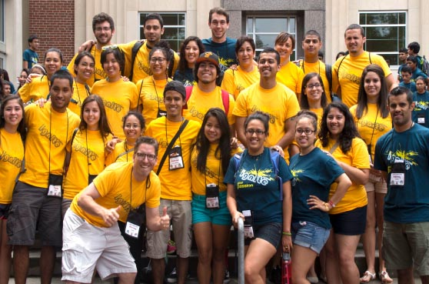
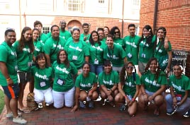
NC State Juntos Leadership Team
Andrew Behnke, Cintia Aguilar, & Diana Urieta
Program developed at NC State University
Notes:
WHAT TO SAY: Co-developers Dr. Andrew Behnke and Cintia Aguilar created the high school curriculum to empower Latino students and their families with the necessary knowledge, skills, and resources to encourage families to work “together.” In 2011, Diana Urieta joined NCSU Juntos as the Juntos Director and became a program co-developer, as Juntos expanded its services to the community by including three new components and a middle school family curriculum, which will be introduced later in this module.

Slide 19
Program Growth
Grants
Leadership support from local and state 4-H, National 4-H Council and Extension
National interest
Notes:
WHAT TO SAY: The program is growing in four specific ways:
Through various funding sources since 2007, the Juntos program in North Carolina has grown to include Juntos 4-H clubs, mentoring/success coaching, the Juntos 4-H summer academy, as well as ongoing Family Nights and events that support families in reaching their educational goals.
Through the support and guidance of local, state, and National 4-H Council, Juntos 4-H clubs are growing, and youth and their families are becoming more connected to 4-H and other parts of the extension community.
With the growth and success of Juntos in North Carolina, other states have shown interest in the program and have applied and received support and/or funding to start their own programming.

Slide 20
Program Growth
Support from National 4-H Council and New York Life Foundation to focus on sustainability and implement
Through this partnership, Juntos and 4-H came together to create Juntos 4-H
Notes:
WHAT TO SAY: In 2015, the partnership between National 4-H Council, New York Life Foundation, and the Juntos program at NCSU, brought about further program growth. Under this partnership the program is being implemented in New York, Florida and Texas. National 4-H Council is committed to seeing Latino youth benefit from 4-H, while New York Life Foundation has a strong commitment to give back to the community. As discussed, the New York Life Foundation’s focus on sustainability and growth has provided funds for online modules like these, which allow interested parties access to the program’s resources.
Through this partnership, the name of the program became Juntos 4-H!

Slide 21
Why is Juntos 4-H needed?
Notes:
WHAT TO SAY: Let’s look at why Juntos 4-H is needed.

Slide 22
Demographic Change and Limited Parent Engagement
Notes:
WHAT TO SAY: The start and need for Juntos was based on two facts. First, in 2007 when the program started, Latino students were a growing population with the highest high school dropout rates. Unfortunately, this is still the case today. Second, education research shows that parental involvement has a positive impact on student academic success. Let’s take a look at what’s happening today with our Latino students.
The following slides will provide you with some visual facts for you to consider.

Slide 23
What is the percentage of growth for Latinos/Hispanics in the U.S., NC, TX and NY?
 | 1990 (% Total Pop) | 2015 (% Total Pop) | Percent Growth 1990-2015
United States | 22,400,000 (9%) | 56,569,712 (17%) | 10%
North Carolina | 76,726 (1%) | 913,895 (9.1%) | 73%
Texas | 4,339,900 (26%) | 10,658,016(38.8%) | 10%
New York | 2,214,026 (12%) | 3,721,609 (18.8%) | 5%
Notes:
WHAT TO SAY: Here you can see the Latino population growth in the nation and in the states that National 4-H Council and New York Life Foundation are supporting.

Slide 24
What is the percentage of growth for Latinos/Hispanics in your state?
 | 1990 (% Total Pop) | 2015 (% Total Pop) | Percent Growth 1990-2015
United States | 22,400,000 (9%) | 56,569,712 (17%) | 10%
Your State | ? | ? | ?
Notes:
WHAT TO SAY: Do you know the percentage of Latino population growth in your state? How about in your county? Let’s take a look!
Note to Trainer: Before presenting this module you will need to look up the Latino population growth in your own state. To access this information, go to the U.S. Census Bureau and the Pew Research Center provided in the links below.
U.S. Census
http://quickfacts.census.gov/qfd/states/37000.html
Excelencia for Education
http://www.edexcelencia.org/
NCES
https://nces.ed.gov/fastfacts/display.asp?id=16
PEWResearchCenter
www.pewresearch.org

Slide 25
The Median Age
Latinos
U.S.: 27 years old
NC: 23 years old
NY: 30 years old
TX: 27 years old
Other races (U.S.)
Whites: 42 years old
Blacks: 33 years old
Asian: 36 years old
What is it in your state?
Notes:
WHAT TO SAY: Latinos are a young population with a national median age of 27 years. The median age indicates that this is a young population who are in their prime to start and grow their families.
What is the median age for Latinos in your state?
Note to Trainer: Take time before presenting this module to look up the median ages in your state. Go to: U.S. Census
http://quickfacts.census.gov/qfd/states/37000.html

Slide 26
Only 12 out of 100 college students in the U.S. are
Latino
Notes:
WHAT TO SAY: Too many Latino youths are still not making it to college, which does not paint a positive future for the nation. Only every 12 out of 100 students attending college are Latino. This is not a promising number when today every one out of 4 students is Latino in the K-12 school system.
There are over 12.4 million (Pewhispanic.org) Latino students in the pre-K though Grade 12 system today, so if the number of Latino students in college does not increase, the nation will pay the price in the future. Excelencia in Education, a trusted national data and research source on the status of Latino educational achievement, noted that in order for the U.S. to meet the challenges of the changing global economy, it has to have an educated population.

Slide 27
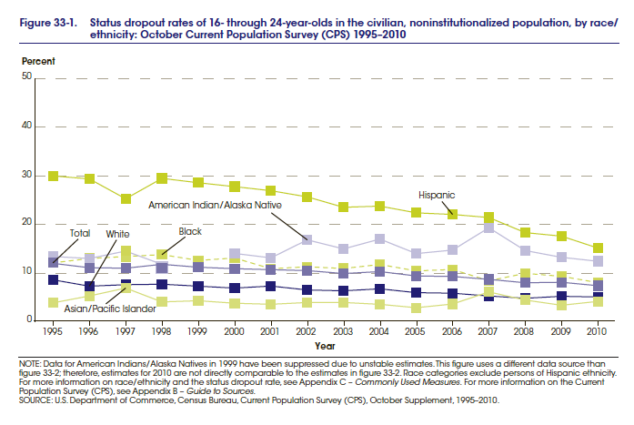
Dropout Rates in the U.S.
Latinos struggling with English
Latinos
Whites
Blacks
Notes:
WHAT TO SAY: This graph shows us the dropout rates of 16 to 24 year olds by race and ethnicity. Note here how the Latino dropout rate is still too high compared to other minorities and whites. The green line at the top of the graph shows dropout rates among Latino students who are identified by school system as English Language Learners (ELL).

Slide 28
What’s Happening in your State?
Resources
U.S. Census
http://quickfacts.census.gov/qfd/states/37000.html
Excelencia for Education
http://www.edexcelencia.org/
NCES
https://nces.ed.gov/fastfacts/display.asp?id=16
Pew Research Center
www.pewresearch.org
NY
NC
TX
Notes:
WHAT TO SAY: Want to learn more about a specific state’s Latino population? You can check out the resources listed here. The U.S. Census Bureau and the Pew Research Center sites will provide information about your state’s population growth. Excelencia for Education, a nonprofit organization based in Washington, D.C., can give you information about college admission for Latinos in your state. The National Center for Education Statistics, or NCES, provides the dropout rates by state and by race.
Now let’s talk about parental involvement and its importance to Latino youth’s academic success.

Slide 29
key
Parents are the Key to Academic Success
Notes:
WHAT TO SAY: Why is it so important that we reach Latino parents? All the research leads to this simple but very true statement. “PARENTS ARE THE KEY TO ACADEMIC SUCCESS!”

Slide 30
Why involve Latino parents?
Immigrant parents are new to the United States’ educational system.
Importance of parent involvement in their child’s academic career.
Parents = the strongest support system for youth.
Empowering parents and youth to come together and take ownership of their educational dreams and goals.
Notes:
WHAT TO SAY: One in five children in the United States is an immigrant or has immigrant parents, according to the National Conference of State Legislatures. Research taken from PewReseach Center says that, “A majority (52%) of the nation’s 16 million Hispanic children are now ‘second generation’, meaning they are the U.S.-born sons or daughters of at least one foreign-born parent, typically someone who came to this country in the immigration wave from Mexico, Central America and South America that began around 1980.”
Source: http://www.pewhispanic.org/2009/05/28/latino-children-a-majority-are-us-born-offspring-of-immigrants/
This means that Latino parents are new to the educational system in this country and need to learn the ways of the system in order to better support their children along their educational path. Research already shows that any youth who has involved parents will do better in school. This program is driven by both the key role parents play in their youths’ lives and the importance of empowering immigrant parents by providing them with the necessary resources and knowledge. Since its inception, Juntos 4-H has made it a priority to focus on guiding parents to establish academic goals as a family.
For more information on immigrant families and dropout rates, visit: http://www.ncsl.org/research/immigration/a-look-at-immigrant-youth-prospects-and-promisin.aspx
To read the article entitled: Latino Children: A Majority Are U.S.-born Offspring of Immigrants, visit:
http://www.pewhispanic.org/2009/05/28/latino-children-a-majority-are-us-born-offspring-of-immigrants/
Check out Module 2 for detailed information on the importance of engaging with Latino parents in order to succeed in getting youth more involved in 4-H and supporting families to achieve academic success.

Slide 31
“Families need to know the path to get their kids to college”
Notes:
WHAT TO SAY: We know what the research says about education knowledge and parental involvement, but what are parents saying about the program? According to one Latino father, “Families mainly need to know the path to get their kids to college.”

Slide 32
“
“Juntos improved our knowledge of college options and the college application process, and improved our communication with our children.” (Juntos parent)
“
Notes:
WHAT TO SAY: Indicating that Juntos 4-H leads families down a path towards education success, one Juntos 4-H parent said, “Juntos improved our knowledge of college options and the college application process, and improved our communication with our children.”
Now that we know why Juntos 4-H is needed, let’s look at the program’s components.

Slide 33
Implementing the Program
Components of Juntos 4-H
Notes:
WHAT TO SAY: There are a total of four components that make up the Juntos 4-H program. Let’s learn what they are.

Slide 34
Four Components of Juntos 4-H
Juntos Family Engagement
Juntos 4-H Clubs
Juntos One-on-one Success Coaching and/or Mentoring
Summer Programing
Notes:
WHAT TO SAY: Today, the Juntos 4-H program has grown to include a 5-week Middle School Family Engagement Workshops Curriculum, a 6-week High School Curriculum, 4-H clubs, Success Coaching and/or Mentoring, and summer programing.
It is important to note that the enthusiasm of parents, youth, cooperative extensions (4-H and FCS), and schools, who continue to work together, led to the development of all four core components.
After experiencing the family workshops, families requested that Juntos 4-H provide a way for youth to get involved in extracurricular activities, which drove the Juntos 4-H leadership to partner with state and local 4-H professionals to support 4-H clubs.
School staff, youth, and parents also commented that the students need more one-on-one attention to guide their academic paths, which led to success coaching and mentoring, while giving students a full college experience came from hearing parents and youth say they had never visited a campus of higher education.
All four components have been built using research-based best practices, which have shown to support family engagement, youth development, and academic success.

Slide 35
Family Engagement and 4-H Clubs
Family Engagement and 4-H Clubs are the core of the Juntos 4-H Program.
No other Juntos 4-H component can be implemented without having the two core components.
Notes:
WHAT TO SAY: Serving both parents and youth is the core of Juntos 4-H! Although the goal is to implement all the components extensively, the two core components that drive the program are Family Engagement and 4-H clubs.
It’s also important to note that, with strong partnerships, these two components have little to no cost in implementation. Please note that no other Juntos 4-H component can be implemented without having the two core components that engage both parents and youth.
Note to Trainer: Finish by stating that detailed implementation of each component with timeline, costs, and resources needed is available in modules 2 to 5.
Now, let’s take a look at each component.

Slide 36
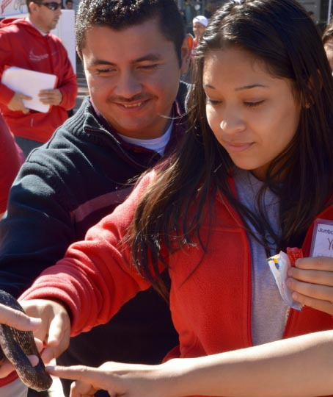
Component #1
Family Engagment
Notes:
WHAT TO SAY: The Juntos 4-H Family Engagement starts with either a 5-week Middle School Workshop Series or a 6-week High School Workshop Series, and follows with ongoing Family Nights throughout the school year. The workshops follow a consecutive week cycle, while Family Nights follow a schedule that both families and organizers determine. It is recommended that the 5-week Middle School Workshop Series be introduced in 7th and/or 8th grade. Eighth grade has been the start-up grade of North Carolina sites due to the focus on the successful transition from middle school to high school. The best time to implement the Middle School Workshops has been fall semester of 8th grade, although 7th grade spring semester is also an option.
The high school curriculum has been administered with families and youth in grades 9 to 12. Keep in mind that many 12th grade youth and parents who attend the sessions report their regret at not gaining the knowledge and resources learned earlier in the students’ academic careers. We’ll learn about the topics for the Middle School and High School Workshop Series shortly.
It’s important to note that two bilingual facilitators are needed to lead each workshop. As the majority of the time the bilingual facilitators are from the community and/or new to Extension, it is highly recommended that Extension staff attend the session or at least plan to attend the first and last session if the ultimate goal is to build trust with the families.

Slide 37
Topics for the 6-Week High School Workshop Series
Making education a family goal
Family and school communication
Requirements for graduation and more
How to finance higher education
Applying for college and more
Creating a plan of action
Notes:
WHAT TO SAY: These are the topics that are covered as part of the High School Workshop Series. Overall goals for the high school curriculum include: to heighten family awareness so that academic success and college attendance is a realistic goal; to build on communication between youth, parents, and school staff; to help families understand requirements for high school success and graduation; to increase youth’s skills and knowledge of the college application process; to increase the sense of belonging among Latino students and families in their schools and communities; and to increase family engagement that leads to students’ educational success.

Slide 38
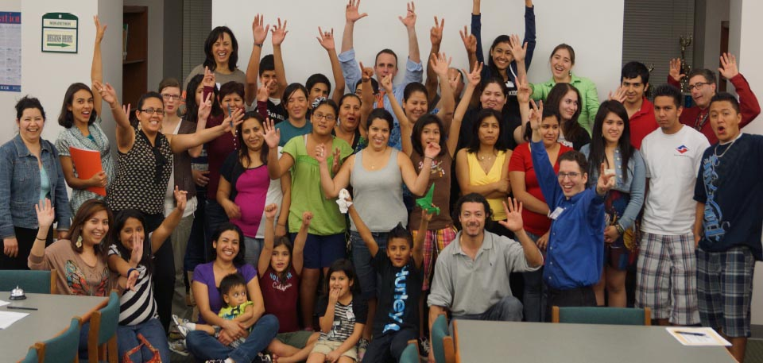
The last Family Workshop ends with a celebration and a discussion of what’s next for the group
Notes:
WHAT TO SAY: Once the workshops come to an end, you should take the time to celebrate the youth and parents for committing their time and energy to participate! Along with time to celebrate the completion of the workshops, the last Middle and High School Workshop sessions should allocate time to discuss next steps.
This is the time to share the other Juntos 4-H components you plan to offer and develop in the community. This is also a perfect time to have extension staff (4-H and FCS) briefly share extension resources with the families. The goal is to get families excited about the next stage of Juntos 4-H and to schedule a follow-up meeting with the group.
A more detailed outline of Family Nights after the workshops will be introduced in Module 2.

Slide 39
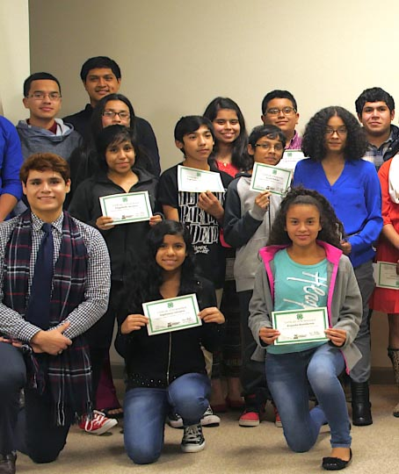
Component #2
Juntos 4-H Clubs
Notes:
WHAT TO SAY: Now we’ll move onto the second component of Juntos 4-H: the 4-H clubs. What do you know about 4-H or why do you think a program like Juntos 4-H that serves Latino families can benefit from 4-H?
Note to Trainer: Ask the questions that best fit your participants’ experiences with 4-H. Have individuals raise their hands and share what they know about 4-H with the rest of the group.
Let’s learn more about how 4-H clubs are benefiting Latino youth.

Slide 40
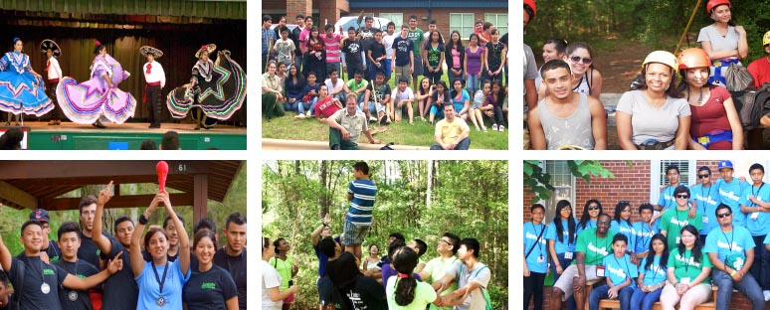
Juntos 4-H Clubs: Focus on Academic Success
Notes:
WHAT TO SAY: There are a few important facts to know about Juntos 4-H afterschool or community clubs.
First, the clubs are built around the youth’s goal to achieve academic success. They also enable students to support their peers in achieving their academic goals.
Second, the 4-H clubs provide youth with access to research-based curricula in areas that support their life skills development and academic success goals. As you will learn or may already know, Latino youth often lack access to youth-adult relationships, so 4-H clubs foster relationships in such a way that Latino youth connect to adults outside of their family. 4-H clubs also provide peer interaction, which gives youth a sense of belonging. This is especially important for newly immigrant and minority youth who may be struggling to belong in mainstream society.
Third, there are several ways for clubs to meet. These include after school at the school where the majority of members go, at the local extension center if feasible for students and families, or at any other community location on which families agree and where transportation is not an issue. Another possibility can be during school hours when a school allows for a club period/time during the day at set dates and times during the month. Note: The majority of current clubs take place after school at the school where most of the members attend.
Lastly, the support of state and local 4-H leadership is required and crucial for youth and families to gain an understanding of the culture and benefits of 4-H.
Let’s look at why the framework of 4-H is of great benefit to Latino youth in our communities.

Slide 41
Purpose of a 4-H Club
To provide positive youth development experiences through an intentional process that provides:
opportunities
choices
relationships
support
Notes:
WHAT TO SAY: 4-H is in the business of providing positive youth development experiences for our youth. It does this in four ways:
It creates an intentional process that provides opportunities for youth.
It gives youth choices.
It builds relationships.
It supports youth in reaching their full potential.

Slide 42
What Do 4-H Clubs Provide?
Long-term involvement in a stable setting.
Interaction with caring adults.
In-depth experiences.
A chance to make life-long friends.
Opportunities to develop and practice leadership skills.
Space to gain self-confidence.
Learning by doing.
Notes:
WHAT TO SAY: Depending on areas of focus, 4-H clubs can provide youth with unique opportunities. These include … (read from slide).
These positive experiences and resources align perfectly with Juntos 4-H’s goal to support Latino youth who are under-represented in the 4-H youth population, and who often struggle through their academic journey.

Slide 43
Juntos 4-H Clubs’ Focus Areas
Areas of interest for 4-H clubs
Life skills
Leadership development
Public speaking
Community service
Healthy living (physical activity, emotional mental, and social health)
Career focus introduction and development
Services within 4-H clubs
Mentoring
Homework help/tutoring
Career and professional shadowing
Cultural identity focus
Notes:
WHAT TO SAY: Areas of interest that have been successful in Juntos 4-H clubs due to youth interests include community service, public speaking, leadership development, life skills development, job and professional shadowing, mentoring, homework help/tutoring, and healthy living (i.e. soccer, dance, etc.).
Juntos 4-H clubs in various communities are not limited to these areas of interest, however. No matter what youth’s interest areas may be, adult leaders should ALWAYS take the time to lead youth through a discussion of how their interest areas will support their path towards the goal of achieving high school graduation and higher education.
Parents should also be made aware of what youth are doing during clubs, and how projects, educational experiences, and activities are supporting the youth’s path to academic success. The best way to share with parents is to have the youth present what they are doing during their club time at Family Nights. Module 3 provides more detailed information and describes the processes that showcase how to best serve Latino youth through Juntos 4-H.

Slide 44
Message from a Juntos 4-H’er
“
“Juntos 4-H has given me the opportunity to meet other Hispanic youth with similar backgrounds as me. It has made a better leader out of me and has helped me strive for higher education. I am starting at a 4-year college in the Fall and I have Juntos 4-H to thank!” (Kerry Aguilar)
“
Notes:
WHAT TO SAY: Can I please get a volunteer to read what a Juntos 4-H'er had to say about the program?

Slide 45
Component #3
Success Coaching and Mentoring
Notes:
WHAT TO SAY: Let's now learn about Success Coaching and Mentoring, the third Component of the Juntos 4-H Program

Slide 46
What is Success Coaching?
Success Coaching is a structured and trusting one-on-one relationship that brings youth together with a caring individual who offers guidance, support, and encouragement.
Notes:
WHAT TO SAY: The third component of the Juntos 4-H program is success coaching and mentoring. This component relies on a structured and trusting one-on-one relationship that brings youth together with a caring individual.
This individual, trusted by the school and community, offers guidance, support, and encouragement aimed at achieving students’ goals, with an emphasis on graduation and college access.
Implementing success coaching requires either funds to pay an individual to work in and with schools, to have a school commit the time of a staff member who can undertake success coaching, or to have a trusted volunteer who can commit to meeting with Juntos 4-H youth once a month or as needed.
Through success coaching, personnel build relationships with the parents or guardian of the youth in order to support academic progress, become an advocate for the youth in the school and their community, and provide resources and guidance to support youth academic progress.

Slide 47
Facts about Success Coaching
Positive impact on students’ academic success.
Another individual focusing on and invested in youth’s academic success.
An advocate (for students and parents).
Provides ongoing guidance, tools, and resources to youth and parents.
Notes:
WHAT TO SAY: Bill Milliken, the founder of Communities in Schools, has said that, “Programs don’t change kids, RELATIONSHIPS do. Every child needs one adult who’s irrationally committed to his or her future.”
Through success coaching, one-on-one relationships lead to positive impacts because the focus is on the youth and their individual academic goals. The personal contact creates a natural process for the youth and their parents to have an advocate on their side. Ultimately, this core component offers many resources on an individual level to youth and their parents.

Slide 48
Success Coaching requires…
Creative partnerships or grant funds to hire committed paid or unpaid professionals.
Quality training to set the person up for success.
A tracking system and documentation tools to:
capture the progress of students; and
provide quantitative and qualitative data to support students and share with stakeholders (e.g. schools system and funders).
Notes:
WHAT TO SAY: In order to provide success coaching, you will need a plan to pay for personnel or partner with another organization like Teach for America, Americorps etc. to ensure that a long-term individual with professional experience can take on the role of success coach. You can also reach out to schools that can choose to allocate a percentage of a staff member’s time to success coaching.
Alternatively, you can seek partnerships with other organizations that provide success coaching to youth. For instance, you may partner with Communities in Schools so you can carry out other components of the Juntos 4-H program while they are responsible for success coaching. You may even apply for grants that will enable you to hire part or full time staff, depending on student needs and staff responsibilities.
In North Carolina, grants have allowed the program to hire part-time and full-time staff who can carry out success coaching and coordinate the other components of Juntos 4-H. New York Life Foundation funds are also enabling Texas, New York, and Florida to hire staff to take on success coaching.
Success coaching requires professional training to ensure purpose and quality; training provides staff with the best tools to capture the academic progress of youth. In addition, training for success coaching provides a documentation process that captures the progress of students and provides quantitative and qualitative data that can be used to better serve families and share with stakeholders (e.g. school personnel and funders).

Slide 49
What the experts say…
“
“Academic coaching is an ongoing partnership to help students produce fulfilling results in their lives. Through the process of coaching, students deepen their learning, take responsibility for their actions, improve their effectiveness, and consciously create their outcomes in life.”
“
Notes:
WHAT TO SAY: In an interview, Carol Carter said that… [read slide]. As you can see, success coaching can play an important role in shaping students’ academic paths. Module 4 will further explain the role of success coaching, the tools used to capture the individual sessions with the youth, and the costs associated with success coaching.

Slide 50
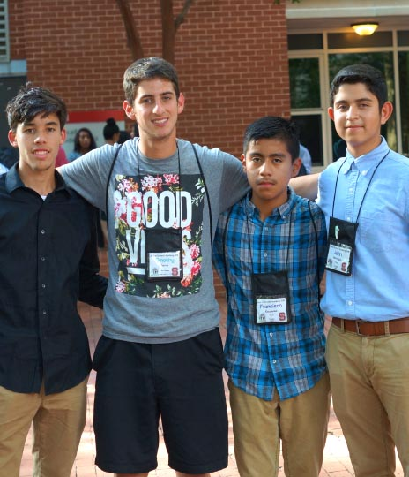
Juntos 4-H Mentoring
Notes:
WHAT TO SAY: Mentoring in Juntos 4-H is developed over time.

Slide 51
What is Mentoring?
A structured and trusting relationship aimed at developing the competence and character of the mentee.
Notes:
WHAT TO SAY: Juntos 4-H mentoring provides another resource to Juntos 4-H youth to focus on achieving academic success.
Mentoring is a structured and trusting relationship that brings young people together with caring individuals who offer guidance, support, and encouragement aimed at developing the competence and character of the mentee.

Slide 52
Mentors in Juntos 4-H
Provide resources, guidance, time, and a positive example.
Have experience and/or passion working with Latino youth.
Support and believe in the efforts and mission of the Juntos 4-H program.
Notes:
WHAT TO SAY: Volunteer mentors can be older peers, for instance a 7th or 8th grader can be paired with an 11th or 12th grader. College students have also shown to be great mentors for Juntos 4-H youth, as they are embodiments of a future academic goal: to attend college. In North Carolina, college students are paired with 11th and 12th graders. Older adult volunteers provide resources and knowledge that support the parents of the youth.
The key to recruiting Juntos 4-H mentors is to ensure that possible mentors have experience and/or an interest in working with Latino youth and believe in the Juntos 4-H mission. Juntos 4-H mentors follow the same protocol as 4-H volunteers. Juntos 4-H mentoring can be managed by an extension staff member or a hired Juntos 4-H program coordinator who can recruit, train, and maintain a strong mentoring system.

Slide 53
Mentoring Supports your 4-H Program
Juntos 4-H mentors can become advocates and spokespeople for your 4-H program.
Bilingual mentors can help non-bilingual staff communicate with parents and the Latino community.
Outreach to college students (e.g. community college and 4-year students.)
Notes:
WHAT TO SAY: Having Juntos 4-H mentoring supports the 4-H program in various ways. For one, it grows your volunteer base as you recruit mentors for youth. These volunteers will ultimately become a 4-H “face” in the schools and Latino communities that Juntos 4-H serves.
In addition, mentors who are bilingual bring not only their second language skills but also their bicultural knowledge, which can help you further connect with the Latino community. Finally, reaching out to college students expands your community outreach and opens doors to building relationships with college staff and faculty.
In fact, North Carolina has experienced a growth in passionate Latino college students who have taken on the leadership of mentor recruitment and training under staff guidance.

Slide 54
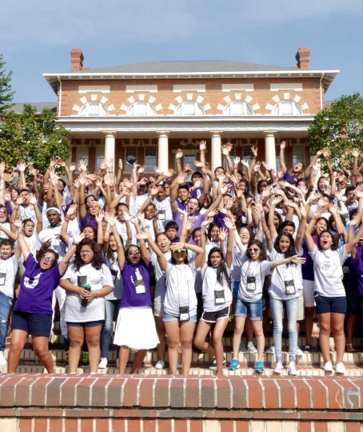
Component #4
Juntos 4-H Summer Program
Notes:
WHAT TO SAY: Now we will learn about the fourth component of the Juntos 4-H Program, its Summer Academy and other local summer programming.

Slide 55
Overnight Trips to a University Campus
Goal: To give Juntos 4-H youth a taste of the college experience.
Notes:
WHAT TO SAY: The purpose of the Juntos 4-H Summer Academy is to provide youth in the program with a college experience. The Academy equips students with the knowledge and tools that encourage them to be more committed to the pursuit of high school graduation and higher education.
The experience can be as short as one overnight stay to as much as a week-long stay at the university. The length of time will depend on funds available and partnerships with the land-grant university or other local universities. A Summer Academy can only happen with strong partnerships and a staff member who is connected to the university hosting the event.
The Summer Academy takes months to plan and a planning committee is vital for success.

Slide 56
Youth attend classes, meet professors and college students, and learn about career options.
Notes:
WHAT TO SAY: During Academy, youth learn about different majors and careers at the university, attend classes and workshops, participate in recreational activities, and stay in the college dorms.

Slide 57
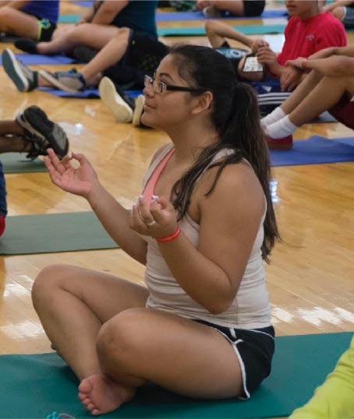
Health Seminars
Notes:
WHAT TO SAY: Classes and workshops can include, but are not limited to, professional panels, college student panels, STEM focus subject matters, goal-setting, financial matters (e.g. how to pay for college), male and female dialogues, and health sessions at the university gym.

Slide 58
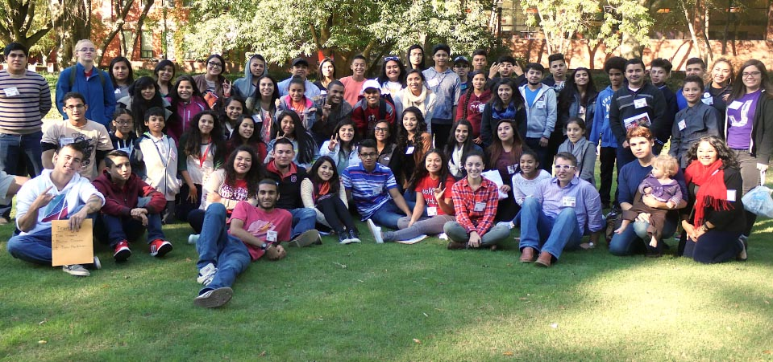
College students mentor and guide the youth
Notes:
WHAT TO SAY: Youth are also connected to college students who become their team captains, or mentors, for the duration of Academy. This connection to college students serves to create positive role models whose paths to higher education youth can emulate as they, too, aspire to become college students.

Slide 59
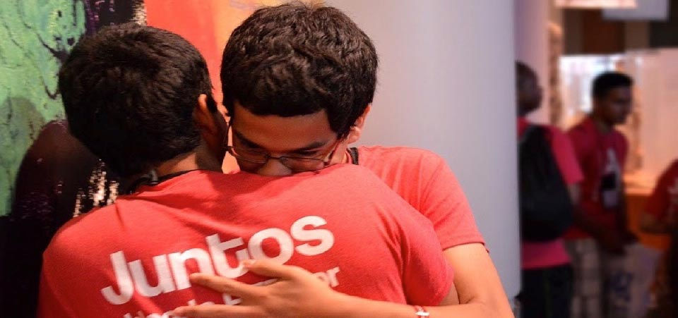
Lasting memories and relationships are made
Notes:
WHAT TO SAY: During the Juntos 4-H summer programs lasting memories and relationships are made.

Slide 60
Why Summer Academy?
It is a promising intervention which can guide first generation and low-income potential college students as they explore higher education.
It promotes and can lead to a strong college-going culture.
It provides a space for Latino students to gather with their common backgrounds and cultures and experience college together.
Notes:
WHAT TO SAY: Why is this type of experience important for youth?
In January 2014, the Executive Office of the President revealed promising models and a call to action report titled, ‘In the Increasing College Opportunity for low-Income Student.’ This report identifies summer enrichment programs like the Summer Academy as being promising interventions that can guide first generation and low-income potential college students, as it helps them to explore the idea of higher education and promote a strong college-going culture.
Source: https://www.whitehouse.gov/sites/default/files/docs/white_house_report_on_increasing_college_opportunity_for_low-income_students_1-16-2014_final.pdf
In the years that Juntos 4-H has been in existence, the majority of its youth have come from low-income homes and identify as future first generation college students. The Juntos 4-H Academy provides students who have a common background and culture with an opportunity to step into a college student’s world.
Summer does not have to end with the Academy experience; local 4-H summer programs can also become part of Juntos 4-H youth’s summer experience.

Slide 61
Local 4-H Summer Programming
A Summer program schedule provides:
opportunities for youth and their parents to learn more about 4-H,
connections among Juntos 4-H youth, and
a chance to build a community and watch youth grow from experiences.
Notes:
WHAT TO SAY: With strong commitments from local 4-H agents, Juntos 4-H youth will be connected to summer schedules in their counties and participate in day and overnight campus events.
These events will bring more unity and understanding about 4-H for a population that is new to its resources and benefits. State 4-H can also provide opportunities for youth to participate in state summer programming.
Counties that have given Juntos 4-H youth summer opportunities have benefited from watching these youths become 4-H program club leaders and spokespeople. Youth share their experiences at Family Nights or club meetings, which gives parents and other youth concrete examples of all that 4-H has to offer.

Slide 62
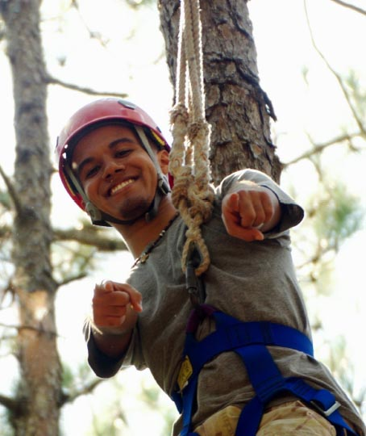
National Growth
Notes:
WHAT TO SAY: Now that we have learned the four core components of the program, let’s take a look at where it is currently implemented

Slide 63
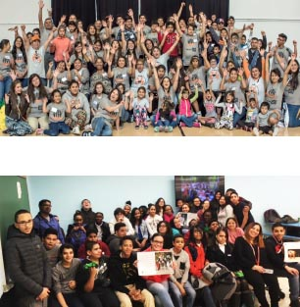
Nationally
Oregon 4-H
North Carolina
Iowa
Oklahoma
Oregon
New York
Texas
Florida
New York 4-H
Notes:
WHAT TO SAY: Juntos 4-H is a growing program. After starting in North Carolina, it has expanded to other states in the nation. As not all states are implementing all four components, their partnerships and/or funders can look very different. In order to be considered an official Juntos 4-H program, states must partner with Juntos NC and together develop an agreement. This agreement protects the program’s fidelity and includes training, technical assistance, and evaluation as needed by the new states.

Slide 64
Quotes from the youth and parents
Notes:
WHAT TO SAY: Before ending this module, let’s see what youth and parents had to say about Juntos 4-H. The following quotes were taken from focus groups in North Carolina after youth had completed at least one full year in the program.

Slide 65
“
“Juntos has helped me a lot. I have learned to be a better leader and it kept me motivated for what I want for my future and to never give up on myself.” (Juntos youth)
“
Notes:
WHAT TO SAY: During an end-of-year programing focus group, a youth participant said, “Juntos has helped me a lot. I have learned to be a better leader and it kept me motivated for what I want for my future and to never give up on myself.”

Slide 66
“
“As he got involved with Juntos, he has advanced more, and he has been determined to have better grades because he knows that by having better grades he can qualify for a scholarship. So, honestly, it has helped him, it has benefited him greatly.” (Juntos parent)
“
Notes:
WHAT TO SAY: Talking about his son, one parent said, “As he got involved with Juntos, he has advanced more, and he has been determined to have better grades because he knows that by having better grades he can qualify for a scholarship. So, honestly, it has helped him, it has benefited him greatly.”
This concludes Module 1 Overview of the Juntos 4-H Program.

Slide 67
A special thank you to:
National 4-H for leading the way in believing in Juntos 4-H, supporting the work, and engaging with partners to ensure that more states benefit from the program;
New York Life Foundation for their commitment to youth and Latino families.
The families and youth that make up Juntos 4-H.
Notes:
WHAT TO SAY: A special thank you to the National 4-H Council for leading the way in believing in Juntos 4-H, supporting the work, and engaging with partners to ensure that more states benefit from the program. We also especially appreciate the New York Life Foundation for their commitment to youth and Latino families. We also would be remiss if we didn’t thank the families and youth that make up Juntos 4-H.

Slide 68
Notes:
WHAT TO SAY: Last but certainly not least, we thank you for taking the time to learn about the Juntos 4-H Program.

