Slide 1
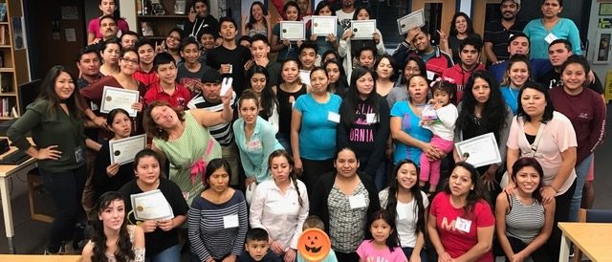
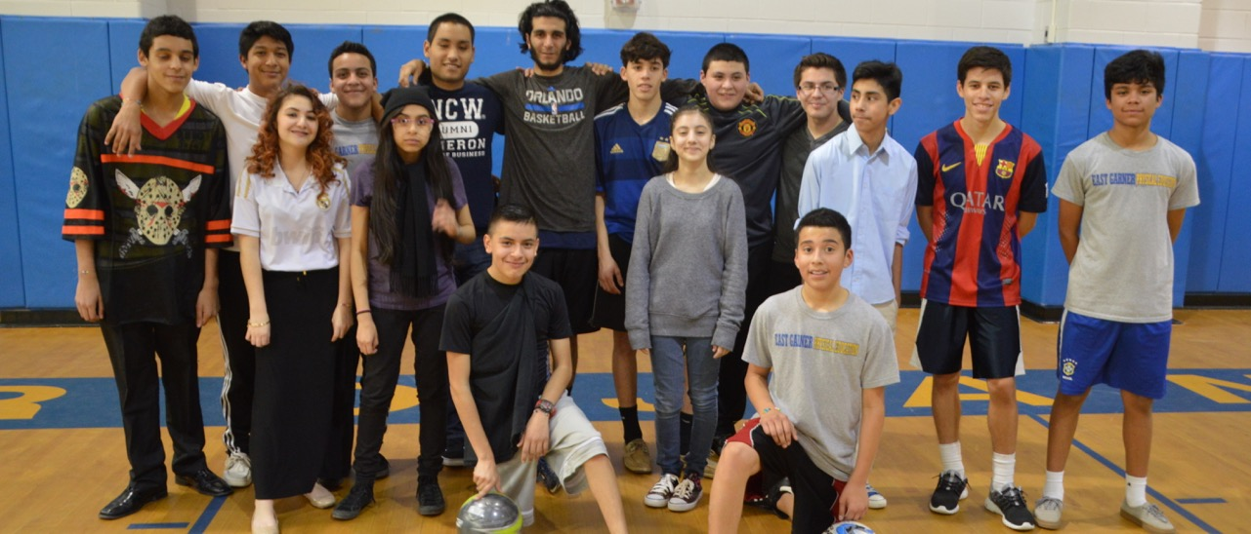
Module 3: 4-H Clubs
Notes:
WHAT TO SAY: Welcome to Juntos 4-H Module 3 on 4-H Clubs. This module will inform 4-H Agents (or educators), Family Consumer Science (FCS) professionals, volunteers, and community partners about four key areas that will lead to the successful implementation of Juntos 4-H Clubs.
Module 3 is the third in a series of five Juntos 4-H modules, all of which have been made possible through National 4-H Council’s partnership with NC State University and the New York Life Foundation.

Slide 2
Recap from Family Engagement module 2
Core of the program
Family engagement is ongoing
It takes a team to achieve success
Cultural considerations leads to strong relationships
Notes:
WHAT TO SAY: In Module 2 we learned what family engagement looks like within the frame of the Juntos 4-H Program.
Let’s recap what we learned:
1. Without Family Engagement, Juntos 4-H cannot be implemented.
2. Family Engagement includes a middle school and high school Family Workshop series, bi-monthly Family Nights, and special family events throughout the academic school year.
3. Extension Agents (FCS, 4-H Agents, etc.) and community partners working together results in the success of the Juntos 4-H Program.
4. Juntos 4-H embraces the Latino cultural value of familismo, which leads program facilitators to build stronger relationships with families and their communities.
Now, let’s talk about 4-H Clubs within the Juntos 4-H Program.

Slide 3
4-H Clubs: A Core Focus of Juntos 4-H
Implementing 4-H clubs is a required component of Juntos 4-H
None of the other components may be implemented without implementing the Family Engagement and 4-H Club component
Notes:
WHAT TO SAY: Like Family Engagement, under the Juntos 4-H partnership, 4-H Clubs are a required component of the program.
As mentioned previously, none of the other components may be implemented without conducting both Family Engagement and the 4-H Club components.

Slide 4
Module 3: Juntos 4-H Clubs
Understanding Cultural Considerations of Juntos 4-H clubs
Planning for Juntos 4-H Clubs
Implementing Juntos 4-H Clubs
Retaining Engaged Juntos 4-H’ers
Notes:
WHAT TO SAY: Today we will look at four key areas that make Juntos 4-H Clubs effective.
1. Understanding the cultural considerations of Juntos 4-H Clubs.
2. Planning for Juntos 4-H Clubs.
3. Implementing Juntos 4-H Clubs.
4. Retaining youth in Juntos 4-H Clubs.
Let’s start the 4-H Club module with a 4-H tradition.

Slide 5
4-H Pledge
Notes:
WHAT TO SAY: Who can start us out with the 4-H pledge in English?
I pledge:
my head to clearer thinking, my heart to greater loyalty, my hands to larger service, and my health to better living, for my club, my community, my country, and my world.
Note to trainer: Encourage a participant who knows the pledge well to lead. If your group does not have a member who is familiar with the pledge, have someone read it while you perform the motions that follow each line.

Slide 6
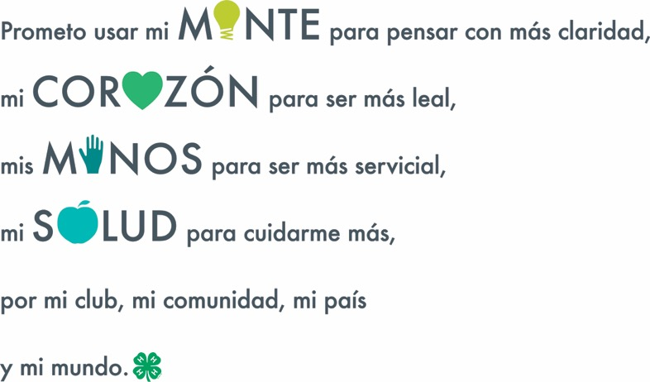
4-H Pledge in Spanish
Notes:
WHAT TO SAY: Who would like to say the pledge in Spanish?
Promesa 4-H
Prometo usar:
mi mente para pensar con más claridad,
mi corazón para ser más leal,
mis manos para ser más servicial,
mi salud para cuidarme más,
por mi club, mi comunidad, mi país y mi mundo.
Note to Trainer: If no one in the group volunteers to read the pledge aloud, you can practice it and recite to the group. You can also be creative and record a native speaker saying the pledge or play a video/audio clip. If you have a large group of learners who are not familiar with the meaning of the pledge, take time to show the link provided below:
https://youtu.be/HEhisaDNtOw
End by saying: In this module, we will discuss ways to help Latino families learn to trust the 4-H program. Once families have a better understanding of 4-H, including the meaning of the pledge and the history and culture of 4-H, it’s important to get in the habit of saying the pledge in both languages. We encourage you to recite the pledge at the beginning of all Club meetings, as well as during each Family Night following the Family Workshop series.
Be creative and have fun in how you share the meaning of the pledge with the youth and families, for example:

Slide 7
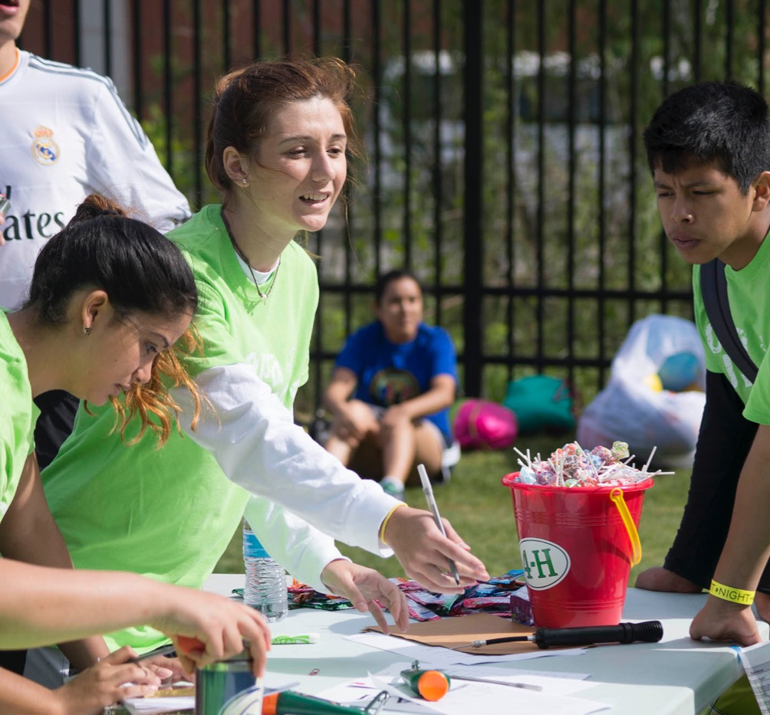
Activity
Share the meaning of the 4-H Pledge
Notes:
WHAT TO SAY: Let’s participate in an activity you can do with the youth and parents to discuss the meaning of the 4-H pledge.
SAY: The 4-H pledge tells us the meaning of 4-H and the goal to develop the youth in four areas: Head, Heart, Hands, and Health.
Let's break up into four groups and create a poster where we can visualize the meaning of the pledge.
Ask the participants to count off to four and remember their number. Designate a space for each group to work on their poster.
Tell participants to use their poster or flip chart sheet to draw an image or images symbolizing what their assigned part of the pledge means to them. Groups have six minutes to complete their task - two minutes to discuss and agree on what their assigned part means to them, and four minutes to draw their picture.
Rules: Everyone in the group must participate in the drawing. Each group will select the person who will present their drawing to the whole group.
End the activity by allowing each group to share their image’s meaning.
Close by saying that this activity is a great way for families to work together to identify what the 4-H pledge means to them. It allows families to take ownership of the pledge as they are able to incorporate their values and personal meanings around the key words within the pledge, such as: clearer thinking, greater loyalty, larger service, and better living.
Note to Trainer: To make the activity go faster, have the posters/flip chart sheets ready with each part of the pledge written on top. For example:
Group 1 - My Head to clearer thinking. Group 2 - My Heart to greater loyalty.
Group 3 - My Hand to larger service.
Group 4 - My Health to better living.

Slide 8
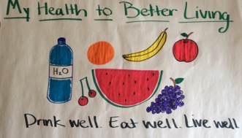
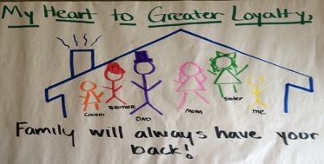
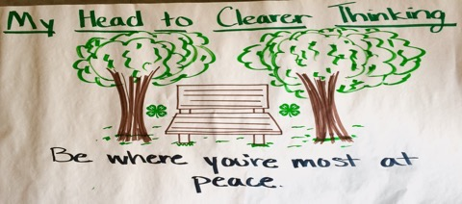
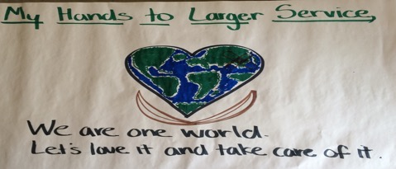
Samples from a 4-Her
Notes:
WHAT TO SAY: Take pictures of each poster or flip chart sheet so you can present them at future Family Nights or Club meetings as you say the pledge. You can also safely store the actual posters or flip chart sheets and put them up in the room you use to meet with youth and families. Be creative in how you remind them of their 4-H Pledge meaning.
Lastly, remind the learners not to make the mistake of simply saying the pledge without taking the time to process its meaning and purpose. Failure to share the purpose of the 4-H pledge could lead to families never really taking ownership of its meaning and value.
Materials Needed for Activity: Four posters or flip chart sheets, colored markers, and a timer.

Slide 9
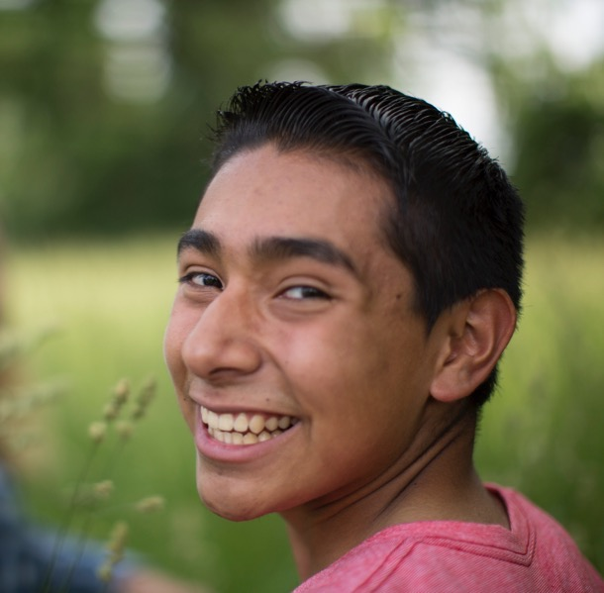
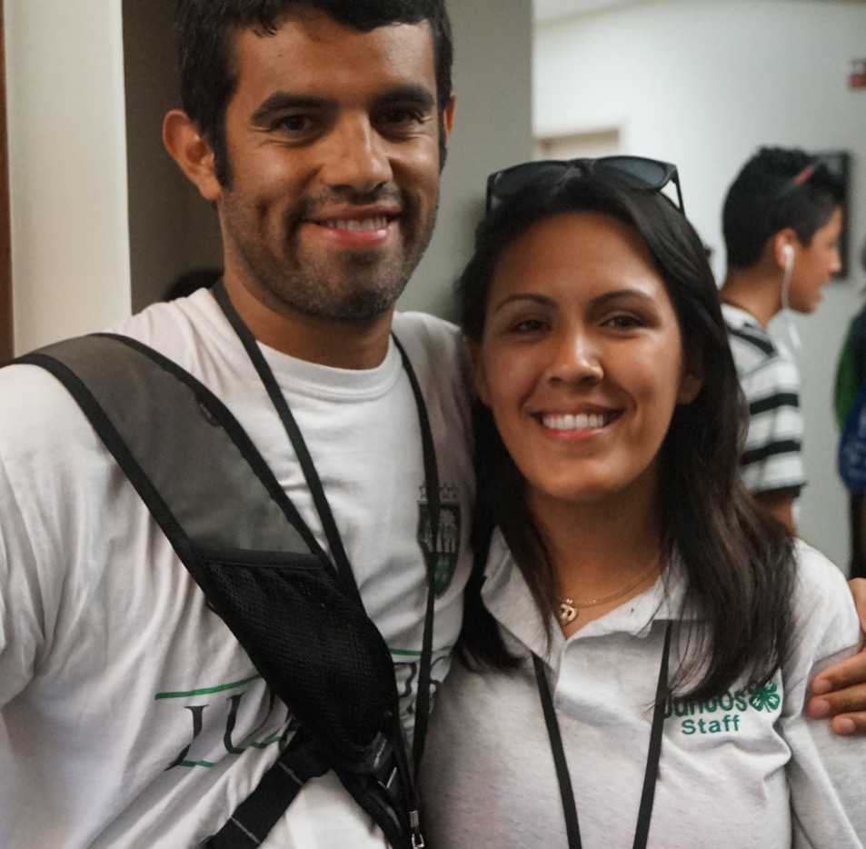
Juntos 4-H Clubs
Cultural Considerations for
Juntos 4-H clubs
Notes:
WHAT TO SAY: Let’s discuss how to inform Latino families about 4-H and how to create an environment where families grow to understand it better. We will discuss cultural considerations that 4-H Agents, FCS Agents, volunteers, and community partners need to think about as they work to grow sustainable 4-H Clubs among Latino youth and their families.

Slide 10
Three Cultural Considerations
Many Latino families are new to 4-H
Clubs have different meanings in different parts
of North, Central and South America
3. Familismo must be part of the club
Notes:
WHAT TO SAY: There are three cultural considerations that 4-H Agents and volunteers need to know if they plan to support a Juntos 4-H Club, or any club that engages Latino youth and their families (especially immigrant, first- and second-generation Latino families).
1. Understand that 4-H is new to many Latino communities across the nation. Many Latino families do not know what 4-H is and are unfamiliar with the history of Extension in their communities.
2. Recognize that the term ‘club’ has different meanings in some Latin American countries. In some cases, Latin Americans think of ‘clubs’ as expensive sport youth clubs or elite social clubs that only the rich can afford. In other cases, Latinos may think of nightclubs. To avoid misunderstandings, ask families to say the first word that comes to mind when they hear the word ‘club’. This way you can learn what they know and also clarify what is meant by a 4-H Club.
3. Make sure that familismo is a part of the Juntos 4-H Club culture. Remember that Latinos are strongly connected to family members and put family first.
Keep in mind: If a parent comes to appreciate what 4-H has to offer their youth, youth are more likely to engage in 4-H long term.
While there are many other cultural considerations that could be covered in this module, the program has found that these three are particularly vital to engaging the whole family in 4-H. Strong family engagement has resulted in building trust and commitment to the program among families.

Slide 11
Introducing 4-H Clubs to Latino Families
Notes:
WHAT TO SAY: Now we’ll focus on the cultural considerations that are important for Family Engagement. The following slides will cover cultural considerations that will support your work when implementing Juntos 4-H or any other Extension program where you intentionally reach out to the Latino community.

Slide 12
Telling the 4-H Story
Share the history of 4-H
Once youth know the 4-H story, have them share it
with their families
Allow families time to develop trust
Be creative and have fun!
Notes:
WHAT TO SAY: Let’s break down each of the cultural consideration with examples of what Juntos 4-H has done to engage families.
Tell the 4-H story in a way that personalizes it to the youth and families you are serving. Let them know that farmers in the early 1900s did not readily accept the new developments in agriculture that universities showed would help their crops. Instead, university faculty reached out to rural youth through forming Tomato and Corn Clubs and taught them ways to use their new innovations to grow award-winning crops.
For more on the 4-H story, see: http://4-h.org/about/history/. After briefly talking about the 4-H history, share how the 4-H program develops youth today. Give examples of programing in your own community that specifically introduce what is being done to support youth’s college and career readiness.

Slide 13
Tell the 4-H Story Example
Reflect on the similarity of the start of 4-H to
Juntos 4-H
Showcase Today’s 4-H
Allow families to highlight what they found
interesting from what 4-H has to offer
Notes:
Slide: Tell the 4-H Story Example
1. Relate the start of 4-H to the experience many immigrant families face today, where it’s the youth who learn how the educational system works before their parents do. Juntos 4-H is the partner that is able to bring youth, parents, schools, and other community partners together so families learn to navigate the educational system and reach their educational goals for their youth.
2. Today there are still 4-H Clubs that focus on agriculture, but we do so much more. After you share what your local and state 4-H has to offer, provide time for youth and parents to make a list of what sounded interesting to them about what 4-H has to offer in their communities.
Once you start a Juntos 4-H Club, come up with creative ways for the youth to tell their 4-H story and share their experiences during Club with their families.
3. Make sure you always introduce an element of fun when you share the 4-H story. Take time to ask the youth and their parents what they understand about 4-H. As your time with the families continues year after year, it will be the parents and youth who will share their 4-H story with new families.

Slide 14
The Meaning of 4-H Clubs
Share what 4-H clubs are in creative ways
Learn what families think of clubs
Notes:
During the program kick-off or informational session, a 4-H Agent or 4-H volunteer can briefly share what 4-H Clubs are and what they offer to youth. If time permits, a 4-H Agent or 4-H volunteer/leader can provide some hands-on activities that the families can experience to help them learn about the benefits of being in a 4-H Club.
Make sure to explain that 4-H Clubs are an extra-curricular activity, which is valued in college applications. Remind families that there are other clubs in the school and community in which youth can participate that can also support their academics as well as personal interests and goals.
Please note that families will learn more about extra-curricular activities during their participation in the middle and high school Juntos Family Workshop Series.
There is no harm in asking what families think and know about clubs. Over time you will understand what preconceptions families have and how to best explain the concept of clubs to them.

Slide 15
The Meaning of 4-H Clubs
Example Activity: Separate youth and parents by having them in opposite sides of the room. Give them one minute to write down as many benefits they think 4-H Clubs can have on youth. Ask them to appoint a scriber and presenter who will write down their ideas and present to the larger group. The group with the longest list will get free candy.
Notes:
An example activity that can be implemented with the families is to separate youth and parents by placing them on opposite sides of the room, then give them one minute to write down as many benefits as they can from being a part of a 4-H Club. Ask them to appoint a scribe who will write down their ideas and share them with the larger group - the group with the longest list gets free candy.
The 4-H leader or Juntos 4-H staff should take time to add any benefits of 4-H Clubs that were not mentioned by the families, and highlight some from their list that connect well with 4-H Clubs.
Ask the youth and parents what they thought of this activity. Did they learn anything new about 4-H Clubs?
This activity can take 15 minutes or more depending on discussion time. Always be mindful of time and how much you want to spend on this activity.
Note to Trainer: Let the learners know that this activity can be introduced at a at a family night or Juntos 4-H Club meeting where only youth participate. If introduced at a Juntos 4-H Club meeting, prepare youth leaders to lead this activity with parents with support from an adult leader during a family meeting.

Slide 16
The Meaning of 4-H Clubs
Best way to show 4-H! Have the youth share
their experience
Invite and welcome families to 4-H events
Focus on building trust and understanding about
4-H will follow
Time is on your side!
Notes:
WHAT TO SAY: Let’s continue to address the meaning of 4-H Clubs as we consider the Latino culture.
As Clubs develop and become more established, have the youth present what they do at their 4-H Club to their parents during a Family Night. This has proven to be the best way to allow parents to hear and see how 4-H Clubs help their children be successful. Hearing from their children gives parents a real perspective of what 4-H Clubs mean.
For example: Youth worked on a sustainability project for the county fair where they created artistic butterflies out of recycled plastic water bottles. Students could share how they came up with the idea, what sustainability is, why they chose this project, how it was presented at the fair, and what they learned.
Invite families to other 4-H events that have bilingual staff and/or volunteers and resources so that they can engage during the event. This is a great way for families to feel they are part of the 4-H community.
Focus on building strong relationships with families. Show true interest in their child(ren) before expecting them to trust the 4-H system. Youth and their families will trust the 4-H leaders before they will trust 4-H as an organization.
As Clubs develop and become more established, have the youth present what they do at their 4-H Club to their parents during a Family Night. This has proven to be the best way to allow parents to hear and see how 4-H Clubs help their children be successful. Hearing from their children gives parents a real perspective of what 4-H Clubs mean.

Slide 17
Show Your Interest
Remember what families tell you about them
Know the family unit
Be consistent and keep your word
Allow them to get to know you
Know that your time and commitment with the youth will gain parents’ trust over time
Notes:
WHAT TO SAY
Remember family details as they are shared with you and bring them up in future conversations. For example: Abuelita (grandmother) is very sick in El Salvador. Ask how abuelita is doing from time to time.
Know the family unit: Ask how the other children in the family are doing.
Be consistent and keep your word.
Share about your own family, as this lets them know that the trust and relationship is two-sided.
Your time and commitment with the youth will gain parents’ trust over time.

Slide 18
Resources for families
The 4-H Family Handbook http://www.4-hmall.org/curriculum/Look-Inside/PL/FamilyHandbook/01610_LookInside.pdf
4-H Fotonovela from NC State University https://dl.dropboxusercontent.com/u/905330/Juntos_Program/4-H%20Fotonovela/4-H%20Fotonovela_English.pdf
https://dl.dropboxusercontent.com/u/905330/Juntos_Program/4-H%20Fotonovela/4-H%20Fotonovela_Spanish%20.pdf
Notes:
WHAT TO SAY: Here are two resources to help you guide families as they learn about 4-H:
The 4-H Family Handbook: This information handbook welcomes parents to
4-H and provides facts about 4-H Clubs. It can be purchased at 4-HMall.org. Please note that the handbook is not available in Spanish and thus will need to be explained to parents who are not bilingual.
http://www.4-hmall.org/curriculum/Look-Inside/PL/FamilyHandbook/01610_LookInside.pdf
4-H Fotonovela from NC State University: This fotonovela provides a story line with photos of how two families learn about 4-H. It introduces Spanish- and English-speaking families to the story of a young adolescent who wants to join a 4-H Club, but whose parents do not have any knowledge about 4-H.
WHAT TO SAY: Today we will look at four key areas that make Juntos 4-H Clubs effective.
https://dl.dropboxusercontent.com/u/905330/Juntos_Program/4-H%20Fotonovela/4-H%20Fotonovela_English.pdf
https://dl.dropboxusercontent.com/u/905330/Juntos_Program/4-H%20Fotonovela/4-H%20Fotonovela_Spanish%20.pdf

Slide 19
Familismo & Juntos 4-H Club
Families + Juntos 4-H = Academic Success
Key to keeping the whole family engaged
Example:
Use the youth to help make the connection between Families +Juntos 4-H leading to Academic Success
Encourage parents to get involved and volunteer
Notes:
Families will be drawn to the idea that you and 4-H are bringing youth together to support their academic success and that parents and youth both have a role.
It is important to help families understand the link between 4-H and their youth’s academic success. At Family Nights ask the youth to present what they have done during Club meetings.
An example of youth sharing could be: A 4-H share fair where the Agent/Club leader has a hands-on lesson from a curriculum for everyone to participate in. Have 4-H'ers lead the share fair tables and talk about their 4-H experiences, etc. This will show the families that their youth have learned public speaking and leadership skills, and will also showcase their 4-H projects.
Lastly, parents should be encouraged to volunteer and/or participate in 4-H Club activities. Parent involvement can help ease the workload of the program staff and ensure program sustainability. Parents may not be used to volunteering in this capacity, so work with parents to help them take an active role and make a valuable contribution.

Slide 20
Getting Parents Involved
Make calls to families
Be an adult chaperone during field trips
Support during club meetings
Support during a family night
Present at a family night
Organize pot-lucks for family nights
Notes:
For example: Take time during a Family Night to come up with a list of how parents want to and can support their children and the program. This discussion should take place after you have implemented the workshop series, since at that point families have had a chance to get to know each other as a group. You should bring your own list of ideas to help kick-start the conversation.
A volunteer list can include:
- Helping to call families to invite them to or remind them about programing events;
- Attending 4-H Club field trips as an adult chaperone;
- Assisting 4-H Club leaders during Club sessions. Parent volunteers can attend all Club meetings or rotate so they don’t have to commit to all of them;
- Assisting during Family Nights;
- Presenting to families about their 4-H field trip or Club experience at a Family Night; and
Organizing pot-luck for Family Nights (think about assigning more than one parent for this task).
Now, let’s talk about planning for Juntos 4-H Clubs.

Slide 21
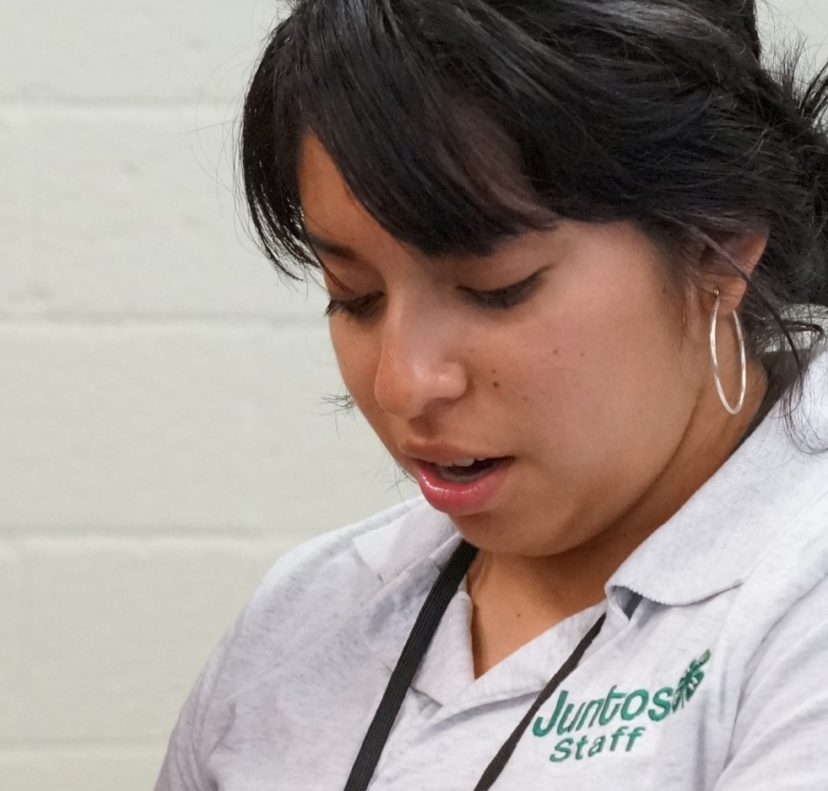
Planning for Juntos 4-H Clubs
Notes:
WHAT TO SAY: The next two slides will provide a recommended timeline for implementing the Juntos 4-H Program. A role chart has also been provided in order to outline tasks, lead staff, and define the responsibilities that are essential to ensure the Club’s success.

Slide 22
Juntos 4-H Clubs Timeline Note: Biweekly club meetings refers to having two club meetings a month throughout the school year.
Start-up Summer
May-July
August-December
January-April
May-July
Build partnerships & volunteers
Relationship building with schools, partners and interested volunteers
Identify volunteers
4-H Clubs
Biweekly at each school
Club starts after workshop series
Establishing and focusing on Club’s goal
Intro to 4-H
4-H Clubs
Biweekly
Introduce 4-H Curriculum/Project Areas
Plan with partnerships & volunteers
Identify successes and ways to improve
Plan for next school year
Discuss training schedule with existing or new volunteers
Focus Areas
Building relationships with students and school personnel
Forming a 4-H club that youth and parents trust
Building community among Families
Plan for club
identify location, schedule, curriculum, activities,
Local 4-H events
No club meetings
Invite youth to summer 4-H events that are relevant to their interest
Summer Program
(optional) invite potential youth to local 4-H summer programing
Optional Spring Event–Ex.
Soccer Tournament at Local University/ or special field trip/event
Notes:
WHAT TO SAY: Here is an ideal timeline for first year implementation of Juntos 4-H Clubs. This timeline coincides with the Family Engagement timeline discussed in
Module 2.
Start-up: Summer May - July: During the summer prior to the beginning of the program, take time to focus on building relationships with schools and partners. Identify volunteers with the skills and passion to work with this population and who have talents in areas that would interest the youth.
Plan for Club - Work with your partners to plan a schedule of events that works for all involved parties.
Summer Program (Optional) - We suggest engaging families early , because it offers opportunities for families to learn about and register their youth to participate in summer camps and summer events. Some communities have used the end of the school year to hold an information session with Latino families in the target school. This early engagement with families helps reinforce the program in the fall. Youth who participate over the summer also learn more about 4-H and are able to share their experiences with their peers and families when the full program starts.
Fall implementation: August - December: 4-H Clubs should start after the last Family Workshop session. This means that the first Club meeting is likely to take place in October, depending on when the Juntos Family Workshop Series ends. It is recommended to plan for biweekly Juntos 4-H Club meetings. Club time should be focus on establishing and focusing the Club’s goal which is Academic Success. It is also during this time that youth learn about 4-H in a fun way.
Spring Implementation: January - April: Continue with biweekly Club meetings and slowly create opportunities for youth to plan, organize, and lead the meetings. It may take until year two for youth to take on full leadership of Clubs, so be open to the process and do not rush the youth to meet your expectations if they are not ready.
Optional Spring Event: After you have established the Club and built families’ trust, you might consider adding a spring event or field trip.
For example: In North Carolina, a soccer tournament at NC State University where youth can play soccer with college students has become a traditional spring event. College students organize the event.
Summer Time: May - July: Take time to discuss the successes and challenges of year one with partners, 4-H Agents, and staff. Focus on what’s next with your partners, include current partners in the 4-H volunteers’ training schedule, and invite new partners to join. You can also identify a parent leader to join these conversations. Since the club will not meet during the summer make it a point to inform and invite youth and parents to local and state 4-H programing opportunities.
Note to Trainer: Provide a copy of this timeline to each participant.
Let’s talk Project Areas

Slide 23
A look at Club’s Project Areas
Project areas focused on supporting academic success
Example:
public speaking;
financial literacy (My Financial Future);
science and technology (STEM);
civic education; and
one chosen by Club members with support from the 4-H Agent and/or the Club leader.
Notes:
Make sure project area topics are focused on supporting academic success and include a curriculum that has fun, hands-on activities that help the Club members to learn. Your local 4-H Agent should play a big role in supporting you to find a curriculum that best supports the youth’s academic success and maintains the interest of the youth and their families.
Example of project areas in North Carolina and New York include:
public speaking;
financial literacy (My Financial Future);
science and technology (STEM);
civic education; and
one chosen by Club members with support from the 4-H Agent and/or the Club leader.

Slide 24
Planning Continues
Goal for first year 4-H club
Building relationships with youth, parents, schools, other partners
Goal for more established Clubs
Showcasing the impact of clubs on the youth to their families, schools and partners involved.
Notes:
WHAT TO SAY: The first year of the Juntos 4-H Club should focus on building relationships with youth, parents, and the school. As the Club becomes more established, think of creative ways to showcase its impact with the school leadership and staff, as well as the families in the program.

Slide 25
Ways to Showcase a Club’s Impact
Post club news on school bulletin broad,
Update principal or school administrator on club success
Report Clubs past and future activities at Family Nights
Have youth present on their club’s activities
Notes:
WHAT TO SAY: Here are some ways Juntos 4-H clubs have showcased their impact.
many schools provide a bulletin broad for school clubs, so post Club pictures and youth narratives of Club activities;
any time you see a principal or school administrator, share a quick success story of what’s happening with the youth in the 4-H Clubs; and
plan to report on what the 4-H Clubs have done and will do at your Family Nights. The Club leader can present during the first two Family Nights and then transition this task to a 4-Her.
Note to Trainer: If time allows, ask participants the following questions. Do you have any other creative ways to share your Club’s impact?

Slide 26
Planning Continues
Plan for biweekly club meetings but be flexible
Have a plan on how Juntos 4-H youth will have opportunities to participate in local and state 4-H events
Notes:
WHAT TO SAY:
Although Juntos 4-H Clubs should normally meet twice a month, there may be months when only one meeting can take place due to the school calendar or inclement weather. For example, December is often a short month, and in May, principals often prefer that Clubs not be held during end-of-year testing.
Lastly, do make sure to give Juntos 4-H youth the opportunity to access and participate in local and state events. It is recommended that youth participate in local and state events once they become more familiar with 4-H and trust with the parents has been established.
Now let’s look at a Role Chart for Juntos 4-H club implementation

Slide 27
Role Chart
Task
Lead Person
Responsibilities
1. Build Partnerships and Volunteers
4-H Agent/educator (hired Juntos staff/volunteer Club leader) with support from FCS Agent and other partners
Establish the relationship with schools and clear implementation plan
Engage and recruit volunteers
supports by training and mentoring hired bilingual staff or volunteers
Provides guidance on 4-H Curriculum and protocol
Welcoming Juntos 4-Hers and their parents into 4-H and Extension
2. Supporting 4-H Clubs during
the school year
4-H Agent /educator (appointed person)
Paid Juntos Staff/volunteer Club leader with support from 4-H Agent, school, Bilingual staff or volunteer, other available extension staff
Manage clubs
Communicate with schools
Communicate with parents
Grow volunteer base
3. Manage 4-H Clubs during the
school year
Notes:
WHAT TO SAY: This role chart identifies the tasks, lead people and responsibilities that are needed to ensure Juntos 4-H Clubs are successful during the first year of implementation.
Task One: Building partnerships with the school and recruiting volunteers will help support the start of Juntos 4-H.
Lead People: 4-H Agents/educator, hired Juntos staff, and/or volunteer Club leaders and support from FCS and other partners if available
Responsibilities Include: Establishing relationships with schools and coming up with clear implementation plans. Being able to recruit volunteers before implementation starts will only strengthen the program.
Task Two: Supporting 4-H Clubs during the school year.
Lead People: The 4-H Agent/educator or appointed person
Responsibilities Include:
supporting the success of Juntos 4-H by training and mentoring hired Juntos 4-H staff or volunteers;
providing guidance on the 4-H curriculum and protocol; and
welcoming Juntos 4-Hers and their parents into 4-H and Extension.
When funding is available to hire a Juntos 4-H Coordinator, the 4-H Agent’s roles are to support the 4-H Club program component, help the Club engage with other 4-H events, serve as a resource for the coordinator and families, and gain the trust of families.
Task Three: Manage 4-H Clubs
Lead People: Paid Juntos 4-H staff or volunteer Club leaders, with support from a 4-H Agent, school, bilingual staff or volunteers, and/or other available Extension staff who can bring their resources and skills to the Club experience.
Responsibilities include:
managing the Club;
communicating with schools;
communicating with parents; and
growing the volunteer base.
One example of how multiple agents may support Juntos 4-H is by having EFNP staff lead a session on nutrition, with a fun cooking demonstration on easy but healthy recipes for salsa or another dish that the youth choose themselves.
Although the 4-H Agent plays a lead role in endorsing and supporting the Juntos
4-H Clubs, success will also depend on the level of support and endorsement received from State and County Extension leadership. If you are starting Juntos 4-H at a local level, make an effort to connect with State 4-H and Extension to find those who believe in this work and want to support your efforts.

Slide 28
Cost for Juntos 4-H Clubs
Notes:
WHAT TO SAY: Implementing Juntos 4-H Clubs has some potential costs to consider as you plan.

Slide 29
Without Additional Funds | With Additional Funds
4-H Agent leads club start-up with support from other extension staff and volunteers | Hired bilingual staff to lead all aspects of club
Bilingual volunteer(s) to run the club | Budget to hire or contract bilingual staff
Snacks donated by local businesses | Budget for snacks
Club supply and curriculum needs provide by local Extension | Minimal supply needs (curriculum cost, club supplies)
Notes:
WHAT TO SAY: Let’s look at the left-hand side of this chart. Without additional funding, it is possible to run Juntos 4-H Clubs in the following fashion:
4-H Agent organizes volunteers who set up and lead the Club.
- 4-H volunteer(s) become the adult leader(s). A bilingual and bicultural individual is preferred but not required.
- 4-H Agent recruits a bilingual-bicultural parent who is interested in working with youth and is able to be trained in youth development.
- 4-H Agent recruits a bilingual-bicultural college student with the time and commitment to lead the Club for at least one school year.
The benefits of having a bilingual and bicultural individual are that they can communicate with non-bilingual youth and parents; they can lead or support the Family Engagement component where Spanish is the dominant language spoken; they can communicate with Spanish speaking community partners who want to endorse or support the program; and having a bicultural understanding breaks down barriers from the start that may take a non-bicultural individual time.
Because the majority of Club meetings are held after school at the school, snacks are necessary. These can be provided by already existing federal- and/or state-funded afterschool snack programs, or they can be donated by businesses or other partners in the community.
FCS and/or 4-H Agents can develop a plan to cover the cost of the supplies and the curriculum that will be used in Club meetings.
Now let’s look at the right-hand of the chart:
When funding is available, these items might be included:
- Program Coordinator: Considering the culture differences and specifics of the Juntos Program, hiring a bilingual Juntos Coordinator who is responsible for all the logistics for launching the Club is highly recommended.
- School Liaison: A school staff member who can partner to lead the Club throughout the year.
- Snacks: To limit interruptions and maximize the limited time dedicated to the program goals, a budget for snacks can help encourage consistent Club attendance.
- Supplies: Purchasing supplies and curricula that interest the youth will lead to stronger, more sustainable Clubs.
Keep in mind that the pay of the individuals hired often depends on their credentials, skills, and responsibilities. If a new site decides to implement all components of this program, it is advisable to create a Juntos 4-H Coordinator position that can manage all the components. If you are only implementing the Family Engagement and 4-H Club components, it is recommended to hire at least one individual who will be responsible for both components, and who can maintain the goal of building consistency and trust with the families.

Slide 30
Sample budget from North Carolina when implementing with grant funds
Note: Budget based per student served. Average students shared per school 30 to 60 youth
Notes:
WHAT TO SAY: Let’s look at the breakdown of costs from North Carolina when funding is available. Keep in mind that this is a budget based on serving an average of 30 to 60 youth per school.

Slide 31
WHAT TO SAY: | Full or part time bilingual staff based on students served
Supplies & Snacks | $40 per student per year
Transportation | $20 per student per year
* Additional budget items can include funds for youth to attend local, state, and National 4-H events or other educational opportunities.
Notes:
WHAT TO SAY:
The salary for a bilingual Juntos 4-H Coordinator is written into the grant when implementing all four components. The size of the youth group will determine whether a full or part time person should be hired.
Supplies and snacks needed for a complete year of service is approximately $40 per student.
Consider adding a transportation budget for possible youth field trips, staff travel for training, or transportation for youth and families to attend program events. A lack of transportation is often one of the biggest challenges preventing youth and their parents from participating in the services we provide. In North Carolina, we generally estimate about $20 per student per year for transportation, but it varies depending on a community’s access to public transportation.
* Plan for additional budget items that allow youth to have educational and 4-H focused opportunities.

Slide 32
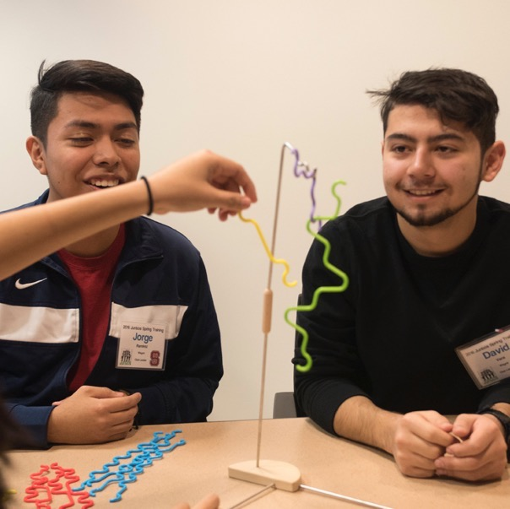
Juntos 4-H Clubs
Implementing successful
Clubs
Notes:
WHAT TO SAY: Let’s now move onto the last topic in this module: Implementing successful Clubs.

Slide 33
Juntos 4-H is a Community Club
Meets regularly
Addresses county 4-H requests and community issues
Usually multi-project
Provides educational program or activities
3-5 different families
Offices/leader roles identified
Notes:
WHAT TO SAY: Juntos 4-H Clubs are community-based or multi-project clubs, which are a common format for youth aged 8-18.
Remember that 4-H Clubs are new to many Latinos, so take the time to discuss what type of club Juntos 4-H is and what makes them a community club.
Community clubs are clubs that:
- meet regularly to conduct a business meeting;
- address county 4-H requests and community issues;
- provide an educational program or activity and offer a selection of projects;
- require at least 3-5 different families to participate; and
- identify officers and/or leadership roles.
Let them know that Juntos 4-H Club meetings include a time for business (e.g. the pledge, minutes, items of business, discussion), an educational project, recreational time, and snack. An established Juntos 4-H Club provides members with an opportunity to give their input on what educational projects are highlighted at each meeting.
Note to Trainer: Inform participants that there are some Juntos 4-H communities that have found spine clubs to be the most effective type of clubs to use when working with Juntos 4-H families. It is to the descretion of each community to develop a club culture that best services the community being served while still maintaining the mission of the Juntos program.

Slide 34
Starting Juntos 4-H Clubs
The first year is about building identity and propose as a club. This means members are committing to their individual academic success as much as they are to seeing each other succeed.
This identity and propose will drive the growth and success of the club!
Notes:
WHAT TO SAY: It’s important to establish the purpose of the Juntos 4-H Club.
Juntos 4-H Clubs are made up of individuals who are committed to their and their peers’ academic success. This goal motivates youth to give their all to support their fellow Club members’ success. This goal also drives parents’ commitment to allow their youth to participate in everything the 4-H program has to offer.

Slide 35
Starting Juntos 4-H Clubs
REMEMBER
Focus on developing trust and unity
Less 4-H structure at the beginning and more relationship building
Notes:
WHAT TO SAY: Remember what was discussed during the cultural considerations section.
Effective adult leaders and 4-H Agents take the time to welcome Juntos 4-H Club members and their families into the 4-H world.
This may mean that Club leaders (with support from a 4-H Agent) will select projects covered during the first year, focusing less on running traditional business club meetings while still introducing elements of traditional clubs. The goal the first year is to allow time to create unity.
After the first year of starting the Club and once your Club is more established, the youth will start taking ownership of leading the Club, selecting projects that interest them and supporting their path to academic success.

Slide 36
Subject Matter Interests
Areas of interest for clubs
Life skills
Leadership development
Public speaking
Community Service
Healthy living (physical activity, emotional mental, and social health)
Career focus introduction and development
Services within Club
Mentoring
Homework help/tutoring
Career and professional shadowing
Cultural identity focus
Notes:
WHAT TO SAY: As discussed in Module 1, the areas of interest that have been successful in keeping youth’s attention include:
- community service;
- public speaking;
- personal development;
- leadership development;
- healthy living activities; and
- career focus experiences (e.g. jobs in the STEM field).
Job and professional shadowing, mentoring, homework help and tutoring, and cultural identity activities are some additional activities that have been provided to Club members in some communities.
Use your experience and the resources of 4-H to bring these interest areas alive.
Clubs are not limited to these areas of interest. No matter what youth may be interested in, adult leaders should ALWAYS take the time to lead youth through a discussion of how their interest areas will support their path towards the goal of achieving high school graduation and higher education.
Remember to always update parents on what youth are doing by having the youth present during Family Nights.

Slide 37
Juntos 4-H Clubs
Be open to culturally relevant projects and activities
Examples: creating a soccer team and leading soccer tournaments, folkloric dance groups with a healthy-living approach
“These projects can lead to public speaking presentations, leadership development, learning healthy habits and organizational skills, and recruitment of more youth”.
Notes:
WHAT TO SAY: It’s important to give youth the opportunity to bring their cultural interests into Club time. For example, Juntos 4-H’ers have formed soccer teams and organized tournaments as a Club, while others have started a folkloric dance team as a project focus.
Adult leaders should be open to include culturally-relevant projects and activities during and outside of Club. These types of culturally-relevant projects have been shown to bring more youth into the program and Club. Invite college-aged and adult volunteers to share their skills and help lead multi-week projects with the youth in areas of interest (e.g. videography, robotics, medicine, STEM, broadcasting, etc.). Lastly, it is the adult leader and member’s role to integrate these projects into public speaking, leadership development, and healthy living experiences. It is also the role of the adult leader to model a discuss on how this projects are developing skills that will support youth’s academic success.
Show the relationship between these interests and 4-H projects.
Note to Trainer: If you have the time, take 3 to 5 minutes to ask participants what other culturally relevant projects they think will be suitable for this population of youth and why.

Slide 38
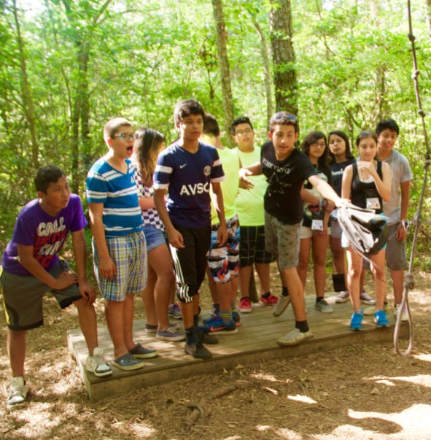
Sample of Club
Meeting Agendas
Notes:
WHAT TO SAY: Let’s look at two different agenda samples. The first sample is what a first meeting might look like, and the second is an agenda from a well-established Club.

Slide 39
1st Club Meeting Agenda
10 min- Welcome members & introductions
20 min- Fun and creative icebreaker
30 min- Discuss purpose of Juntos 4-H, 4-H basics including meaning of 4-H pledge, and importance of Juntos 4-H clubs = coming together to achieve academic success
15 min- What do you want from your Juntos 4-H club? Think of a fun and creative way to get students’ feedback
15 min- Discuss and complete 4-H form (if needed) or end with a fun recreational/social-focus activity
Meeting Adjourned
Notes:
WHAT TO SAY: The first and subsequent meetings should focus on getting to know each other and discussing what brings the Club together. It is here where 4-H principles and the purpose of Juntos 4-H are shared with the youth. Youth should have an opportunity to share what they want to get out of the Club; they should have a conversation about their personal interests and the types of activities in which they would like to participate.
The first Club meetings need to have structure and lots of interactive fun activities that keep students engaged and wanting more.
Year one should be geared towards a Club structure that will help youth be successful in leading their 4-H Club in the years to follow. It is important to follow the lead of the youth. Some Juntos 4-H Clubs will slowly move towards the structure of a 4-H Club, while others have no problem establishing officers and running meetings within the first year.

Slide 40
Established Club Meeting Agenda
30 min- Snack and tutoring/homework help with mentors or volunteers
10- 15 min – Welcome and official business
20-30 min - Educational interactive time (4-H curriculum or project)
15-20 min – Recreational/social time
Meeting Adjourned
Officers: ______________, President ______________, Vice President ______________, Secretary
______________, Videographer
Adult Leaders: ______________, Site Coordinator ______________, School Liaison ______________, Parent Liaison
______________, Extension Agent
Notes:
WHAT TO SAY: Once the Club has laid out the necessary groundwork and the youth have identified officers, the youth lead the Club with the support of the adult leader. An established Club meeting agenda includes:
1. If possible, set aside some time for students to work on their homework or receive tutoring from volunteers or mentors. This can take place at the beginning or end of the Club meeting, and it can be part of Club time or known as an extra resource available to Club members - it is really up to the Club to make the decision.
For example: Some Juntos 4-H Clubs will meet right after school ends. Students will gather at the assigned location for Club, but will use the first 30 minutes to work on their homework.
Another example: Juntos 4-H Clubs that are larger in size due to the number of families served are divided into two groups - group A and group B. Staff/Club leaders/volunteers provide tutoring and Club time each week. Group A and B rotate so that each month they attend two tutoring/homework sessions and two Club meetings. Staff who use this model also plan activities where the whole group can come together and be one big group from time to time. Keep in mind that youth all come together during Family Nights. This model has been used where Clubs exceed 30 youth or more, and where volunteers can support this model.
2. Allot a time to welcome new members and conduct Club business. The Club leader (or a 4-H volunteer or staff member) can model this process until Club officers are established.
3. Educational time should include the 4-H curriculum or multi-week projects.
4. End or begin with recreational and/or social time, depending on when the Club chooses to have homework time.
Both of these agendas are examples of what has been successful for Juntos 4-H’ers. Club leaders, 4-H Agents/educators, and Juntos staff (if available) are encouraged to use their own knowledge, creativity, and experience in youth development to make Juntos 4-H Clubs a time for Latino youth and their families to be fully engaged in what 4-H and Extension has to offer.

Slide 41
Why Homework Time?
Youth asked for it
Parents want it
Supports academic success
Provides opportunity to partner with school
Notes:
Why is homework time and/or tutoring important?
Youth surveys from North Carolina over the years continue to highlight youth’s request to include homework time and tutoring during Club time.
Many Latino parents have noted that, due to their limited English skills and time after work, it is hard for them to help their youth with homework.
Through 4-H Clubs, youth start to establish positive academic skills and habits.
It provides another opportunity to partner with the school. Some schools may be able to provide tutors or together with the 4-H Agent/educator be able to recruit community volunteers or mentors to work with the youth.
Homework time can be an addition to Club that can be established over time, when resources and youth commitment strengthens. It is not a requirement to having a Juntos 4-H Club.

Slide 42
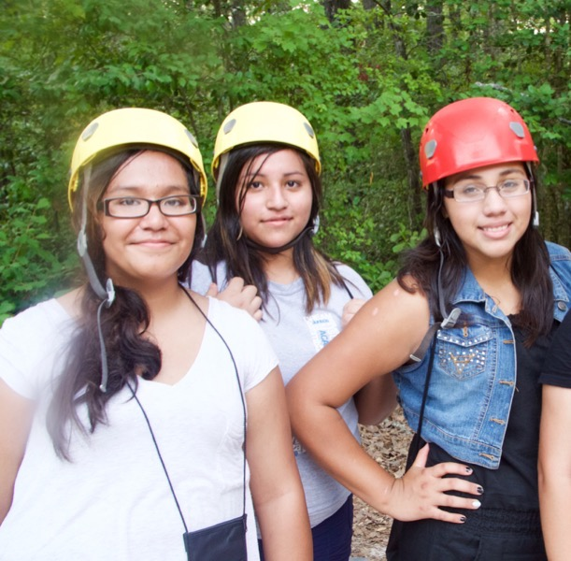
Juntos 4-H Clubs
Retaining Youth
Notes:
WHAT TO SAY: Now that implementation has been covered, let’s talk about retention.

Slide 43
What Keeps Students Engaged in Club
The value of 4-H is practiced
Respect, acknowledgment, achieving academic
success, and empower
3. Have fun and create unity
Notes:
WHAT TO SAY: The top three factors that keep Juntos 4-H youth engaged are:
1. Putting into practice what 4-H has been providing youth for years: long-term involvement in a stable setting, caring adults, educational experiences, life-long friends, development and practice of leadership skills, space to gain self-confidence, and the concept of “learning by doing.” Each 4-H community implementing Juntos 4-H has to have a long term vision for Juntos 4-H Clubs. This includes having a sustainability plan for how clubs will continue year after year. The goal of Juntos 4-H is to continue serving youth through their high school graduations. In North Carolina there have been examples of Juntos 4-her who continue to serve their local Juntos 4-H clubs as mentors even after they graduate HS and start their higher education journey.
2. Genuine respect for youth’s background, culture, and family; acknowledgment of their bi-cultural experience, their families, and their abilities to achieve academic success in high school and beyond; and empowering them with the knowledge, skills, and tools that challenge them to become their own advocates.
3. A robust combination of fun and work to create the feeling of family among the Club members. For many of these youth, their Clubs become an extended family upon whom they can rely.
We have now come to the end of Module 3.

Slide 44
A Special Thank You To:
National 4-H and New York Life Foundation for supporting the growth of Juntos 4-H
NC State 4-H for their feedback during the development of this module
The families and youth that make up Juntos 4-H
Notes:
WHAT TO SAY: The developers of the program would like to give a special thank you to:
- National 4-H Council for leading the way in believing in Juntos 4-H, supporting our work, and engaging with partners to ensure more states benefit from the program.
- The New York Life Foundation for their commitment to youth and Latino families.
- North Carolina State 4-H for their support in creating this module.
- The families and youth that make up Juntos 4-H.

Slide 45
Notes:
WHAT TO SAY: Thank you for taking the time to participate in Module 3 Juntos 4-H Clubs! Module 4 follows this module and covers Juntos 4-H Success Coaching/Mentoring.

