Slide 2
Don’t create a “New Presentation”
Use the existing 4-H Military Partnership PowerPoint template as your starting point. It has all your styles, colors and slide templates you need to create your presentation.

Slide 3
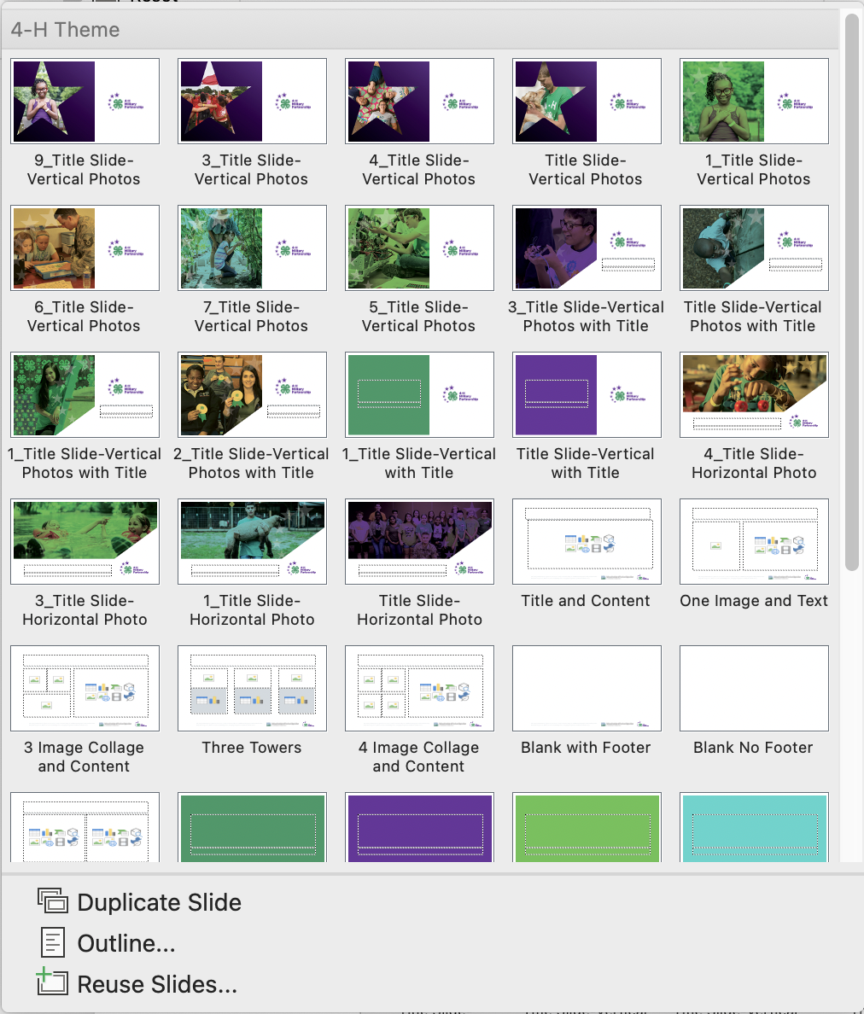
Slide Layouts
This is where you access a template’s slide designs, change a slide’s layout or reset it.

Slide 4
Accessing the Master Pages
If you want to make a global change to your PowerPoint, like adding a partner logo to the footer, you should use the Master Pages to do that.

Slide 5
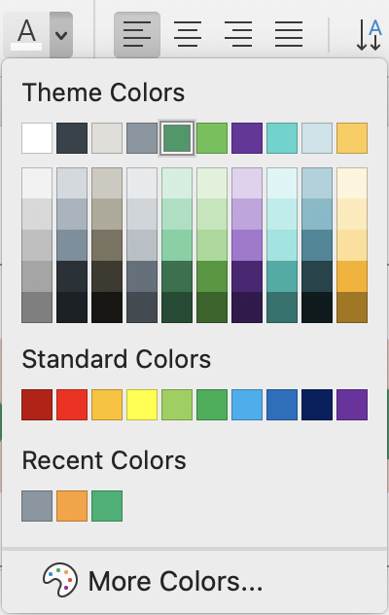
4-H Military Partnership Color Palette
Light Green
R97 G194 B80
Orange*
R255 G160 B47
Not included in the PPT colors
4-H GREEN
R51 G153 B102
Teal
R71 G213 B205
Wheat
R224 G222 B216
4-H MILITARY PARTNERSHIP PURPLE
R105 G53 B156
Sky
R202 G227 B233
Slate
R137 G150 B160
WHITE
R255 G255 B255
Lemon
R255 G203 B79
4-H Text
R55 G66 B74

Slide 6
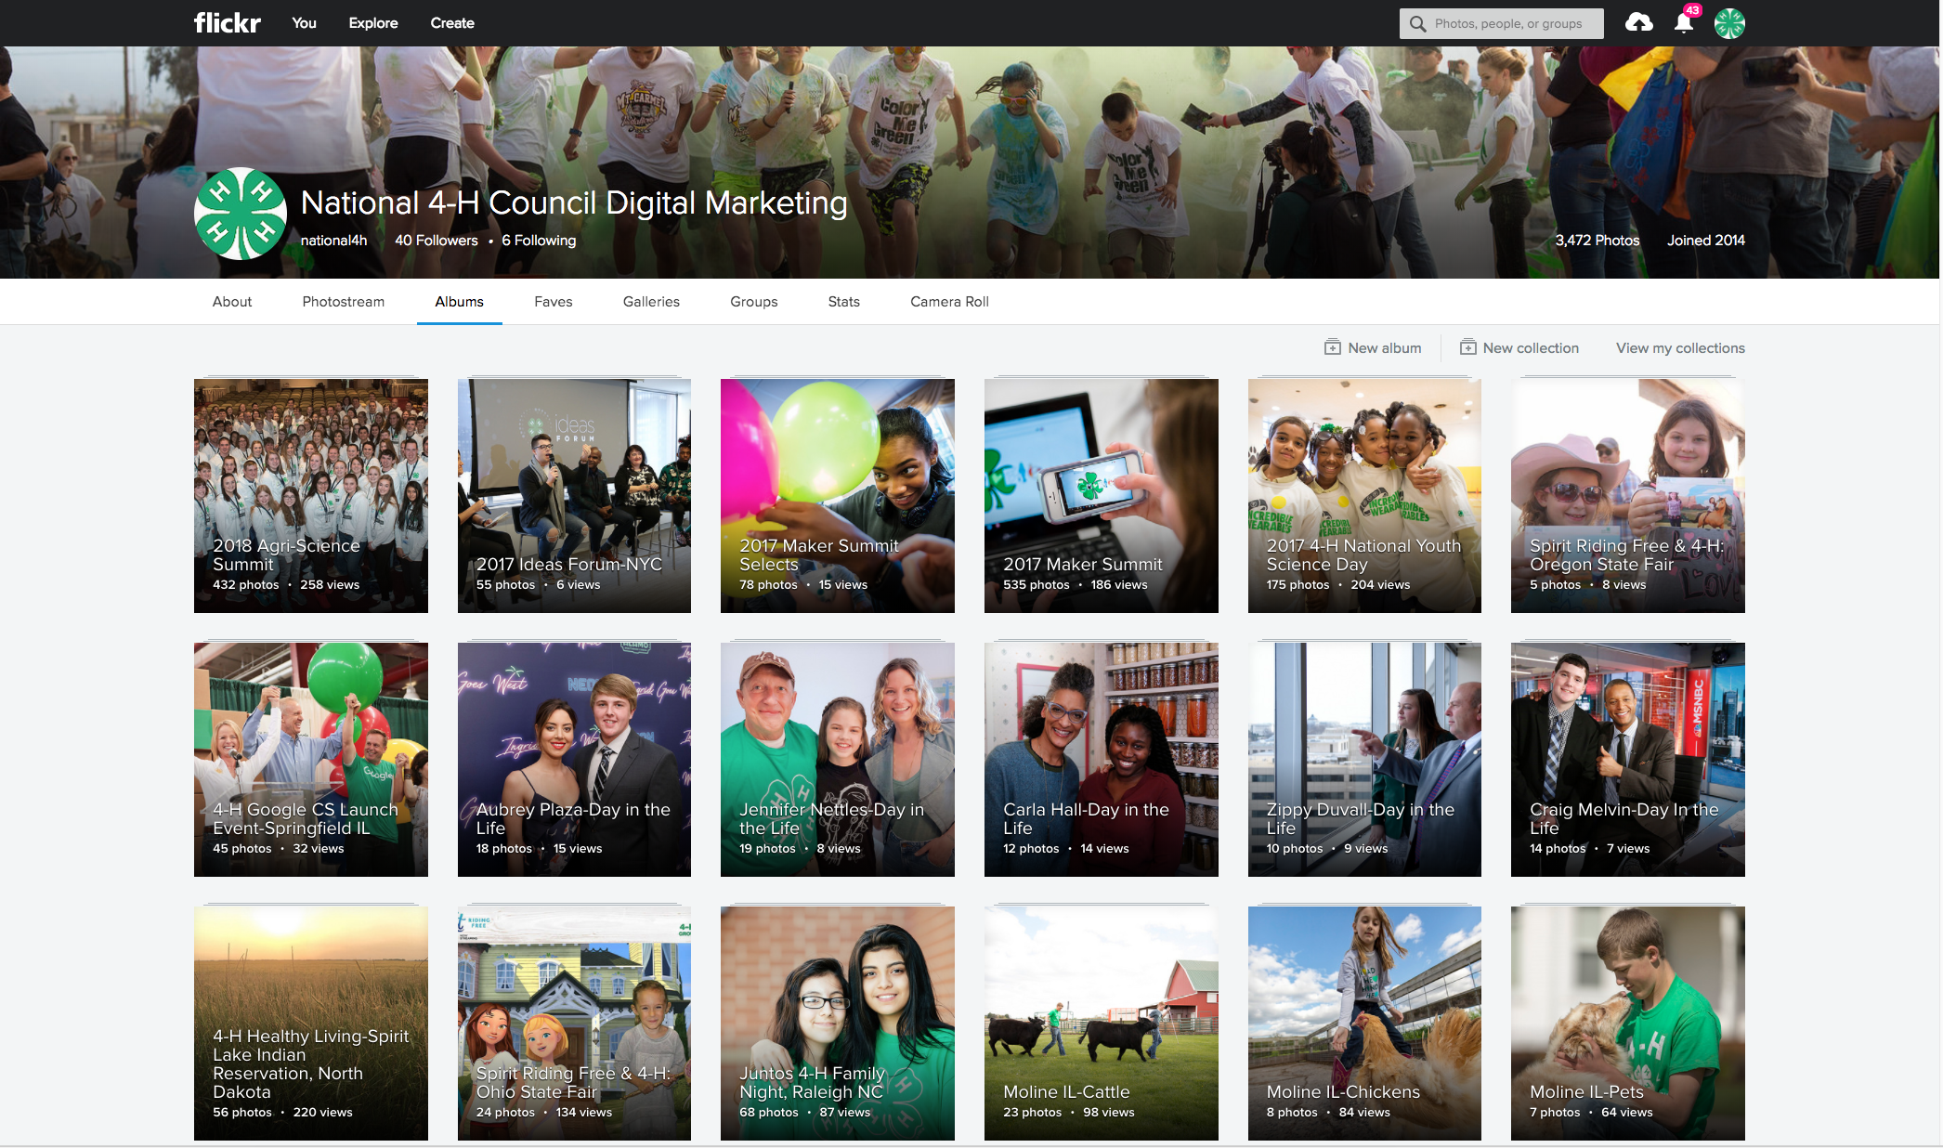
Flickr is your best resource for images.
https://www.flickr.com/photos/128520025@N03/albums

Slide 7
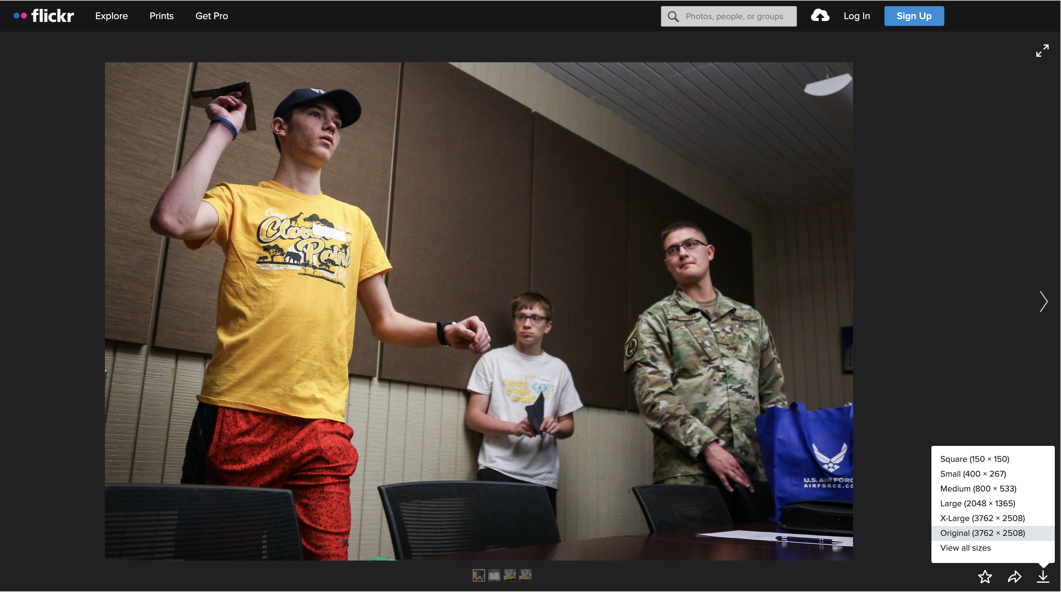
How to use Flickr.
https://www.flickr.com/photos/128520025@N03/albums
To access National 4-H Council Flickr images;
Click (or copy and paste) the link above
Select the image you want
In the lower right-hand corner of the screen, select ‘downward arrow’ and then select the image size you want to download.

Slide 8
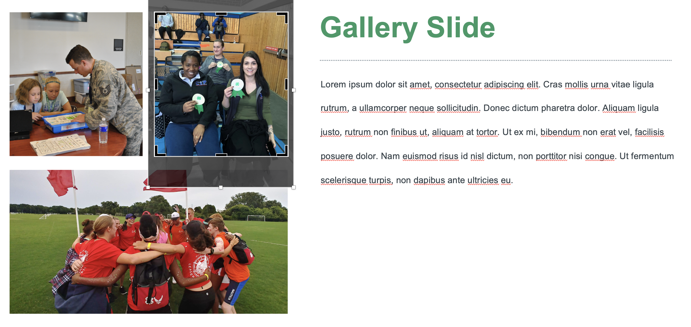
Image Adjustments
The PowerPoint templates let you easily drop photos into existing photo frames. To further adjust images, you can use the crop tool to zoom in on a specific portion of the image, change the crop shape or ratio.

Slide 9
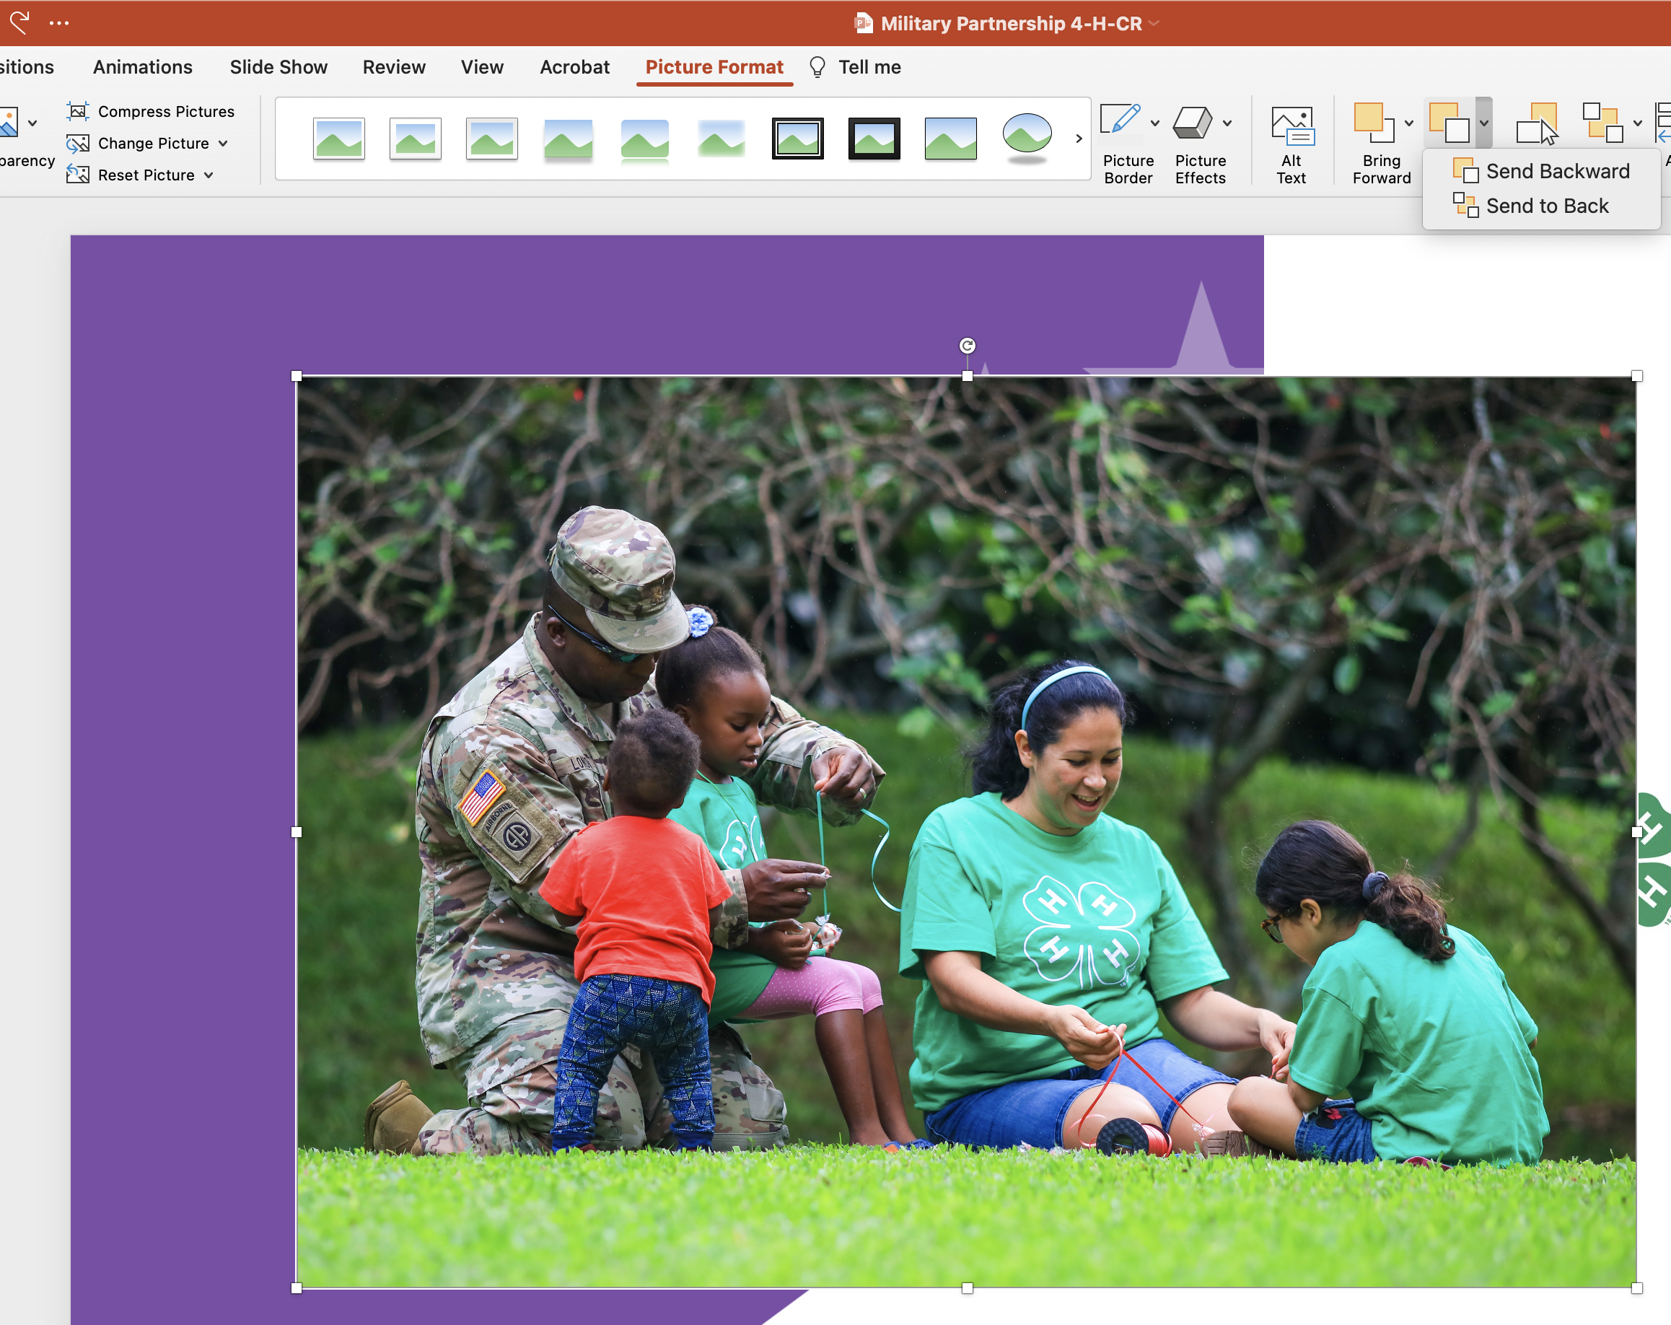
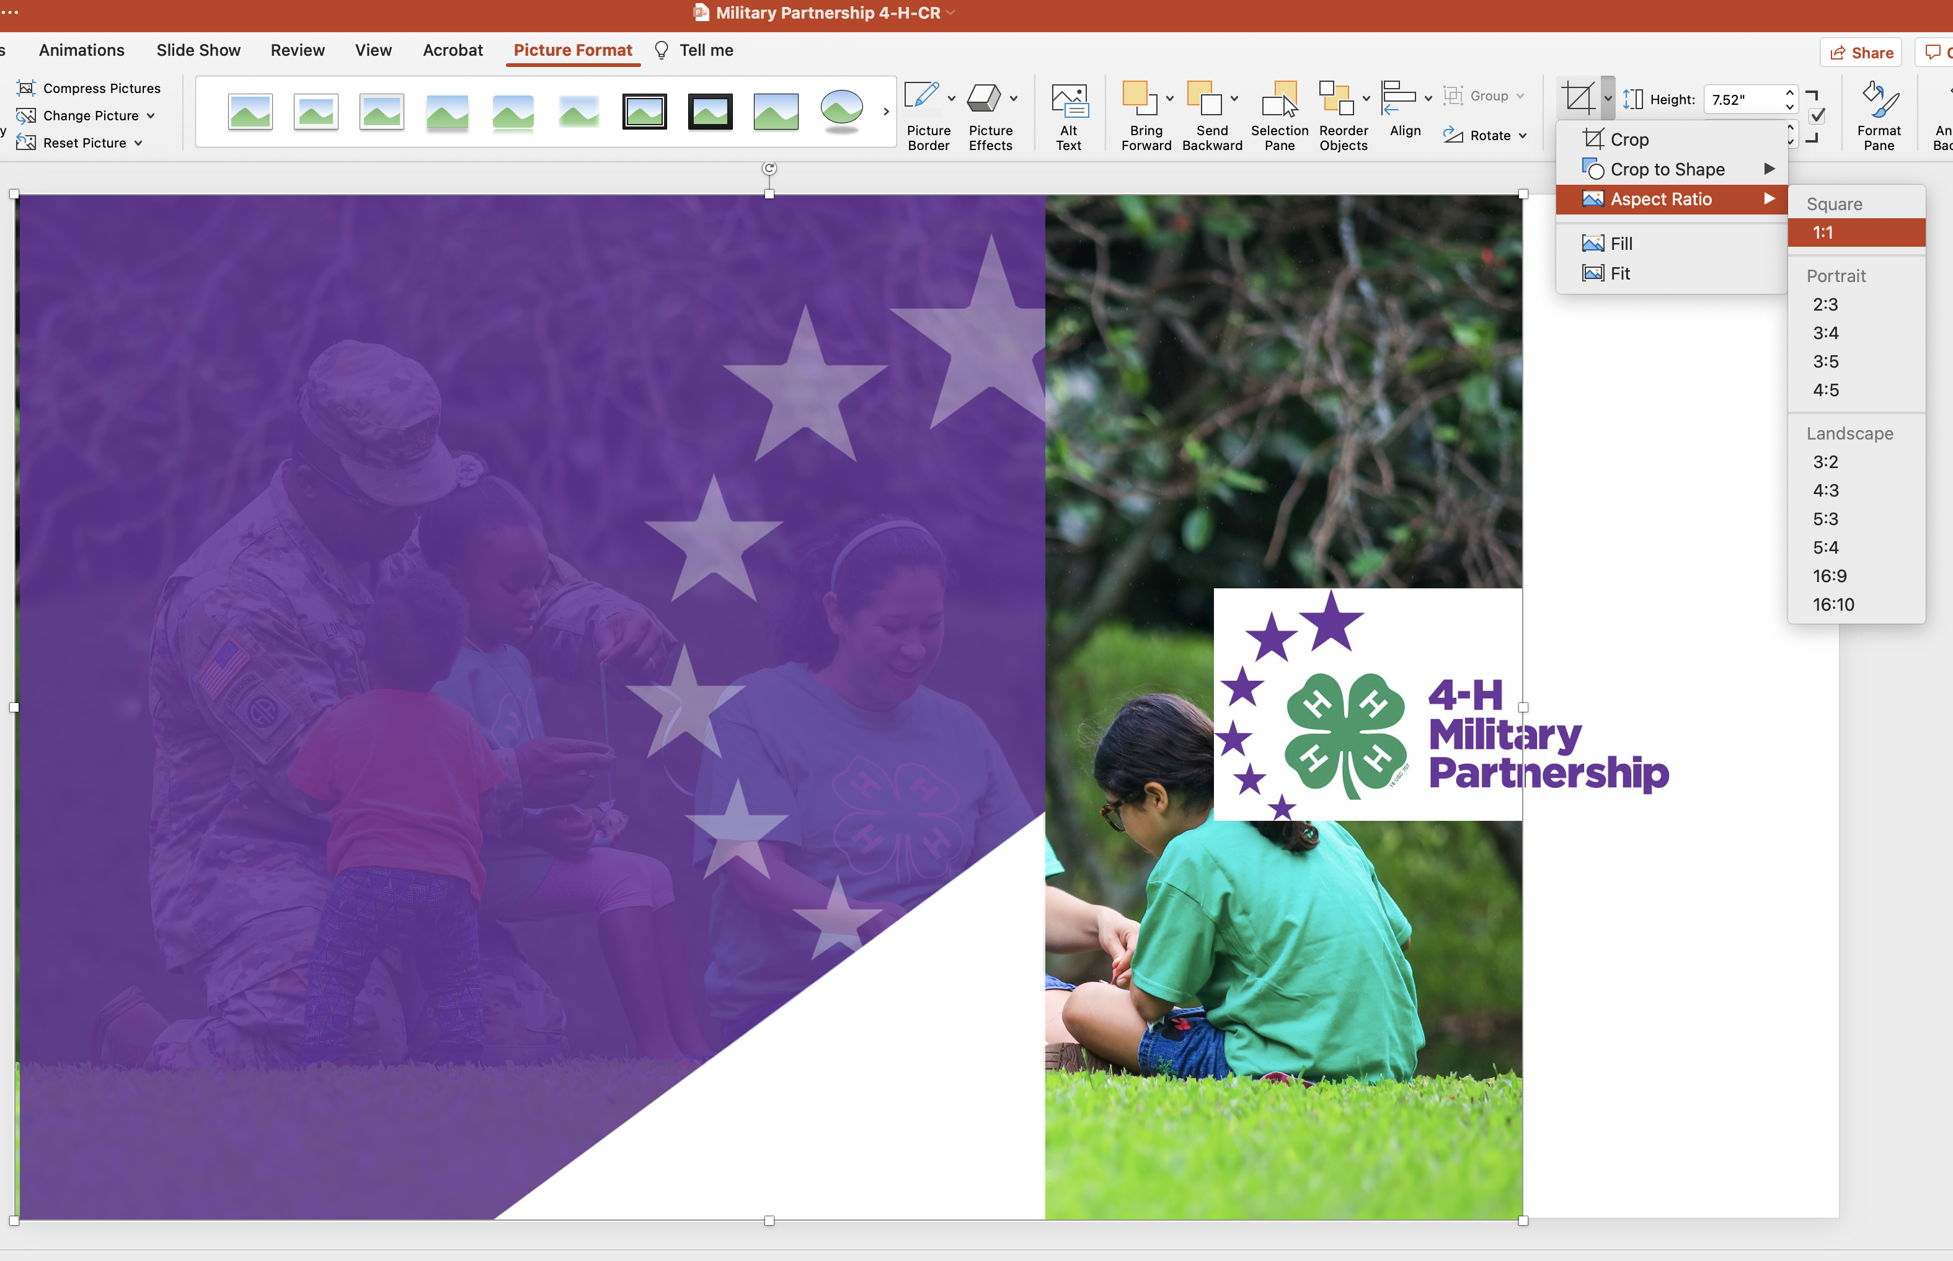
How to place photo images into Color Block Templates
Drag and drop the image you want to use onto the ‘Template Slide of your choice’
Crop and adjust the image down to fit the square shape (*You can refer to the Image Adjustments slide of this deck, for this step, if you are unsure how). For a perfect square crop of the photo, use the ‘Aspect Ratio’ under the Crop tool, and then select ‘Square - 1:1’
Select the image, then select ‘Arrange’, and then select ‘Send to Back’

Slide 10
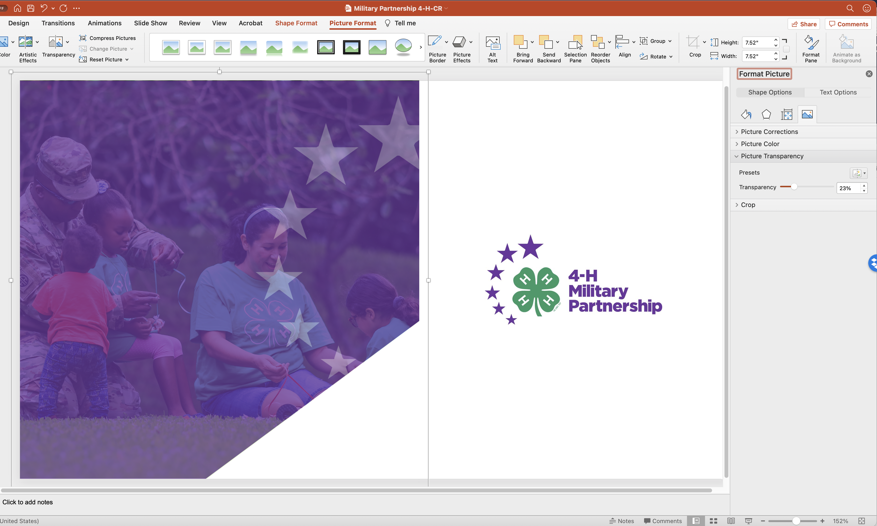
How to adjust the opacity of the Color Block in front of the photo
To adjust the opacity of the color block to see the photo more clearly, double click on the color block. (Double clicking the color block isolates the color block away from the white triangle on the lower right-hand corner, so that the triangle is not affected.)
Under ‘Format Picture’, select the picture icon on the far right.
Select ‘Picture Transparency’ and either type in a number or use the slider to adjust the opacity to the desired effect.

Slide 11
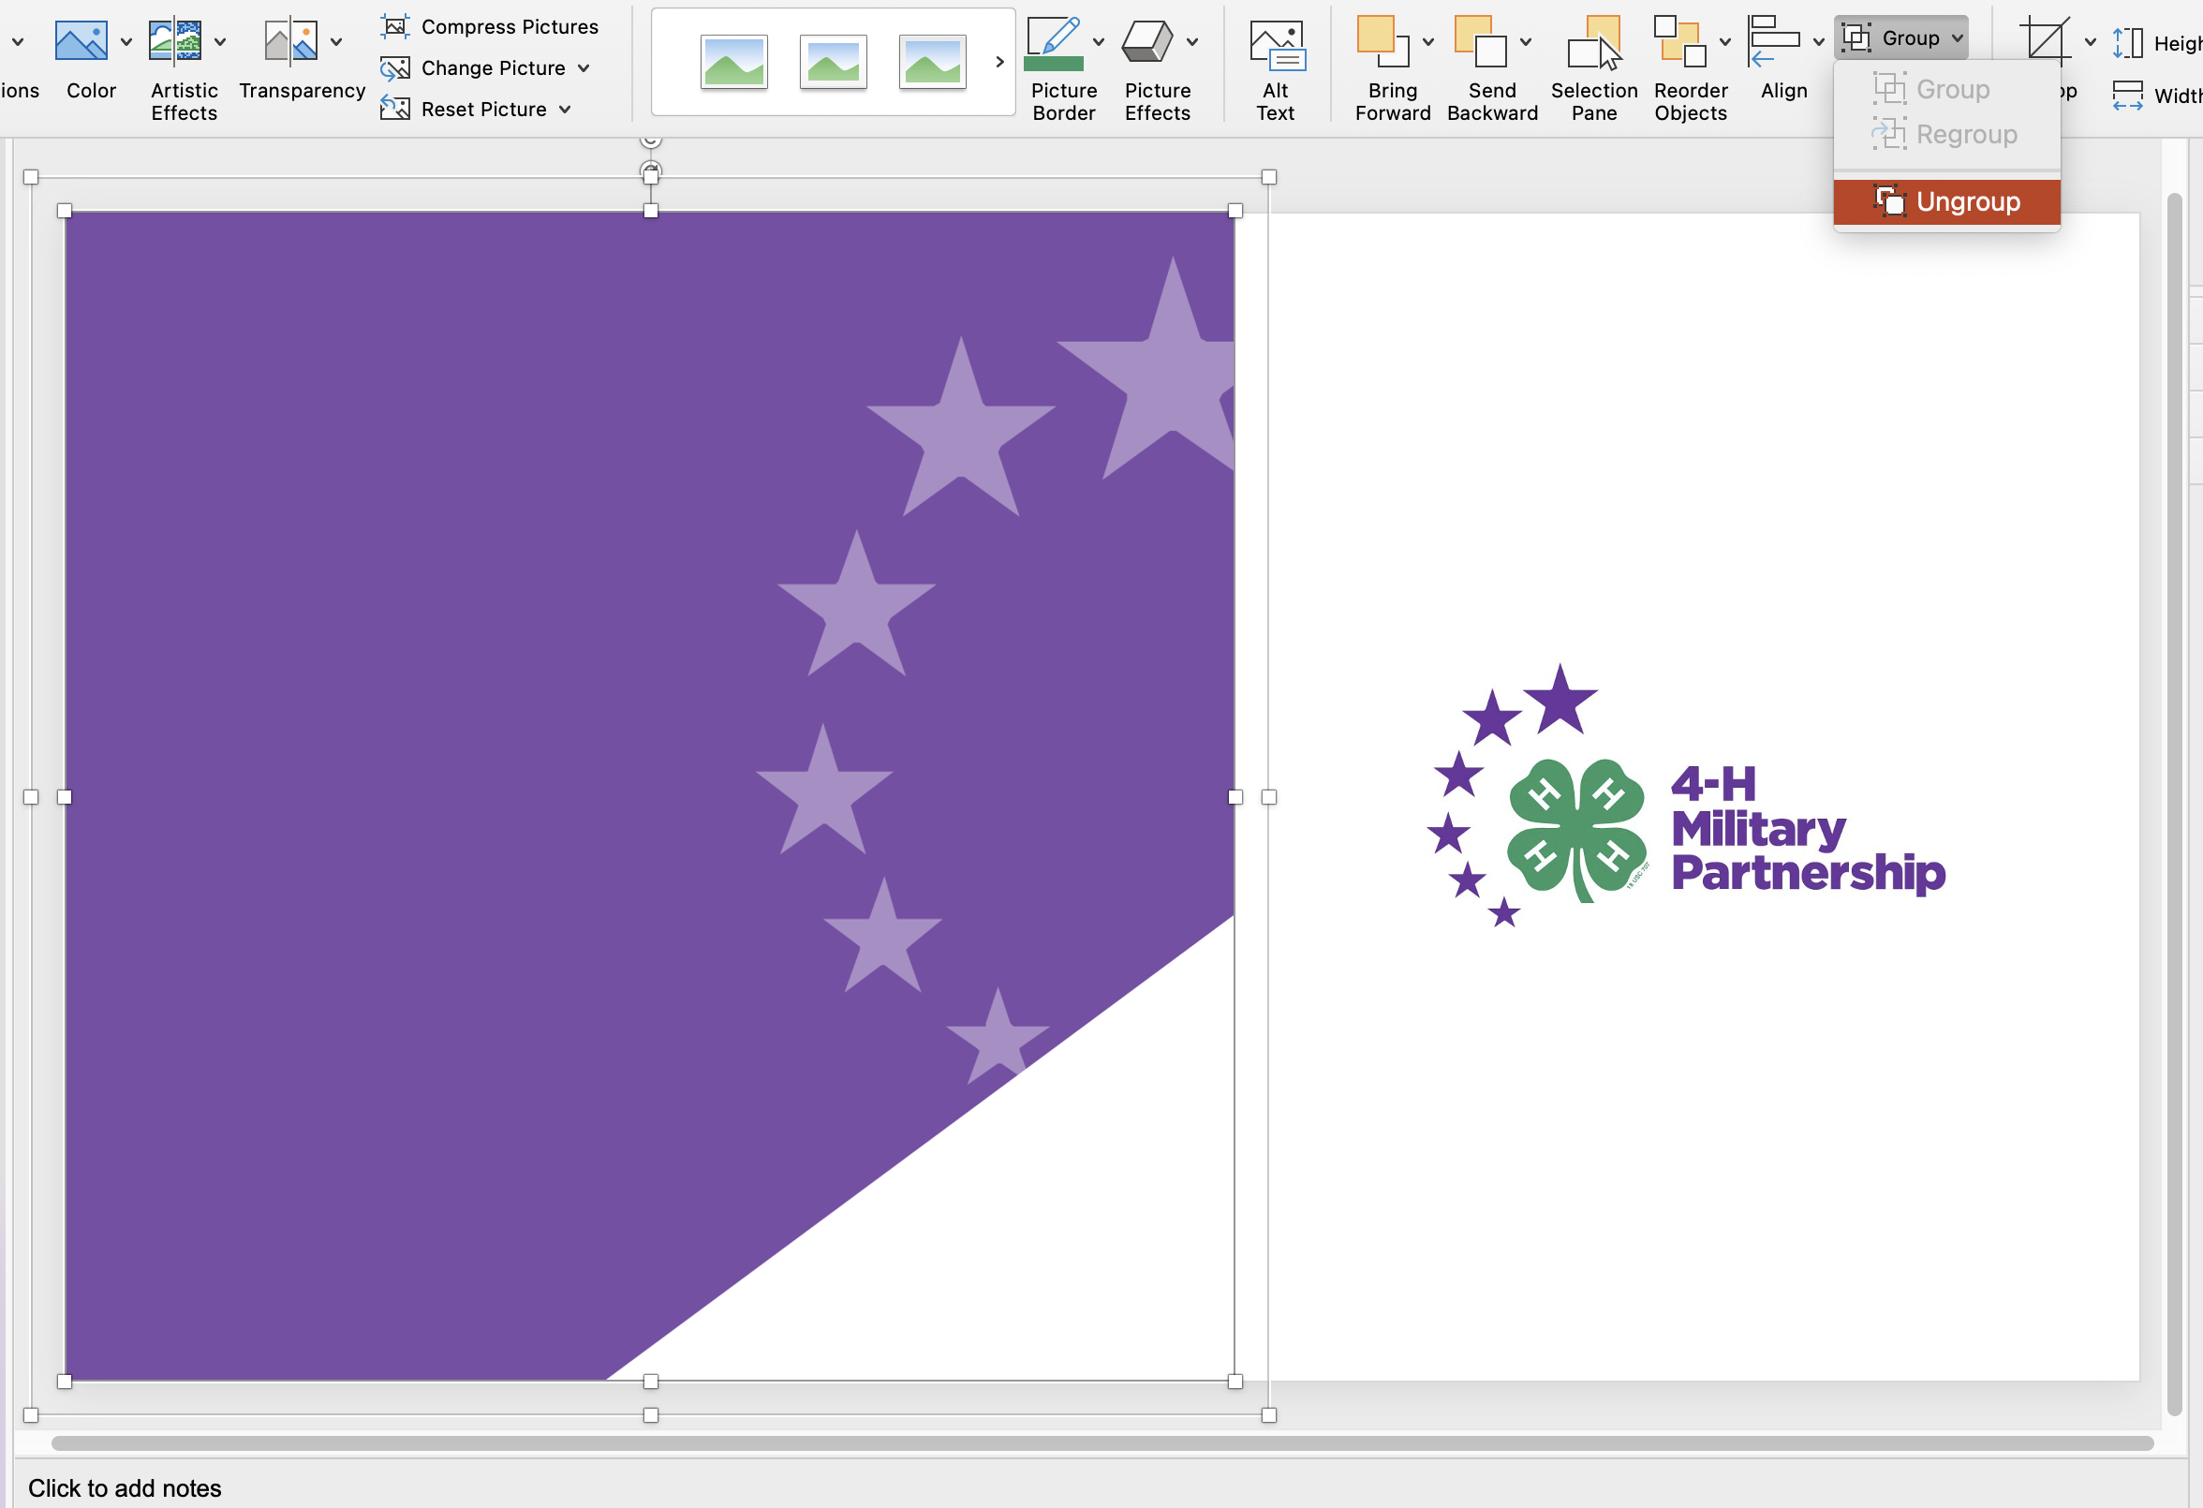
How to delete the Color Block in front of the photo
To delete the color block in front of the photo, ungroup color block from the white triangle that is in the lower right-hand corner.
Select the color block and delete.
Place and crop your photo behind the white triangle

Slide 12
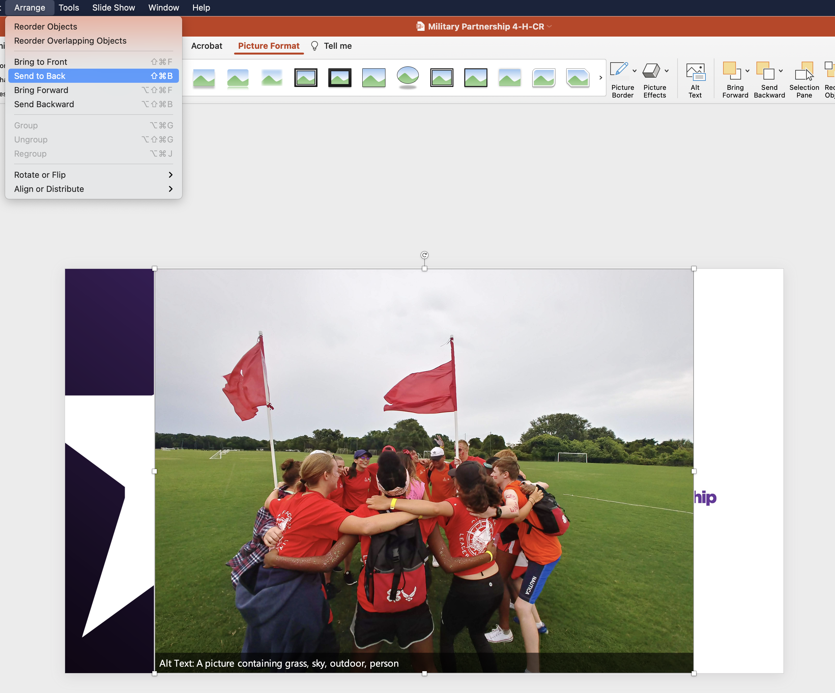
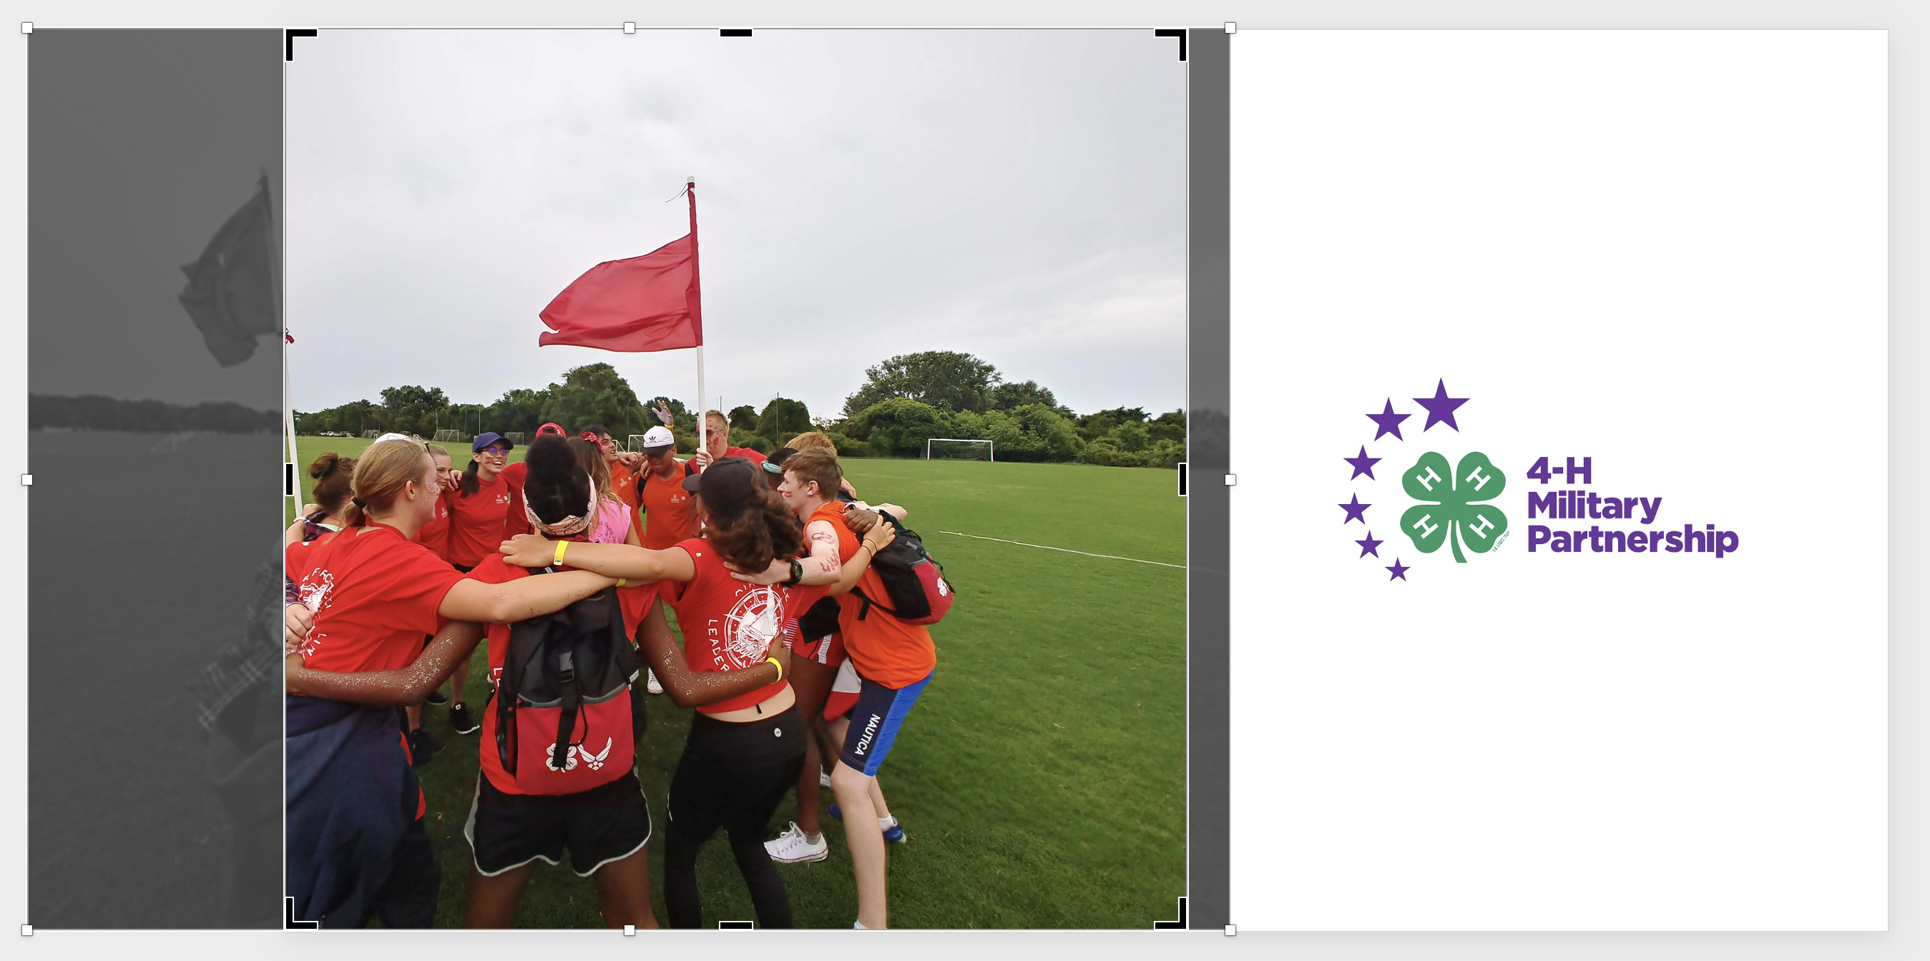
How to place photo images in the ‘Star – Opener Slide – Template’
Drag and drop the image you want to use onto the ‘Star - Opener Slide - Template’
Crop and adjust the image down to fit the square shape (*You can refer to the Image Adjustments slide of this deck, for this step, if you are unsure how).
Select the image, then select ‘Arrange’, and then select ‘Send to Back’

Slide 13
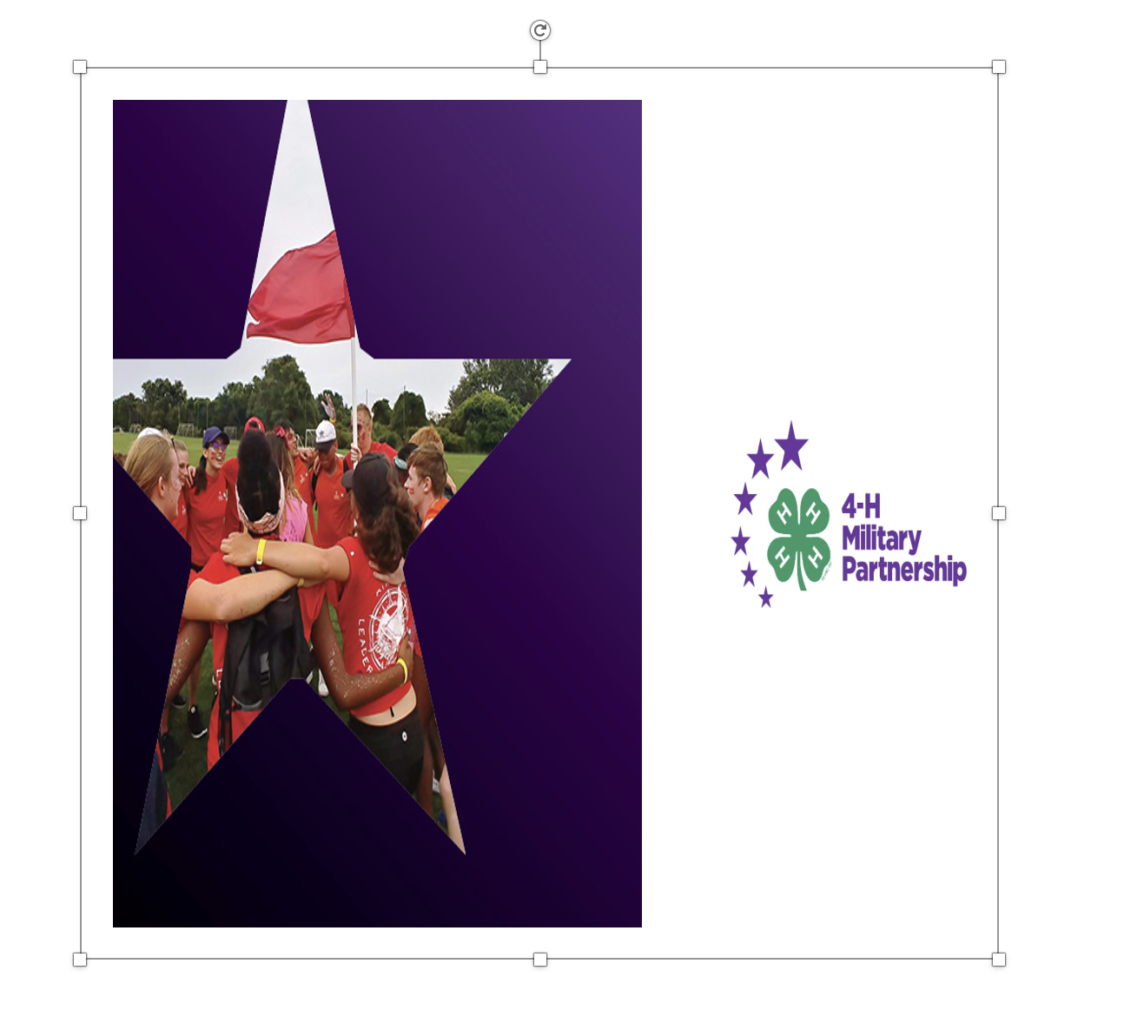
Don’t Squish or pull your images
Use only the corner boxes when resizing a photo, or use the crop tool. Do not use the sides, top, or bottom boxes to resize.

Slide 14
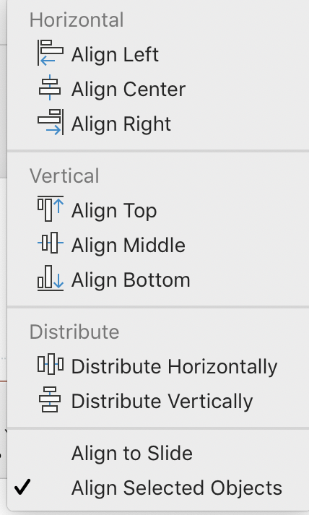
Align and Distribute
Before
Alignment
After
Alignment
First select your objects that you want to align/distribute. The you can click on the “Picture Format” or “Shape Format” tabs to access the “Align” tool.

Slide 15
4-H Military Partnership Logo

Slide 16
We can tell when you’re stuffing the text in.
4‑H is a Community for all Kids
4‑H is delivered by Cooperative Extension—a community of more than 100 public universities across the nation that provides experiences where young people learn by doing. For more than 100 years, 4‑H has welcomed young people of all beliefs and backgrounds, giving kids a voice to express who they are and how they make their lives and communities better. Through life-changing 4‑H programs, nearly six million kids have taken on critical societal issues, such as addressing community health inequities, engaging in civil discourse and advocating for equity and inclusion for all.
National Reach, Local Programs
In 4‑H, kids complete hands-on projects in areas like health, science, agriculture and civic engagement in a positive environment where they receive guidance from adult mentors and are encouraged to take on proactive leadership roles. Kids experience 4‑H in every county and parish in the country through in-school and after-school programs, school and community clubs and 4‑H camps.
4‑H’s reach and depth are unmatched, reaching kids in every corner of America – from urban neighborhoods to suburban schoolyards to rural farming communities. Our network of 500,000 volunteers and 3,500 4‑H professionals provides caring and supportive mentoring to all 6 million 4‑H’ers, helping them grow into true leaders today and in life.

Slide 17
Head Heart Hands Health

Slide 18
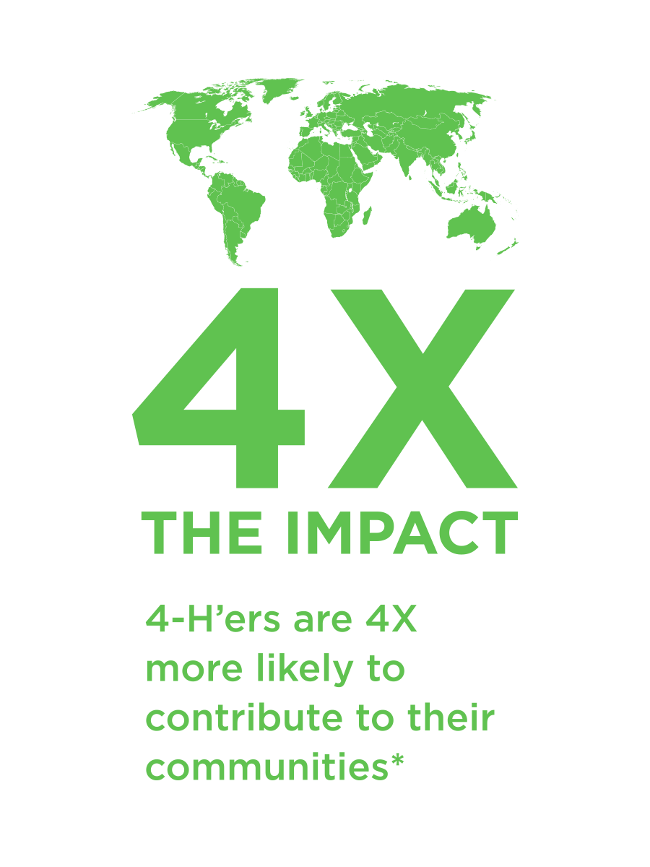
Tuft’s Impact Graphics

Slide 20
U.S. map
The map is made up of individual states that are grouped in PowerPoint.
To ungroup the states, right click on the map and choose Group > Ungroup.

Slide 21
U.S. map with state initials
WA
ME
MT
ND
OR
MN
VT
NH
ID
SD
WI
NY
MA
WY
MI
CT
PA
RI
NE
IA
NJ
NV
UT
IL
IN
OH
DE
CA
CO
WV
MD
KS
MO
VA
D.C.
KY
TN
NC
AZ
NM
OK
AR
SC
MS
AL
GA
TX
LA
AK
FL
HI

Slide 22
World map with countries

Slide 23
Thank You.

