Slide 1
Welcome to the National 4-H Volunteer e-Forum!
Host Site Facilitator Training,
September 20, 2:00-3:00 p.m. (ET)
Notes:
STEVE- Hi Everyone! Welcome to the Host Site Facilitator Training for the National 4-H Volunteer e-Forum that is scheduled to take place this fall! We are excited that you are able to join us today and look forward to a great response for the e-Forum sessions that will take place this fall.

Slide 2
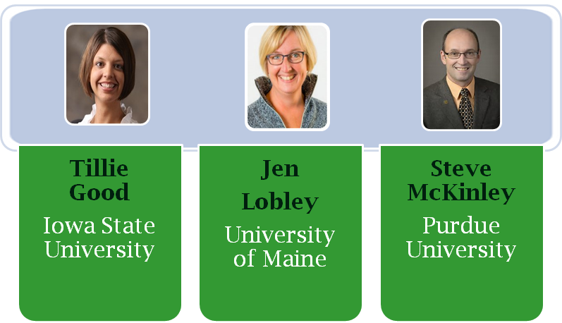
Notes:
STEVE- My name is Steve McKinley and I am from Purdue University in Indiana. Co-hosting with me today are Tillie Good from Iowa State University and Jen Lobley, from the University of Maine. Our hope is that by the end of our session, you will have a clear understanding of what the e-Forum will offer, how it will work, what your specific role will be, and where you can access the resources you will need to make this a successful event in your county or state.
Tilie will now give us a short orientation to the ON24 system.

Slide 3
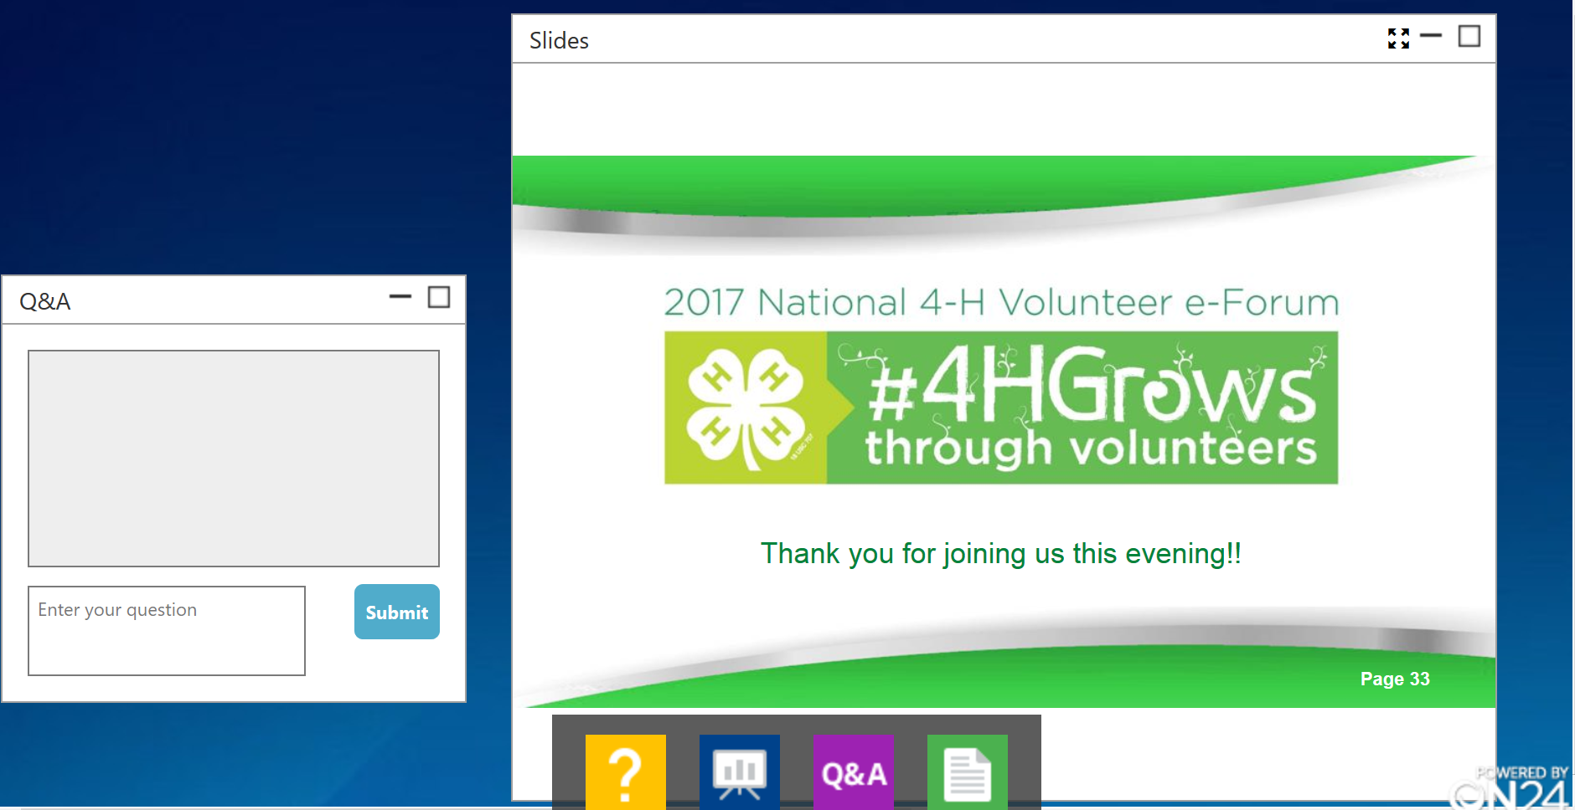
Notes:
TILLIE- We will be using the system we are using today for all three e-Forums. It is one of the many webinars systems available for use on the market today. If you have participated in any of the recent e-Academies hosted by National 4-H, you may be familiar with this system. What you or your participants see on the screen is driven by your choice. You can click and expand any of the options included in the bar along the bottom. You can then move them around on the screen to maximize the space. You can also enter full screen mode with the PPT so it covers the entire screen. If you want to minimize any of the boxes, click the line icon in the upper right hand corner of each box.

Slide 4
Thank you!
National & State Program Leaders
Volunteer Specialists
4-H County Staff
Notes:
STEVE- We would like to take a moment to thank some very important groups of people. This is the first time we will be offering a national training for 4-H volunteers of this magnitude on a virtual platform. We have received overwhelming support from our national and state program leaders, volunteer specialists and county 4-H staff to help make this event happen. A special thank you to the National 4-H Council for their support. They have provided the use of the ON24 virtual training platform and space on the National 4-H.org web site where staff and volunteers can find all the resources and related materials for this event. Thanks also to Doug Swanson, of 4-H National Headquarters, for his support of this process!
Poll question is next.

Slide 5
What is an e-Forum?
Online
Face-to-Face
e-Forum
Notes:
STEVE- So what exactly is an e-Forum?
An e-Forum is a method that can be used to provide professional development to volunteers and staff. Typically an e-Forum has a virtual component, with a speaker or speakers presenting content via the Internet. An e-Forum also has a local face-to-face component, with 4-H Staff and/or Volunteers hosting Adult and Youth Volunteers at a community location. Opportunities to interact with each other at the host sites are provided. Participants can also interact with volunteers at other sites who are viewing the program via chat pods and poll questions. 2017 will be the first time that an e-Forum for 4-H volunteers has been held on the national level.

Slide 6
Benefits of e-Forum
Volunteers
Learn the scope of the National 4-H Program
Network with and learn recommended practices from peers and experts
Receive training with minimal cost and time commitment
4-H System
Technology used to engage more volunteers
Collaboration allows for sharing of resources
Enhanced, uniform volunteer training experiences
Durable resources developed for volunteers
Notes:
STEVE- Why are we putting together such an event? There are a few reasons and benefits for both 4-H volunteers as well as our 4-H organization as a whole.
For our 4-H volunteers, bringing them together for a national event can help them to better understand the scope of the National 4-H program. It provides a chance for volunteers to network with and learn recommended practices from both peers and staff. We also are giving volunteers a chance to receive training with minimal cost and time commitment.
Our 4-H system will benefit as well. By using technology, we are going to be able to engage more volunteers. 4-H programming doesn’t happen without volunteers. The sharing of resources between states and the ability to offer uniform training opportunities across the country will strengthen our 4-H organization, because we will reach more volunteers with the same information. And by pooling our durable resources, we are able to provide more choices and opportunities for our volunteers by providing the tools and support they need to create positive youth development experiences.

Slide 7
Site 1
Site 2
Site 3
Site 4
ON24
Site 5
Site 6
Site 7
Site 8
Notes:
STEVE- Here’s a pictorial view of what happens during an e-Forum, using the ON24 technology platform.
The outside perimeter of circles represents individual host sites in various counties or regions around the country. Of course there will be many more than the eight sites pictured on this screen. Each site will have one to two host facilitators and a gathering of teen and adult volunteers. On site, you will have a large screen or videoconferencing system. All the sites will connect online to the ON24 virtual platform that Tillie described earlier. ON24 (the platform we are using today) is where presenters will lead the evening discussion and activities. Volunteers at the sites will be able to hear the presenter, view slides, video clips and also interact via poll questions, chat pods and surveys. Participants will also spend some of their time engaging in hands-on activities at their sites that are designed to be part of the presentation.
Jen will now give you an overview of the topics to be covered in the e-Forum series.

Slide 8
2017 e-Forum Topics
Cultivating an Environment for Growing True Leaders
“STEM”ming into Animal Science, Growing True Leaders
Helping 4-H’ers Grow in Life & Work
Oct 5th
Nov 2nd
Dec 7th
Each e-Forum begins at 7 p.m. (ET) and lasts for 90 minutes.
Notes:
JEN- The first e-Forum session on October 5 will provide ideas for successful club meetings by helping volunteers learn about and understand the basics of positive youth development. The second session, on November 2, will focus on how to bridge traditional animal science projects with Science, Technology, Engineering, and Math, or STEM concepts. The third session, taking place on Dec 7, will look at how we help 4-H members begin to explore their future. Life-long learning, workforce readiness and career exploration will be included on that evening.
Each of the three sessions will be 90 minutes in length, beginning at 7:00 p.m. in the Eastern Time Zone. Please make the corresponding adjustments for your specific time zone. Also note that each session includes an activity prior to 7:00 p.m. to allow participants to get to know each other better and to start to introduce the topic for the evening.

Slide 9
Register your site.
Prepare your site to host.
Download the resources for the session
LOGISTICS GUIDE
Step One:
Step Two:
Step Three:
http://4-h.org/professionals/professional-development/volunteer-development/#!4h-volunteer-e-forum
Notes:
JEN- One of the most important resources for you as a host site facilitator will be the logistics guide. The logistics guide provides you with helpful information to host an e-Forum. We’ll take a look at it more closely now.
The first step will be to register: You will officially need to register your site. Most of you have probably done this, but if not, we will show you what the registration page looks like in just a moment.
Step 2 is to prepare your site- one of the most important things to do in preparation for this e-Forum is to test out the equipment we will be using. If joining us live today, you are getting that opportunity, if you are using the equipment today that you will use on the evening of the e-Forum. We would like to recommend that you plan to have someone there with you to co-host and be your “tech guru”. If something goes wrong on the night of the e-Forum, it is hard to be the only person hosting while trying to troubleshoot technology issues. Meet with your tech-person (this could be a great role for a teen!) ahead of time- walk through the plan for the evening- this person can pay attention to volume, type an answer for the site into a group chat, and arrive early to connect to the online presentation room. You can connect to the ON24 system as early as 6:30 ET, but should definitely plan to be connected by 6:45 p.m.
Step 3 is to download the resources for your session. It is always good practice to have a copy of the PowerPoint slides and Lesson Plan. Having your tech person is your first line of defense, but if your technology truly goes down, you don’t want to be left with a room full of teens and volunteers for over an hour with nothing to do. You want to be able to carry out the evening as planned to the best of your ability. So take some time to download and review the resources, familiarize yourself with the layout, and plan for the session.

Slide 10
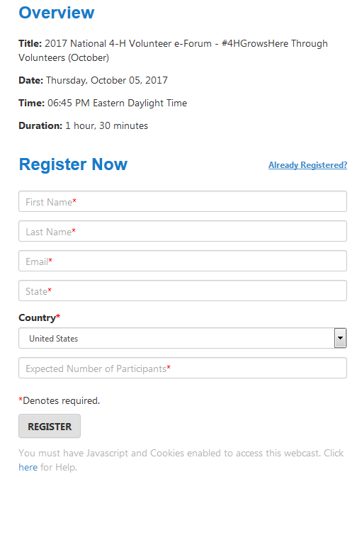
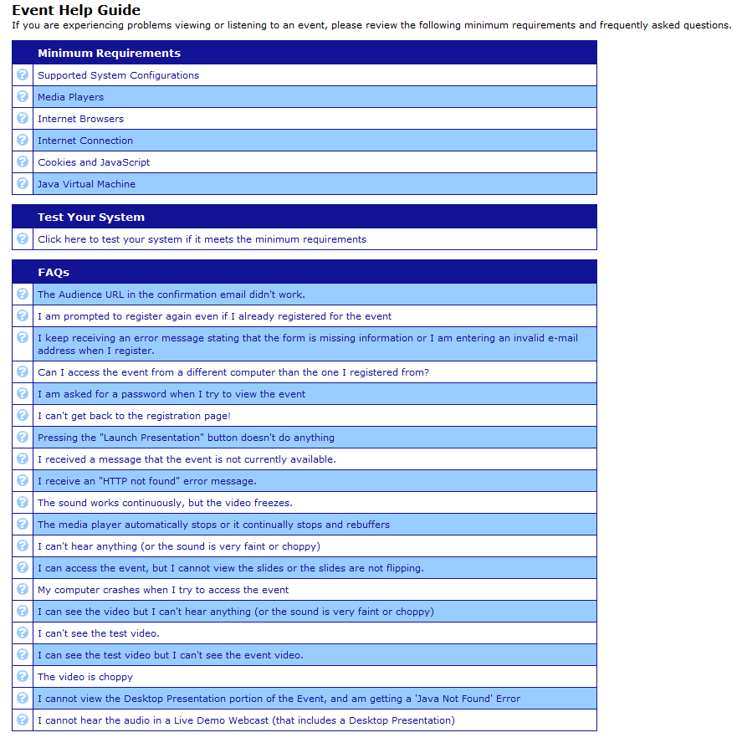
Test your connection with the technology you plan to use during the e-Forum!
Notes:
TILLIE- One way to test your connection is to click on the link in your confirmation email that you received after registering. Remember to use the computer that you will use for the actual session(s). Be sure your speakers are connected and you have connected your computer to your projector, etc. The ON24 site will be open 30 minutes prior to the 7:00 p.m. ET start time. Plan to test your connection prior to when your participants arrive or have your identified youth or adult volunteer plan to test it.

Slide 11
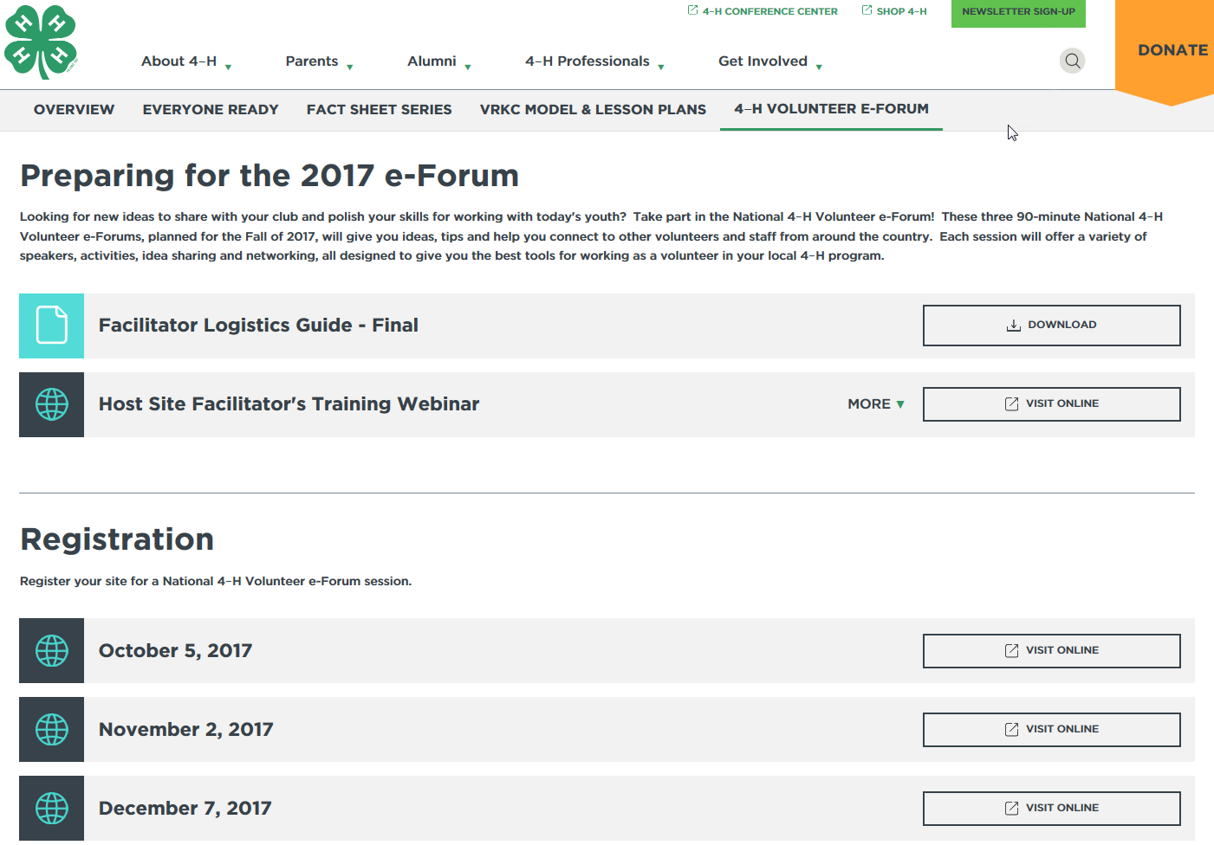
National e-Forum Website
Notes:
TILLIE- You will find additional E-Forum resources on the 4h.org website. We would like to thank the National 4-H Council for hosting the e-Forum resources on their website!
This is where you can find and download the resources that you will need for each of the e-Forum sessions and where you can register your site to participate. Recordings of each e-Forum session will be available soon after the live session has concluded...at the same place where you registered.

Slide 12
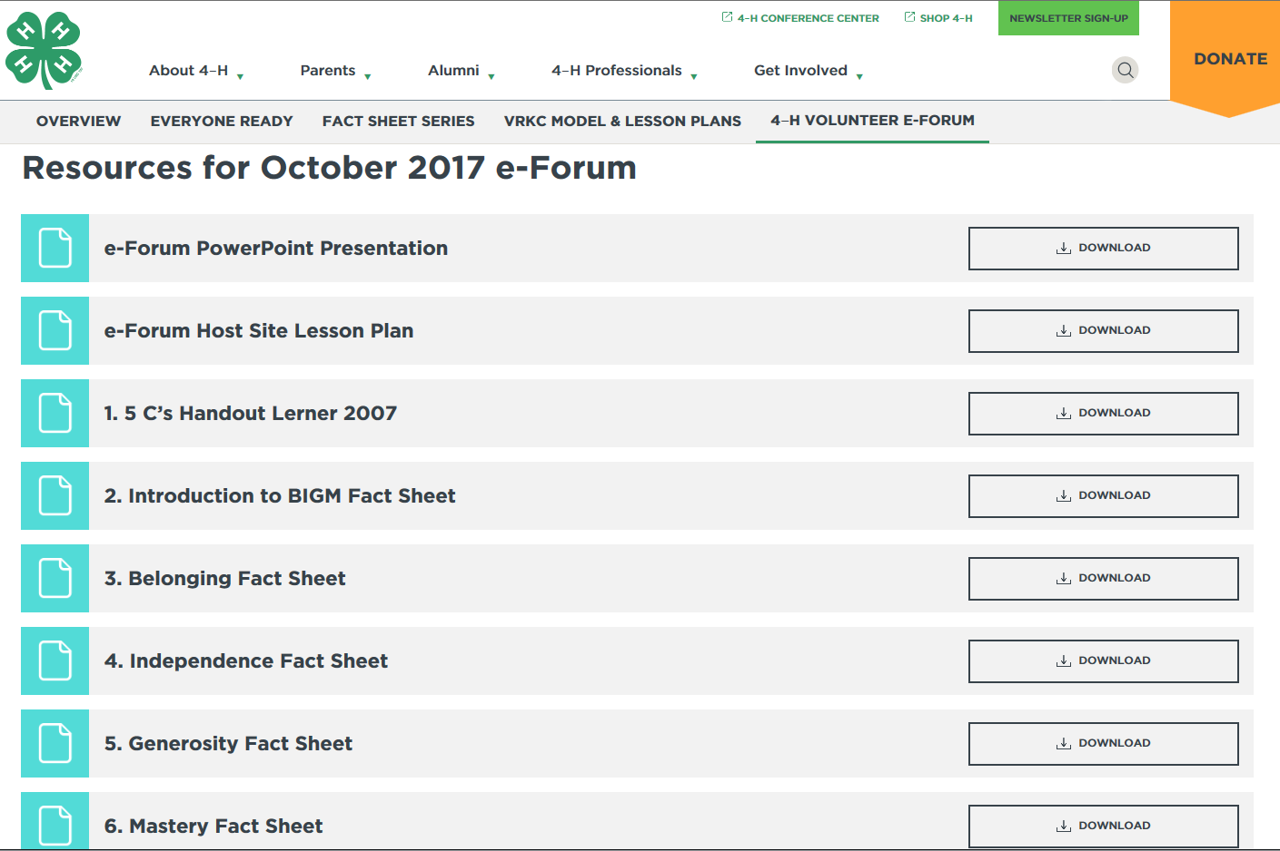
National e-Forum Website
Notes:
TILLIE- On this slide you see an example of some of the resources available for the October e-Forum session. You will need to scroll down to see all of the resources that are posted.
Included for each session will be a lesson plan, PowerPoint, and supplemental resources. The lesson plan will include instructions for which resources you will want to download and print to distribute to the participants at your host site.

Slide 13
Resources You’ll Need:
PPT
Handouts
Lesson plan
Evaluation
http://4-h.org/professionals/professional-development/volunteer-development/#!4h-volunteer-e-forum
Notes:
STEVE- As you prepare to host the e-Forum, here are the resources that you’ll want to have on hand.
You will find the lesson plan to be helpful. It will be available on the 4h.org website several weeks before the e-Forum session is held. I recommend reviewing it prior to the session. Jen will share some of the contents of the lesson plan on the next slide.
It’s always a good idea to download the PPT slides to your computer- that way you can share them via your projector if need be. You will want to download and print off handouts for your participants. Check your lesson plan to determine if you will need individual handouts or enough for partners or small groups and when they will be needed or referred to during the presentation.
The final resource will be the evaluation. There will be a paper copy available for download on the website. If you use the paper copies, be sure to collect them on site before people leave. The host site facilitators will be responsible for entering the data into the Qualtrics survey. The link can be found in the Logisitics Guide. Please make sure that evaluation data is entered within one week of the e-Forum.
The link from the logistics guide could also be provided to participants and they could complete the evaluation on their smart phone. Tablets and/or laptops could also be provided on site for participants to enter their evaluations.

Slide 14
Supplies
Handouts
On-Site Activities
PPT Script and Actions
LESSON PLAN
Evaluation Procedures
Notes:
JEN- There is a detailed, scripted lesson plan for each of the three e-Forum sessions. Please review this lesson plan ahead of time to learn about the supplies and handouts that you’ll need to have on hand for your participants. The lesson plan provides the layout for the session and will help you to understand specifically when your group will be watching and listening to the person on the screen (the virtual presenter), when they will be engaging in a hands-on activity with you on site, and what you will need to do as the host site facilitator. That might include purchasing or gathering some basic supplies ahead of time and having them set up, or it might provide a set of questions that you will go through with your on-site group. It will help you to know when you will have the opportunity to contribute a response to a chat pod and when and where you might need your technology assistant.
The lesson plan also includes a script you can use in the unlikely event that your technology fails; in that case, you will be able to continue to present the information using this script, even without the virtual presenter! If you are well-prepared, your participants will not notice the difference!
You’ll also learn about how to facilitate the on-site activities during the e-Forum. Evaluation procedures are also included.

Slide 15
Lesson Plan Example
Black text- online facilitator script
BOLD Black Text - Host site instructions/reminders
Green text- online facilitator cues
Notes:
STEVE- This slide provides a sample view for you of what your lesson plan will look like. Slide numbers are noted in the first column, along with an estimated time for the slide. The second column in black text is the script the online presenter will be following. And the last column will have both bold black and green text- the bold black text are cues for the host site facilitator with reminders about what you will need to do on site- it will range from passing out a fact sheet to leading a brief discussion.
Depending upon the size of your audience, you may find it helpful to pass out all handouts at the beginning of the program to minimize the interruptions during the session.
Any green text will alert you to things that the online facilitator might be doing. In the sample, you see that the green text let’s you know that a poll pod is going to be initiated.

Slide 16
On-site Activities
Before the Session
During the Session
Content Delivery
PowerPoint
Script
Evaluation
Demographics
Session Objectives
Notes:
TILLIE- We recommend that you invite your participants to join you on-site 30 minutes before the e-Forum starts. Each session has a pre-activity that can be used as an icebreaker and help put the participants in the right frame of mind for the information that will be shared during the e-Forum.
During the e-Forum, you’ll hear from 3-4 virtual presenters sharing information with you. According to the lesson plan provided, you will be instructed when to facilitate the on-site activities with your participants.
At the end, there will be time included for your participants to complete an evaluation of the session.

Slide 17
General Flow of an e-Forum:
Welcome
Pre-session activity
Wrap-Up
Q&A
Evaluation
Content
PPT Slides
Activities
Discussion
Notes:
TILLIE- For those of you who appreciate a more linear approach, here is another visual to show how each e-Forum is organized, from the welcome and pre-session activity; to the content shown on the PowerPoint slides, on-site activities and group discussion; to the final questions and answers and evaluation.

Slide 18
Timeline for a Successful e-Forum: At Least Three to Six Weeks Before
Secure a location
Secure your technology
Market the e-Forum:
Adult & Youth Volunteers
Create a welcoming/fun environment
Consider food and drink needs
Plan icebreakers
Notes:
JEN- So, we have provided some general overview information. Now, we want to provide some specifics along with a timeline to help keep you on track. If you go back to the website, into the resources, you will find the e-Forum action plan- this will provide more details about this timeline to help you plan for a successful event.
If you haven’t done so by this point, you will want to secure your location and the technology needed. During the three to six weeks time period prior to the session, do some heavy marketing- don’t forget this is for both teens and adults. The e-Forum is on social media: visit National 4-H Volunteer e-Forum on Facebook, Twitter, and Instagram! Follow along and comment with #4HeForum and #4HGrows.
Finalize your plans to create a welcoming and fun environment- decide if you will have food, and if so, who will bring what, etc.

Slide 19
Timeline for a Successful e-Forum: Two to Three Weeks Before
Prepare yourself to host
Print and review materials–logistics guide & lesson plan
Purchase needed supplies
Print copies of handouts
Ask volunteers to RSVP for final counts needed for food and materials
Identify a co-host site facilitator
Youth or adult volunteer
Find ways to engage youth and adults
Notes:
JEN- By the two week mark, you will want to start to get yourself prepared to be the host. Make sure you have printed and reviewed the materials for the session. Be sure you have the needed supplies and have made copies of any handouts. Follow up with your adult and teen volunteers so you will know how many materials to prepare, or perhaps how much food to have on hand. Choose a co-host facilitator- this can be a great role for a teen leader. And begin to really think about purposeful ways to engage both the teens and adults. Let’s see if we can get some ideas from each other right now on this. How are YOU planning to engage teens and adults to help make this a successful event in your county or state?
Share with us in the poll box how you are planning to engage teens and adults.

Slide 20
Timeline for a Successful e-Forum: One Week Before
Send a reminder email or text to participants
Review all materials one last time
Meet with your co-facilitator to review e-Forum plans
Notes:
TILLIE- One week before the event, you’ll want to contact the participants again to thank them for making this a priority in their schedule. Reviewing the materials another time will help you feel more comfortable as a host site facilitator. And, meet with your co-facilitator to review all of the final details. A reminder email will go out to the site facilitators two days prior to the event and the day of the event.

Slide 21
Timeline for a Successful e-Forum: Day of Session
Hold a brief technical rehearsal
Set up snacks and supplies
Welcome participants
Consider participating via social media: #4HeForum, #4HGrows
Notes:
TILLIE- On the day of the session, it is recommended that you hold a technical rehearsal in the same facility and with the exact technology that you will be using to host the e-Forum.
If you are offering snacks or other food, you’ll be able to set that up, along with any supplies that are needed for the session.
Welcome the participants to the e-Forum. Name tags for each person will help everyone to know each other better.
Participate in the social media options for the e-Forum to be connected with individuals and sites from across the country! Twitter, FaceBook, and Instagram accounts have been set up. The social media aspect might be another great way to involve teens. Perhaps they could have responsibility for taking and posting a few pictures from your site. Or maybe they could get a comment from an adult volunteer and post it.

Slide 22
Notes:
TILLIE- If you need technical assistance during the e-Forum session, please connect with us either via the group chat box or the Q&A box. We will work to troubleshoot as best as we can.

Slide 23
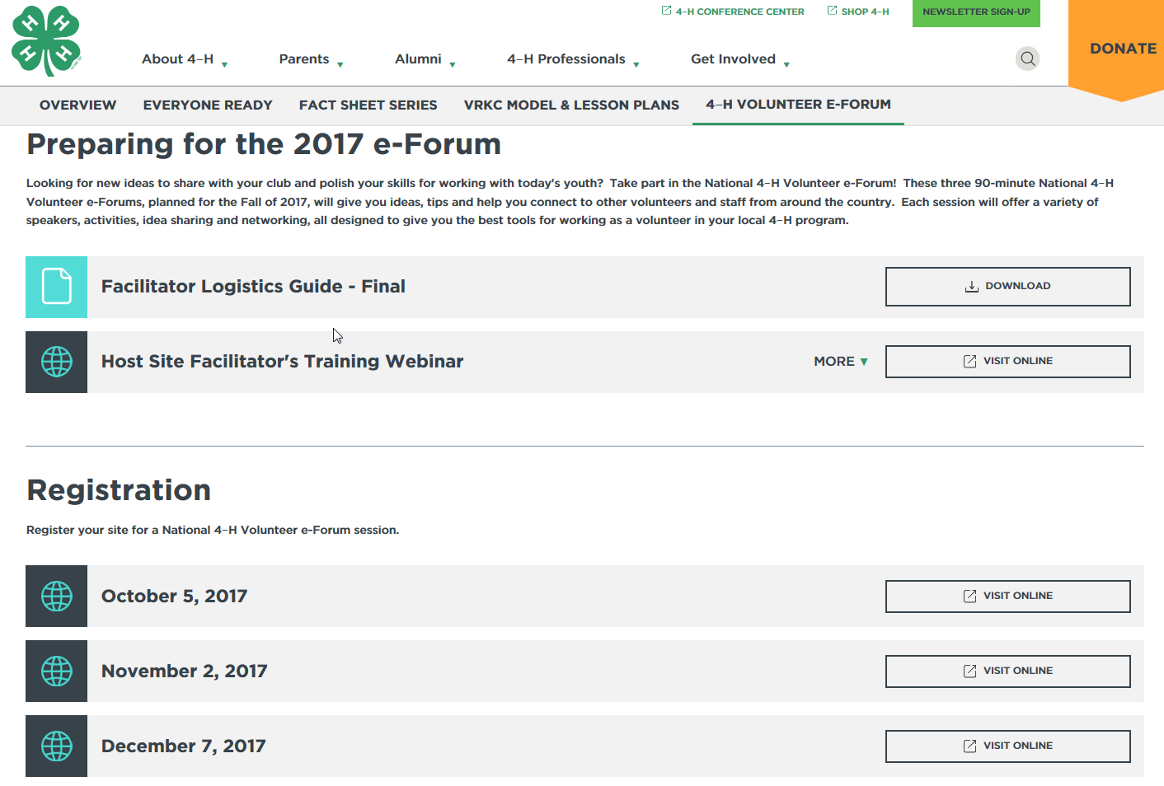
Recorded e-Forum Sessions:
Notes:
STEVE- Once the e-Forum sessions have concluded, a recording of each session will be posted on the 4h.org website, in the location where you registered for each of the e-Forum sessions. These recordings can be used in conjunction with the lesson plans we have provided so that you can offer the training to additional volunteer audiences in the future. The interaction won’t be the same as it was live, but will still have some good information to share.

Slide 24
Notes:
JEN- This brings us to the end of our presentation. We are hoping we covered everything, but I am guessing there might still be a few questions out there. If you have a question, please feel free to type it into the chat box and we will do our best to answer the questions for you.

Slide 25
Thank you for joining us this afternoon!
Notes:
JEN- As we close this afternoon, we again would like to thank you for joining us on this webinar and for organizing a host site where youth and adult volunteers can gather to learn together how 4-H Grows Through Volunteers! Thank you!

