Slide 1
Name of presentation
by Mr X
Notes:
Slide #1
Slide time: 15 seconds
PAT - Welcome to the 2017 National 4-H Volunteer e-Forum, “#4HGrows Through Volunteers.” We are excited that you have joined us from one of the host sites located across the country!

Slide 2
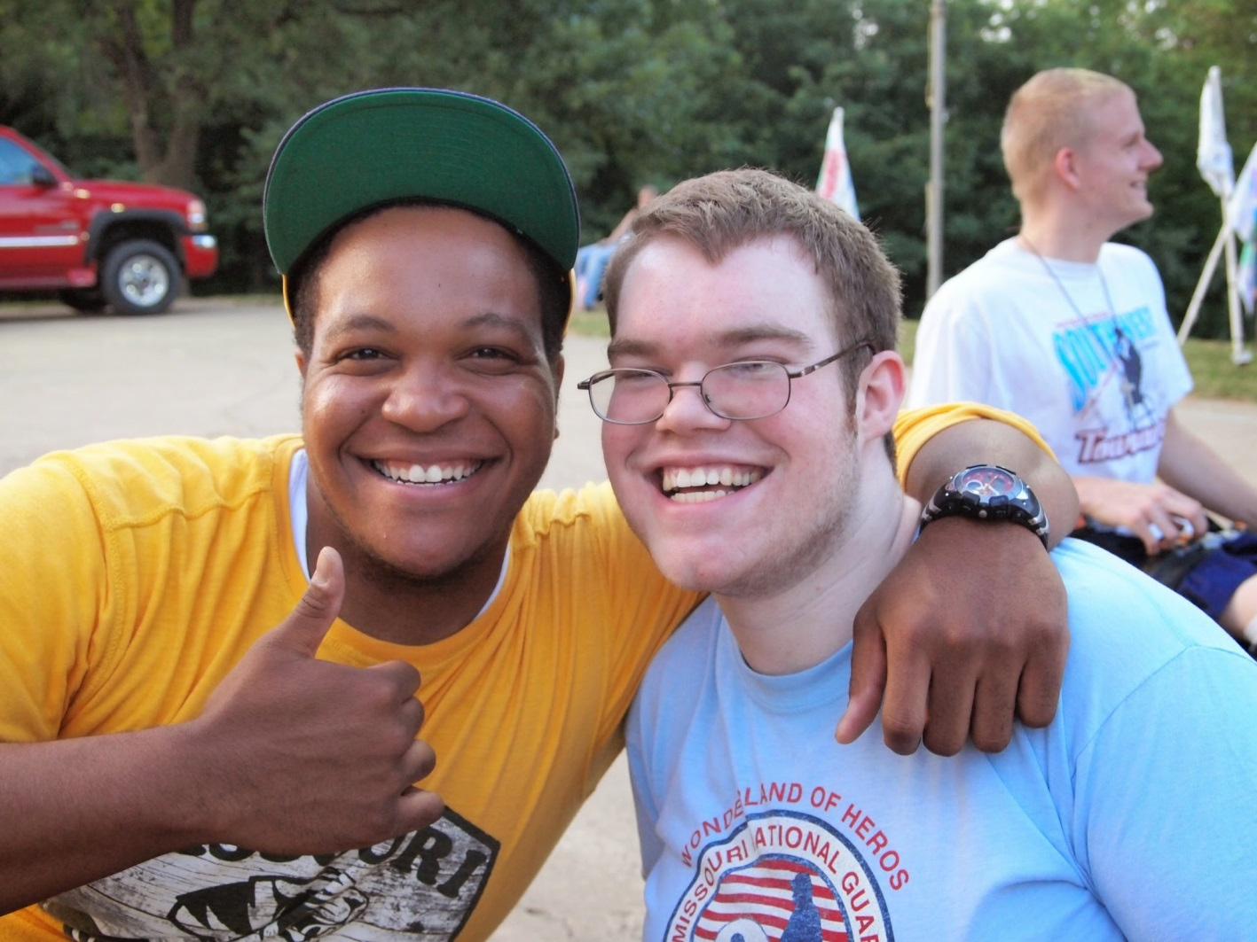
Welcome!
Photo credit::Tammy Gillespie
Notes:
Slide #2
Slide time: 30 seconds
PAT - You will have the opportunity this evening to interact with volunteers and staff in person and virtually. And, you’ll gain some new knowledge and tips that will help you work with your 4-H members at home!

Slide 3
Cultivating an Environment
for Growing True Leaders
Notes:
Slide #3
Slide time: 1 minute
PAT - Tonight’s session is titled “Cultivating an Environment for Growing True Leaders.”
Creating an environment where 4-H members feel safe as they grow and develop leadership skills means having volunteers who understand the basics of positive youth development. This session will feature ideas and activities that help foster life skill development by focusing on strategies for more effective club interactions. Participants will learn about the Essential Elements of 4-H and the 5 C’s of positive youth development, so join us to set the stage for more successful club meetings!

Slide 4
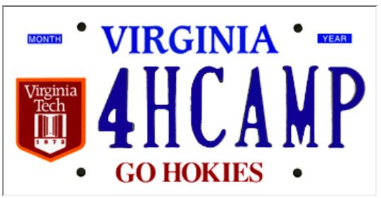
Committee plates from our states!
4H 4EVER
Notes:
Slide #4
Slide Time: 30 seconds
PAT - Many of you created your Vanity Plate during the time before the live session began, and as you can see, we have shared our plates too. We will each reference our plate as we introduce ourselves.

Slide 5
PRESENTERS
Rose Garritano
University of Vermont
Jeremy Johnson Virginia Tech
Patricia McGlaughlin University of Illinois
Notes:
Slide #5
Slide time: 30 seconds
PAT - Our presenters this evening are…
Rose Garritano, University of Vermont
Jeremy Johnson, Virginia Tech
Pat McGlaughlin, University of Illinois
My license plate says 4H 4EVER because I have 5 older brothers & sisters and they were already starting 4-H when I was born, so I feel somewhat that 4-H has and will be forever a part of my life.

Slide 6
THANK YOU!!! National 4-H Council & 4-H National Headquarters
Notes:
Slide #6
Slide time: 1 minute
PAT - We want to offer special thanks and words of appreciation to both National 4-H Council and 4-H National Headquarters for their support of the National 4-H Volunteer e-Forum.
National 4-H Council has allowed us to use their ON24 technology platform to lead these sessions. And, we are able to host our e-Forum resources on the 4-h.org website, managed by the National 4-H Council.
Doug Swanson, Program Leader at 4-H National Headquarters, has been instrumental in supporting the concept of the National 4-H Volunteer e-Forum and with facilitating our discussions with National 4-H Council. Doug, we thank you for your support!

Slide 7
Objectives
Taking the Essential Elements from theory to practice in fun and engaging ways.
Introducing participants to the 5 C’s (competence, confidence, character, connection, and caring).
Notes:
Slide #7
Slide time: 30 seconds
PAT - Our objectives for this e-Forum session include:
1. Taking the Essential Elements from theory to practice in fun and engaging ways.
2. Introducing participants to the 5 C’s of competence, confidence, character, connection, and caring.

Slide 8
Objectives
Focusing on engaging youth as they build skills related to belonging, independence, generosity, and mastery.
Helping volunteers and staff understand how they can create environments to cultivate tomorrow’s leaders today.
Notes:
Slide #8
Slide time: 30 seconds
PAT - Additional objectives include:
3. Focusing on engaging youth as they build skills related to belonging, independence, generosity, and mastery.
4. Helping volunteers and staff understand how they can create environments to cultivate tomorrow’s leaders today.

Slide 9
Foundational Support to Grow True Leaders
5 C’s
Essential Elements
BIG-M
Notes:
Slide #9
Slide time: 1 minute
PAT - 4-H has been growing true leaders for more than 100 years, and 4-H has played a role in the development of governmental officials and legislators; corporate leaders; celebrities and artists; decorated members of our military; and hardworking community members from all walks of life who demonstrate amazing leadership abilities on a daily basis.
Information shared today relates to growing true leaders in a new age. In today’s digital world, information is available 24-7.
Access to constantly emerging information brings a level of responsibility. As volunteers, you play a key role in the development of youth and in helping them develop leadership skills that they will use throughout their lives – as students, as professionals, and as citizens in their local communities.
Today, we start with a quick look at what underlies Positive Youth Development and serves as the research base for why 4-H is important.
Youth Development transitioned through three concepts. First, we had the 5 C’s; later distilled into the Essential Elements of Positive Youth Development; and now further condensed into the BIG-M.

Slide 10
Identifying the Five C’s
Competence
Caring
Confidence
Character
Connection
Notes:
Slide #10
Slide time: 30 seconds
PAT - In the 1990’s youth development transitioned to think about youth in connection to what was happening around them – how they were interacting with others. The realization was that the outcome and development of youth is not a set, non-changing factor, but can be significantly influenced by factors in their homes, schools, and communities.
This led to the identification of the 5 C’s:
•Competence
•Confidence
•Connection
•Character
•Caring (or compassion)
We have provided you with a handout that explains this in more depth.

Slide 11
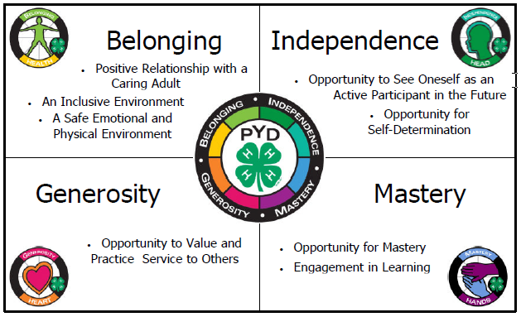
BIG-M
Notes:
Slide #11
Slide time: 1 minute
PAT - Today, we still embrace the Essential Elements; and recognize that the 5 C’s are very much embedded in the work of positive youth development. However, the information has been further fine-tuned to align with four key concepts that we identify with the acronym “BIG-M.”
Belonging
Caring adult
Inclusive AND safe environment
Independence
Opportunity to see oneself actively engaged in the future
Opportunity for self determination
Generosity
Valuing AND practicing service to others
Mastery
Engagement in learning AND mastery
This folds all 8 of the essential elements into the more simplistic and easy to remember “BIG-M” concept

Slide 12
Roll ‘Em: Positive Youth Development
Share an activity or skill you feel is a personal strength.
Think about when you watched a 4-H member “beam” – Share the situation.
Describe someone in your life growing up who believed in you.
What traits do you have as an individual which contribute to a larger community?
How do you show others that you care?
What makes you valuable as a volunteer?
Notes:
Slide #12
Slide time: 10 minutes (for Roll ‘Em activity and quick poll/chat pods)
PAT - We believe each of you probably experienced some BIG-M interaction that had an impact on your development. We think this would be a great opportunity to think back to some of those experiences and share them with others at your site.
Your site facilitator will divide you into groups of two and provide each group with a single die. Once you are grouped together, you will have the opportunity to respond to THREE of the statements/questions posted on the slide. To know which question you will each respond to, roll the die, and respond to the question that corresponds with the number that you roll.
Listen for any further instructions that your site facilitator may have to share. (Facilitator: refer to “Roll ‘Em: Positive Youth Development Processing Key” for suggested answers.)
ALLOW 8 minutes for activity (1 minute per person for each question. If they only get through 2 statements that is ok too).
SWITCH TO POLL - 1 poll for each of the BIG-M concepts.
Which statement or statements aligned with a BELONGING EXPERIENCE?
Which statement or statements aligned with an INDEPENDENCE EXPERIENCE?
Which statement or statements aligned with a GENEROSITY EXPERIENCE?
Which statement or statements aligned with a MASTERY EXPERIENCE?
Thank you for sharing. With this activity, we want you to recognize the foundation that underlies everything we do when working with youth and why it is so important that we are successful. Hopefully, by reflecting back to some of the experiences that you had which helped provide you with your own positive youth development support, you can see what a critical role you play.
I am now going to turn over the platform to Rose Garritano, who is a staff member from the Vermont 4-H Youth Development system. Rose is going to give you some concrete examples of how you can integrate BIG-M strategies into your club setting.

Slide 13
TIME REMAINING:
2:00
Notes:
Slide #13

Slide 14
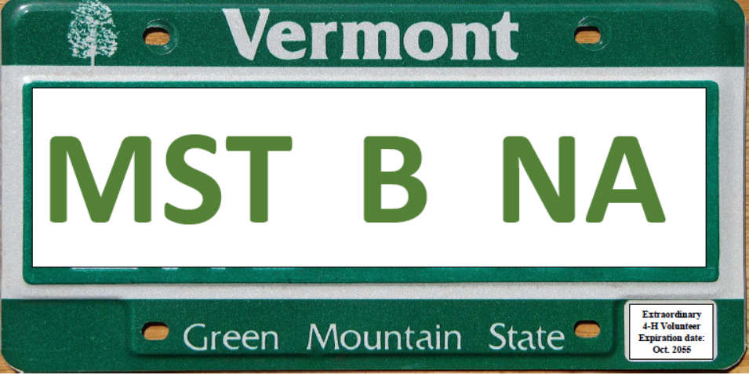
Quick Tricks to Encourage Member Engagement
Rose Garritano, UVM Extension
http://gradingeffort.weebly.com/uploads/6/1/4/6/61466795/9970487_orig.jpg
Notes:
Slide #14
Slide time: 1 minute
ROSE - Hello everyone. My name is Rose Garritano and my Vermont license plate- just so you know – stands for a German phrase- Mist Biene- or manure bee, as I was sometimes called by my father, since I was always hanging out in the barn.
For the next 20 minutes, we will try some techniques for getting 4-H members to interact. As you know, and this comes from the USDA’s page about 4-H, “4-H serves as a model program for the practice of positive youth development by creating positive learning experiences; positive relationships for and between youth and adults; positive, safe environments; and opportunities for positive risk taking.”
Volunteers can have an impact by including a variety of ways to gather input from members, by helping them feel they “belong,” and by giving everyone an opportunity for their voice to be heard.

Slide 15
Now try this!
BALLOON FUN
Notes:
Slide #15
Slide time: 5 minutes
ROSE - Your host site facilitator will provide each of you with a piece of paper, approximately 1” x 2”, a writing utensil, and a balloon. Write down an idea for a field trip destination on the paper.
Blow up your balloon, insert your paper, and tie off your balloon.
Listen for further instructions from your host site facilitator.
You have five minutes for this activity. Have as many people as possible share; you may not have time for everyone to do so. We’ll call you back together when it’s time to move on.

Slide 16
TIME REMAINING:
1:00
Notes:
Slide #16

Slide 17
Balloon Fun:
Write ideas or facts or ??? on a piece of paper that gets put into a blown up balloon.
Tie the balloon off.
Toss the balloons around so each person ends up with a different balloon.
Pop the balloons to find the message inside.
Share information and possibly organize it.
Notes:
Slide #17
Slide time: 3 minutes
ROSE - Here is what we just did - captured for posterity in a PowerPoint slide but also in your handouts available from your host site facilitator.
Please type into the chat box some topics you might use for this activity. Use of a chat box, by the way, is a way to engage group members.
(Reflect on the comments in the chat box)
We just used this fun method to “safely” brainstorm some field trip ideas. This activity could also be used to help plan the 4-H Club program for the coming year. Members could be asked to think of meeting ideas, service learning opportunities, etc. The responses could lead to action performed by the group based on the text they find inside their balloons.

Slide 18
Think-Pair-Share
Topic:
Our goal is to make keeping 4-H records easier.
Think of what might be done to meet this goal.
Pair up with a partner and share your idea.
A member from each group should share the ideas with the larger group.
Notes:
Slide #18
Slide time: 5 minutes
ROSE - Think-Pair-Share slide: A bit of extra effort is sometimes needed to get less vocal 4-H members to engage or to set things up so more vocal members don’t dominate discussions. This method allows quiet members to share ideas without putting them in the spotlight. I’d like you to try this activity at your sites.
For this activity we will use the goal of finding ways to make keeping 4-H records easier.
Think of what might be done to meet this goal for about ½ a minute.
Then you will Pair up with a partner and share your ideas with each other.
Then a member from each group should Share the ideas with the larger group.
You have five minutes for this activity. Have as many people as possible share; you may not have time for everyone to do so. We’ll call you back together when it’s time to move on.

Slide 19
TIME REMAINING:
1:00
Notes:
Slide #19

Slide 20
Sticky Notes and Dots
Topic:
Our goal is to hold a fundraiser.
Write down one idea on a sticky note and then post it on the large newsprint on the wall.
Notes:
Slide #20
Slide time: 7 minutes
ROSE - Using sticky notes is another less threatening way to engage everyone.
Let’s pretend our goal this time is to hold a fundraiser.
Write down one idea for a fundraiser on a sticky note and then post it on the large newsprint on the wall.

Slide 21
Sort of Secret Voting
Using two sticky dots provided to you vote for the idea you like the most by sticking a dot by it.
You can use both dots for the same idea or “vote” for two different ideas.
Notes:
Slide #21
Slide time: 5 minutes
ROSE - Using two sticky dots provided to you, vote for the idea you like the most by sticking a dot by it.
You can use both dots for the same idea or “vote” for two different ideas.
This technique allows everyone to get up and move. It allows for input from everyone and is less obvious with regard to who voted for what.
Of course in a meeting setting you may want to have opportunities for discussion before voting. You could even assign an idea to a think-pair-share group and have them share why a given idea is a good one.

Slide 22
Messages We Send
“WE HAVE TWO EARS AND ONE MOUTH SO WE CAN LISTEN TWICE AS MUCH AS WE SPEAK.”
(Epictetus AD55-c135)
State your intention to listen
Manage the physical environment
Make an internal commitment to listen
Assume a listening posture
Participate actively in the listening process
Notes:
Slide #22
Slide time: 3 minutes
ROSE - A warm welcome for all 4-H members, using different techniques to encourage them to take part in meetings or activities, and the way we react to what 4-H members say all have a big impact on the members’ sense of belonging and their active participation. The more they participate, the more they grow!
1. One- (state your intention to listen)Say something like “I look forward to hearing what you have to say.”
2. Two- (manage the physical environment) Reduce distractions such as noise and disruptions.
3. Three-(make an internal commitment to listen)Be open to hearing different perspectives, don’t judge, make mental summaries about what is said
4. Four-(assume a listening posture) Make eye contact, use appropriate body language, use minimal encouragers like “uh huh”, allow for silence.
5. Five-my favorite- (participate actively in the listening process) Invite the speaker to say more, paraphrase what they said to check for understanding, ask clarifying questions, take notes, work to understand the perspective of the speaker with a statement of respect for the speaker’s views.
Active listening is a valuable leadership skill. In your packets are some short scripts that members can act out to learn or reinforce the 5 points listed on this slide and thereby grow their leadership skills.

Slide 23
BREAK!
We will begin again in 10 minutes.
Notes:
Slide #23
Slide time: 10 minutes
ROSE - It’s intermission time! We will begin again in 10 minutes.

Slide 24
TIME REMAINING:
1:00
Notes:
Slide #24

Slide 25
Putting 4-H Experiences to Work for YOU
School
Applications
4-H
College
Jobs/Careers
Notes:
Slide #25
Slide time: 3 mins
JEREMY -
Hello, everyone and welcome back! My name is Jeremy Johnson, and I am a Volunteer Development Associate Specialist from Virginia Cooperative Extension. My vanity plate has “4-H Camp” on it, because we love 4-H Camp in Virginia!
So far this evening, we have begun to set the stage for success by exploring the ways in which we can create an environment for our 4-H members to thrive. We have practiced ways we can design our 4-H club meetings and programs to include the Essential Elements of positive youth development. When we plan and practice strategies that emphasize Belonging, Mastery, Independence, and Generosity, we are on our way to developing sound outcomes and helping our 4-H members reach the 5 C’s of competence, confidence, character, connection and caring.
It is now time to discover how our 4-H project work develops skills that lead to the 5 C’s. We often spend great amounts of time planning learning experiences around our project work. We plan our 4-H programs to include hands-on activities that allow youth to learn more about a specific project – electrical energy, robotics, sheep, cooking, etc. It is important to incorporate opportunities for 4-H members to practice both technical and life skills through project work.
We want 4-H experiences to work for our youth! We want them to learn skills in 4-H that they can put to good use as real world experiences.

Slide 26
Technical Skills vs. Life Skills
How do we define our goals?
How do we talk about our programs?
How can we encourage our members and leaders to focus on skills before projects?
Notes:
Slide #26:
Slide time: 5 mins
JEREMY -
Project vs. skill development; technical vs. life lessons; tangible vs. intangible.
Are we trying to teach the project or the skills the youth will gain from the project?—We Are Teaching Both!!
Tangible vs. Intangible
Learning to sew vs. gaining poise (Fashion Revue)
Doing a fundraiser vs. building teamwork & communication
Life skills vs. Technical skills—4-H should put emphasis on life skills, but do not discount technical skills. Both life skills & technical skills can be very important related to career choice and workforce preparation.
How do we talk and relate to each other in 4-H?
When you introduce yourself what do you tell people about your experience?
4. Projects are easy to talk about because they are tangible; skills are less concrete, making them more difficult to talk about. What do we put the most emphasis on? What should we put the most emphasis on?

Slide 27
But…We’re Already Doing That!
What skills are youth getting in their project area?
How do you know that your members are gaining life skills?
Are they able to apply these skills?
Notes:
Slide #27:
Slide time: 2 mins
JEREMY -
Think about the projects in your club—what skills can be learned from these?
We say that our members are gaining life skills—how can we measure what we say to prove it? What tools can we use? This is a very difficult question that even staff struggle with. We know that connections are being made and not by magic—we need to be able to find a way to positively identify the correlations

Slide 28
Looking Through a Different Lens
Notes:
Slide #28:
Slide time: 10 mins
JEREMY -
Mask activity: (Refer to “Masks of 4-H” activity sheet)
Your Host Site Facilitators will now lead you through a “Masks of 4-H” activity. Facilitators, please help your participants to complete this activity following the instructions provided. We’ll return in a few minutes to discuss this activity.
Have the group put on their skills mask first; then put the project mask over the top of the skills mask. Ask everyone to look around and explain what they see. They should say they can see the projects that everyone does.
Now have them take the masks off. Put them back on, this time the project mask first, then the clear skills mask over the top. This time talk about the skills that you can see. Then talk about the project that you can see in the background.
This activity illustrates two ways we can tell our 4-H story
Talk about the projects we do first—in this case, this is all the public will see. Eventually, this is all some of us will also see.
Talk about the skills learned first. Skills learned through projects. Put emphasis on what skills/lessons are learned.

Slide 29
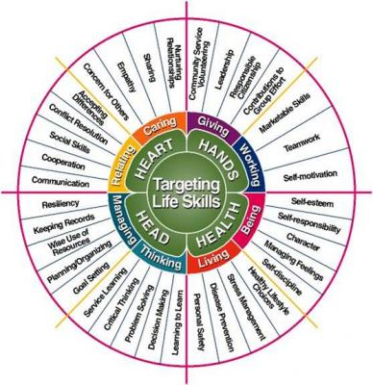
Iowa State Targeting Life Skills Wheel
Notes:
Slide #29
Slide time: 5 mins
JEREMY -
Intentional planning
1. Iowa State “Targeting Life Skills Model” (TLS)
What’s the value of using the TLS model? The TLS model provides a format incorporating major points of youth programming:
- assisting youth to reach their full potential through a positive approach to life skill development
- delivering information and skill practice at the appropriate developmental level for the target audience
- writing specific learning objectives for life skill development that are measurable
- completing an instructional plan that creates experiences based on experiential learning theory to achieve life skill
development
- using these indicators to effectively evaluate program impact/goal
Practical uses of the TLS model: Select a skill to focus on at each meeting to incorporate into the club meeting/activity
-relate it to an activity already planned
- have a reflective discussion about the topic
-talk about how it applies to everyday life now and in the future
Record book—record the project data as well as the skill development

Slide 30
Taking a closer look . . . .
Notes:
Slide #30
Slide time: 6 minutes
JEREMY -
(Discussion about how youth and adults are interacting and engaging with each other during 4-H Club meetings - rather than using the video audio, the presenter will be explaining what is happening in the club experiences.)
Link to video of Youth and Adults interacting at 4-H Club meetings - https://www.youtube.com/watch?v=oOCEKN8ZqWE&feature=em-upload_owner#action=share

Slide 31
Reflection and Application
In what ways did you observe 4-H members practicing the Five C’s (competence, confidence, connection, character and caring)?
How were the Essential Elements (BIG-M - belonging, independence, generosity, and mastery) used to cultivate an environment for success?
What life skills did you observe the youth practicing?
What is one new idea you can bring to your 4-H program to create an environment for success?
Notes:
Slide #31
Slide time: 6 mins
JEREMY -
REFLECTION and APPLICATION
Host Site Facilitators will now lead your groups in a discussion related to the video that we just watched. Please use these discussion questions as your guide. Near the end of your discussion, please type some of the highlights into the group chat box.
The discussion questions are now appearing on your screen.
In what ways did you observe 4-H members practicing the Five C’s (competence, confidence, connection, character and caring)? How were the Essential Elements (BIG-M - belonging, independence, generosity, and mastery) used to cultivate an environment for success? What life skills did you observe the youth practicing? What is one new idea you can bring to your 4-H program to create an environment for success?

Slide 32
TIME REMAINING:
1:00
Notes:
Slide #32
Slide time: 2 minutes (includes session summary)
JEREMY- 1 minute reminder, followed by a two minute summary of the responses to the reflection and application questions. (Refer back to Slide 31.)

Slide 33
References
Lerner, R. M., & Lerner, J.V. (2013). The positive development of youth: Comprehensive findings from the 4-H study of positive youth development. Medford, MA: Institute for Applied Research in Youth Development, Tufts University: http://www.4-h.org/about/youth-development-research/positive-youth-development-study/
Lerner, R.M. & Israeloff, Roberta (2007). The good teen: rescuing adolescence from the myths of the storm and stress years. New York: Crown Publishing.
Nash, BJ, Moyses, K. (2012). Promoting Life Skills through 4-H Projects Facilitator Guide. Michigan State University Extension Children and Youth Institute: Academic Success Work Group, Life Skills.
Iowa State University, Extension and Outreach (1996) Targeting Life Skills Model. https://fyi.uwex.edu/wi4hvolunteers/files/2016/06/Life-Skills-Wheel.pdf
Michigan State University. Masks of 4-H: Life Skill Development. http://msue.anr.msu.edu/news/preparing_youth_for_the_workforce
Purdue University Extension. (2015) Essential Elements of 4-H Youth Development, Fact Sheet. Retrieved from http://www.four-h.purdue.edu/ncrvf/documents/EssentialElementsof4-HYouthDevelopmentFactSheet.pdf
University of Illinois, Extension (2010), 4-H Essential Elements of Positive Development Fact Sheets. http://web.extension.illinois.edu/state4h/volunteers/pyd.cfm
University of Minnesota Extension. (2015). Keys to Quality Youth Development. Retrieved from http://www.extension.umn.edu/youth/research/keys-to-quality-youth-development/
Notes:
Slide #33
Slide time: 30 seconds
JEREMY -
The references we used to create this session are shown on this slide. We thank each of these authors and teams for the work they have done! I’ll now turn it back to Pat to wrap up our program for the evening.

Slide 34
E-Forum Resources
To access resources presented in the e-Forum sessions, please visit: http://4-h.org/professionals/professional-development/volunteer-development/#!4h-volunteer-e-forum
Notes:
Slide #34
Slide time: 30 seconds
PAT -
Thank you, Jeremy! We appreciate the valuable insight you have provided to us this evening!
All resources referenced in any of the e-Forum sessions will be available on the 2017 National 4-H Volunteer e-Forum Website as shown on the slide. Please note that the first time you visit this site, you can create a personal account to allow you to access the materials. You are welcome to access these resources and share them widely!

Slide 35
E-Forum Evaluation
We welcome your feedback from tonight‘s e-Forum session:
http://tinyurl.com/2017Oct-e-forum
Notes:
Slide #35
Slide time: 30 sec
PAT -
As we wrap up our time together tonight, I want to remind each of you to take a few minutes to fill out our e-Forum survey. Your evaluation information is important to us. This is the first national e-Forum we have organized. Your feedback will help assess if we have met our objectives and determine if future e-Forums will be offered. Your site facilitators will have paper copies and/or a link for you to complete the survey with a computer, tablet, or your smart phone. We are interested in hearing your feedback about tonight’s e-Forum session and we want to know what you learned from the session.

Slide 36
Special Thanks
“Cultivating an Environment for Growing True Leaders” Committee
Dean Aakre, North Dakota State University
Harriett Edwards, North Carolina State University
Rose Garritano, University of Vermont
Jeremy Johnson, Virginia Tech University
Eric Larsen, Washington State University
Sarah Maass, Kansas State University
Pat McGlaughlin, University of Illinois
Jennifer Weichel, Michigan State University
Editors:
Tillie Good, Iowa State University
Steve McKinley, Purdue University
Rachelle Vettern, North Dakota State University
Notes:
Slide #36
Slide time: 30 sec
PAT -
Special thanks to the team of Extension staff from across the country who worked together to prepare and deliver tonight’s session.

Slide 37
2017 National 4-H Volunteer
e-Forum Series
October 5 – Cultivating an Environment for Growing True Leaders
November 2 – “STEM”ming into Animal Science, Growing True Leaders
December 7 – Helping 4-H’ers Grow in Life & Work
Each program is held from 7-8:30 p.m. (ET)
Notes:
Slide #37
Slide time: 30 sec
PAT -
We hope you will join us, and bring other youth and adult 4-H volunteers, to the remaining National 4-H Volunteer e-Forum sessions!
Remember, we are offering three different sessions this year.
Cultivating an Environment for Growing True Leaders - Thursday, October 5, 2017
“STEM”ming into Animal Science, Growing True Leaders - Thursday, November 2, 2017
Helping 4-H’ers Grow in Life & Work - Thursday, December 7, 2017
Recordings of each session and accompanying resources will be available at the 4-h.org/professionals site. The link to the recording will be the same as the registration link.

Slide 38
Thank you for joining us this evening!!
Notes:
Slide #38
Slide time: 30 sec
PAT -
Thank you for joining us this evening! We look forward to seeing you again. Have safe travels home.

